Slide 1
The Mad Hedge Fund Trader “Exhaustion”
With John Thomas Silicon Valley January 10, 2024 www.madhedgefundtrader.com
Notes:
*

Slide 3
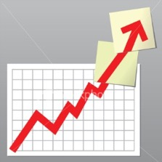
Trade Alert Performance Off the the Races – New All Time High! 60 out of 66 trade alerts profitable – No losers since August 4
*January +3.43% MTD *July +0.44% Final *February +3.41% Final *August -4.70% Final *March +20.85% Final *September +00% Final *April +15.13% Final *October -5.37% FINAL *May +0.30%% Final *November +15.37 Final *June +3.01% Final *December -2.27% Final *2024 YTD +3.43%, versus -2.40% for the S&P 500 and +680.03% since inception *Versus 84.63% for all of 2022 *Versus 79.79% for all of 2023 *Average annualized return of +52.08% for 15 years

Slide 4
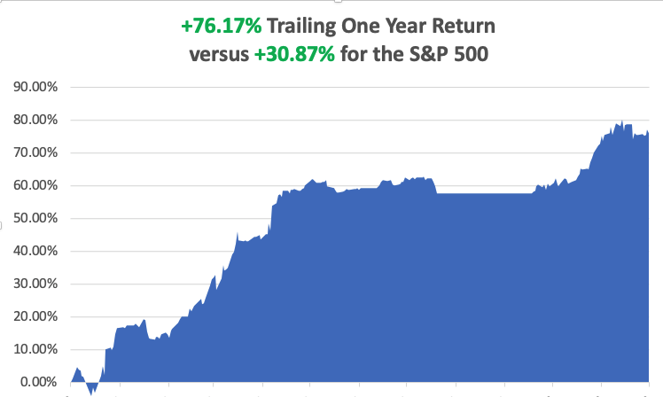

Slide 5
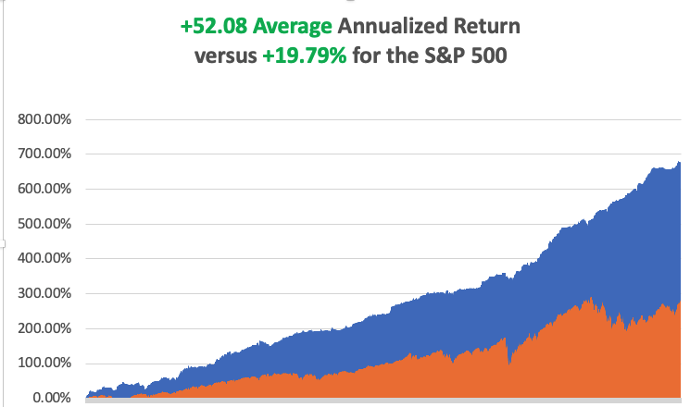

Slide 6
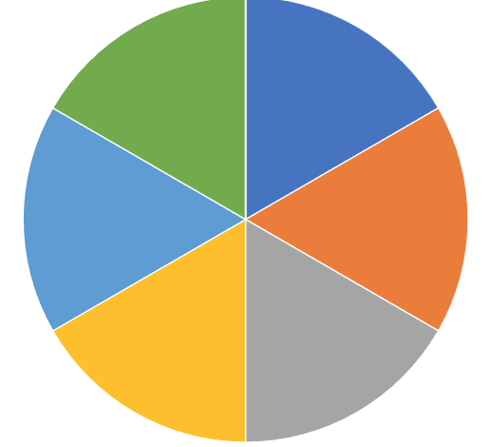
Portfolio Review – Aggressive Long 60% Long, 40% Short, 0% cash
Expiration Value +9.89%
Current Capital at Risk
Risk On
(NVDA) 2/$450-$460 call spread | 10.00%
(NVDA) 2/$460-$470 call spread | 10.00%
(MSFT) 2/$330-$340 call spread | 10.00%
(BA) 2/$190-$200 call spread | 10.00%
(AMZN) 2/$130-$135 call spread | 10.00%
(DAL) 2/$35-$38 call spread | 10.00%
Risk Off
NO POSITIONS | 0.00%
Total Net Position | 60.00%
Total Aggregate Position | 60.00%

Slide 8
The Method to My Madness
*Markets need to digest the massive moves of the fall before than can move forward, which could take months *Both stocks AND bonds delivered the biggest moves in history *All economic data is globally slowing, but modestly *Oil prices and commodities are now trading as one, selling off on slowing economy *The tech bull market is back and will continue for years *Buy stocks and bonds but only after substantial dips *Commodities and industrials are a second half play

Slide 9
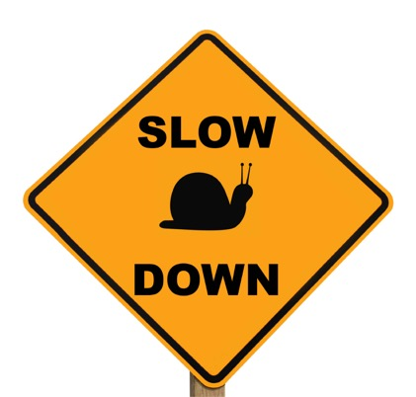
The Global Economy – Slowing
*Nonfarm Payroll Report Sizzles, at 216,000, better than expected *The headline Unemployment Rate maintained a near 50-year low at 3.7%. *JOLTS Falls in December, nudging lower to 8.79 million *Weekly Jobless Claims Drop to 202,000, a two-month low *US Bankruptcies Rise by 18% in 2023 and are expected to rise again in 2024. *The Auto Business is Booming, at 15.6 million units delivered in 2023, a four year high *Private Payrolls Rise by 164,000, in December, far above estimates and a big jump from 101,000 in November

Slide 10
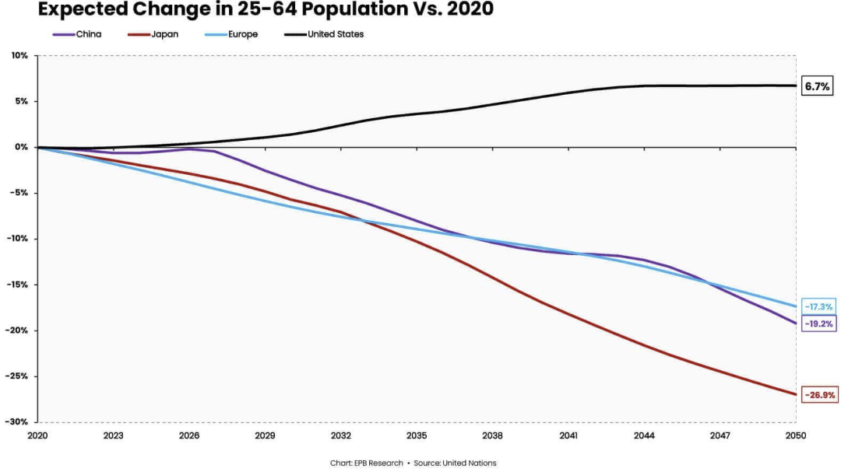

Slide 11
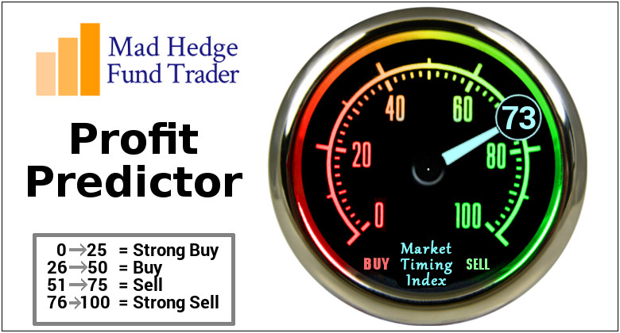
The Mad Hedge Profit Predictor Market Timing Index – At top end of historic range An artificial intelligence driven algorithm that analyzes 30 different economic, technical, and momentum driven indicators

Slide 12
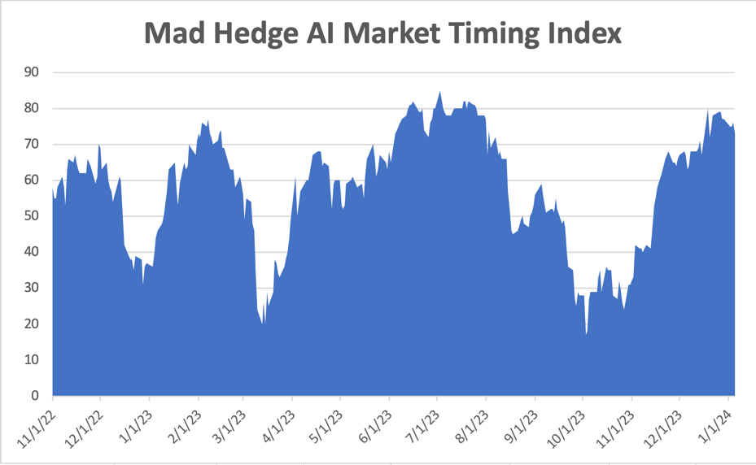
Sell Territory!! – Severe Overbought Territory
SELL
BUY

Slide 13
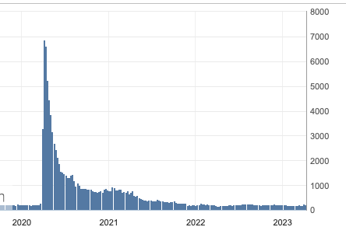
Weekly Jobless Claims – Falling 202,000 – -20,000

Slide 14
Stocks – Indigestion
Did We Just See Another 2009 type Bottom in October? If so, we could be looking at rising stocks for another 13 years, making my own Dow 120,000 forecast look conservative *Certainly, the fundamentals are there, as long as we don’t get another pandemic, or 100 other things go wrong *But all short-term technical indicators are screaming “Sell!” *Santa delivered big time with a monster December rally *70% of corporate profits went into stock buy backs in 2023 *Nippon Steel pays a huge premium for US Steel (X), retiring our LEAPS at max profit

Slide 15
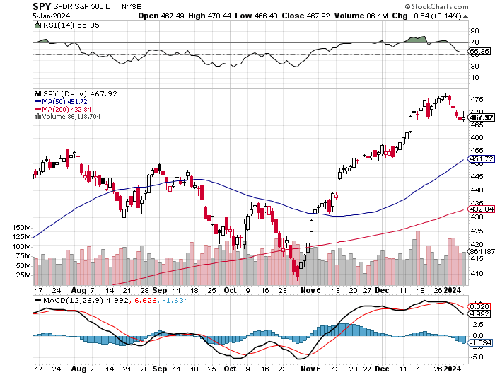
S&P 500 – New High took profits on long 5/$420-$430 put spread, took profits on long 1/$420-$430 put spread, took profits on long 11/$420-$430 put spread
Yearend Target $550 +15%
$455 -4.61% 1st support
$435 -8.80% 2nd support

Slide 16
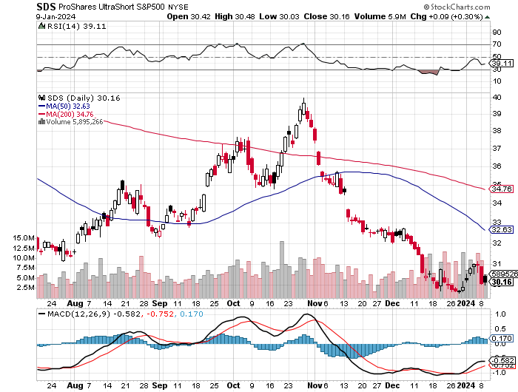
ProShares Ultra Short S&P 500 (SDS)- a great hedge for long stocks and bonds long 2X position has a hedge against longs and bond shorts

Slide 17
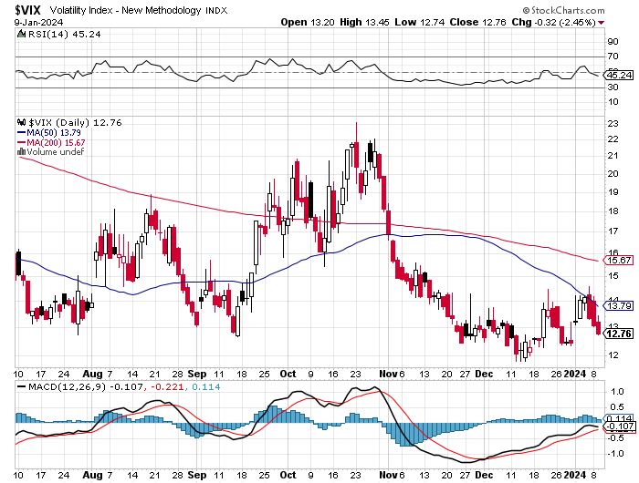
(VIX) – Bargain of the Century

Slide 18
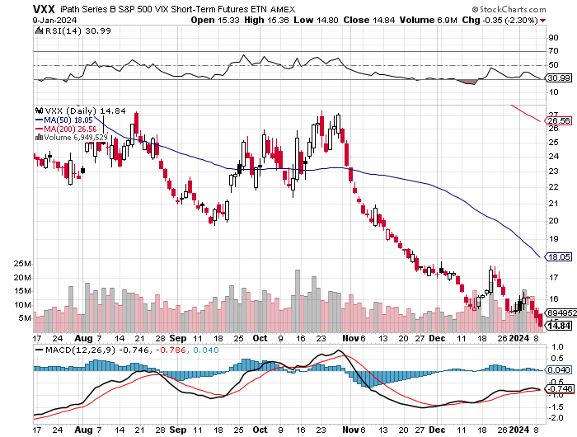
(VXX)-

Slide 19
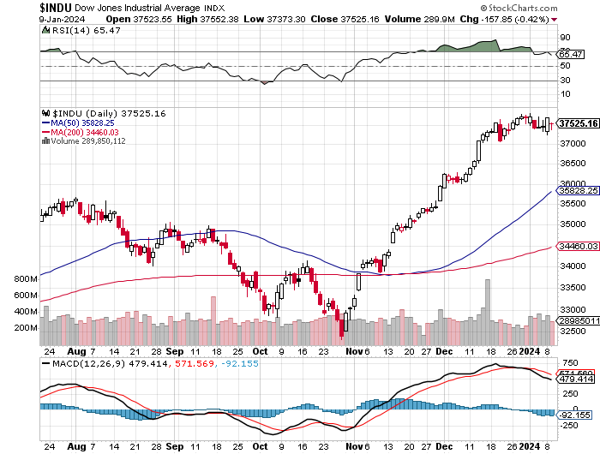
Dow Average ($INDU)-

Slide 20
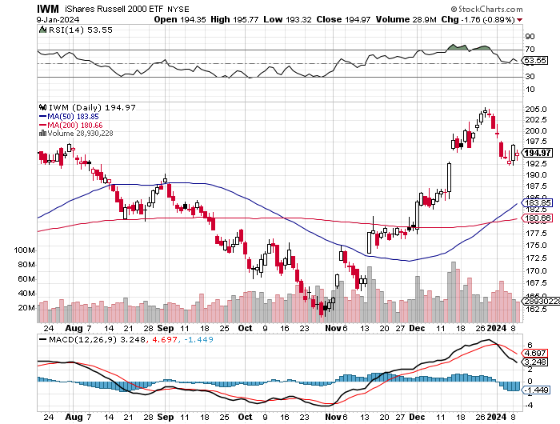
Russell 2000 (IWM)- took profits on Long 10/$137-$142 vertical bull call spread took profits on Long 10/$153-$156 vertical bear put spread

Slide 21
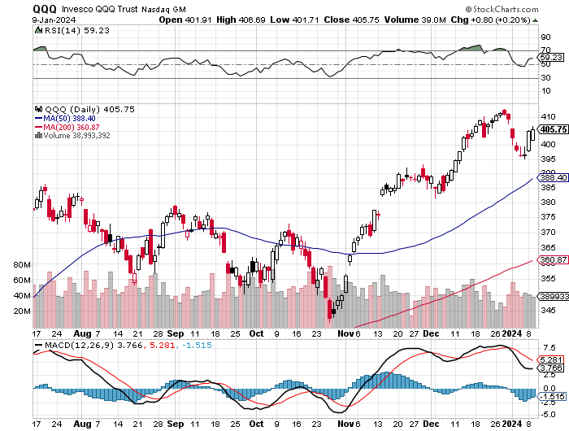
NASDAQ (QQQ) – took profits on Long 5/$335-$345 put spread took profits on long (QQQ) 1/$290-$300 put spread, took profits on long (QQQ) 4/$330-$335 put spread took profits on long (QQQ) 3/$340-$345 put spread, covered long (QQQ) $325-$330 put spread

Slide 23
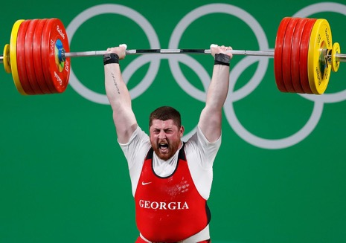
THE MAD HEDGE FUND TRADER
The Barbell Portfolio
*75% Big Tech – 2% of US workforce, 25% of market cap and 25% of US earnings 25% Domestic Recovery, including: Railroads, airlines, cruise lines, Couriers, steel companies Banks, commodities Construction Credit Card Companies Hotels, casinos Online Ticket Sales

Slide 24
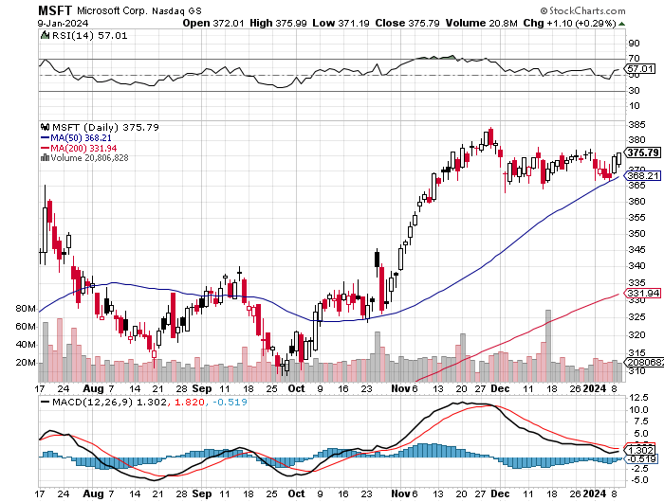
Microsoft (MSFT)- Earnings Beat The AI Wars Continue, with the entire Open AI staff going to Microsoft (MSFT) long 12/$330-$340 call spread, took profits on long 12/$320-$330 call spread took profits on long 9/$235-$245 call spread, took profits on long 7/$220-$210 call spread, took profits on long 6/$220-$230 call spread, took profits on long 2/$200-$210 bear put spread

Slide 25
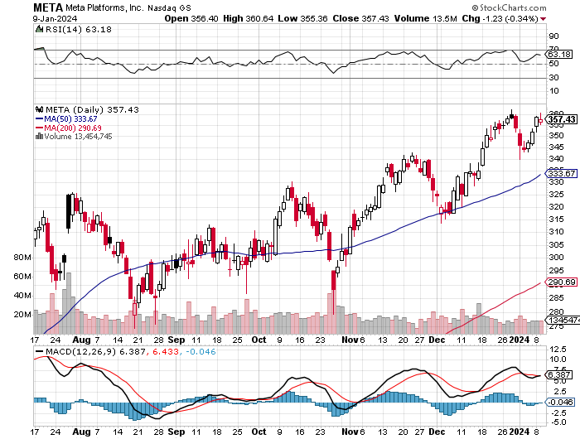
Meta (META)- Soars an Incredible 20% took profits on Long 9/$290-$300 vertical bear put spread stopped out of Long 9/$190-$200 vertical bear put spread

Slide 26
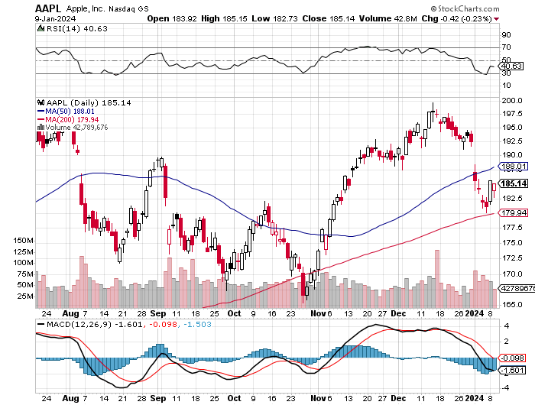
Apple (AAPL) Apple Upgrades New iPhone 15, to deal with overheating from third party gaming took profits on long 1/$145-$155 put spread, Took profits on long 10/$165-$175 put spread took profits on long 6/$155-$165 put spread, stopped out of long 6/$125-135 call spread, took profits on long 6/$110-$120 call spread, took profits on long 2/$180-$190 put spread

Slide 27
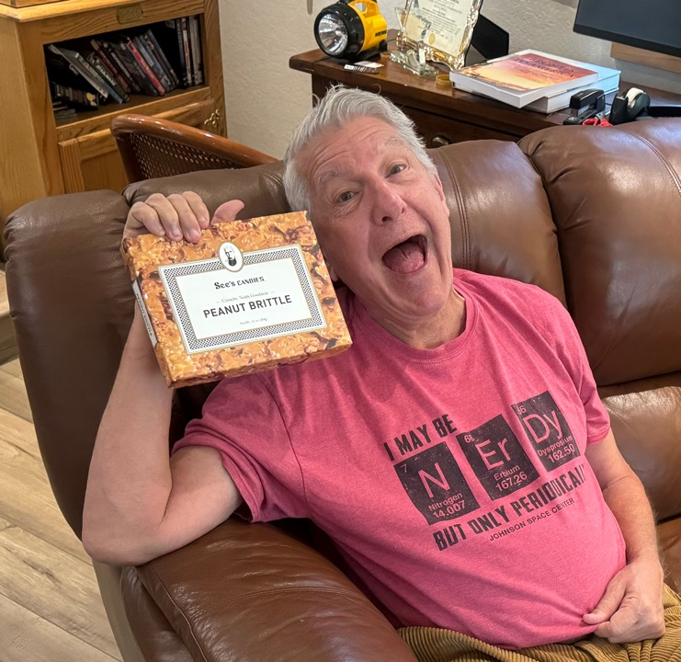

Slide 28
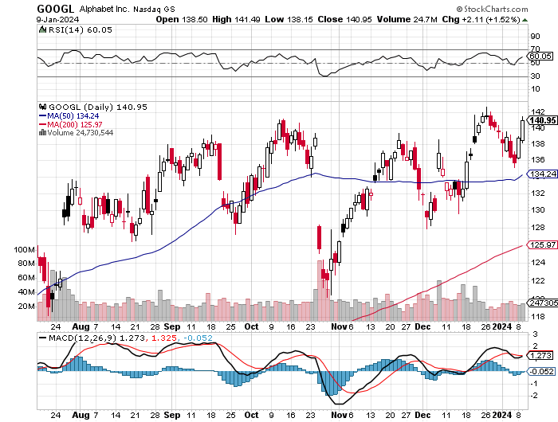
Alphabet (GOOGL) – Google Ramps Up AI Effort Alphabet Unveils New Gemini AI Model long 12/$110-$120 call spread – expires in 2 trading days took profits on long 12/$1,200-$1,230 bull call spread, took profits on long 9/$1,030-$1,080 vertical bull call spread

Slide 29
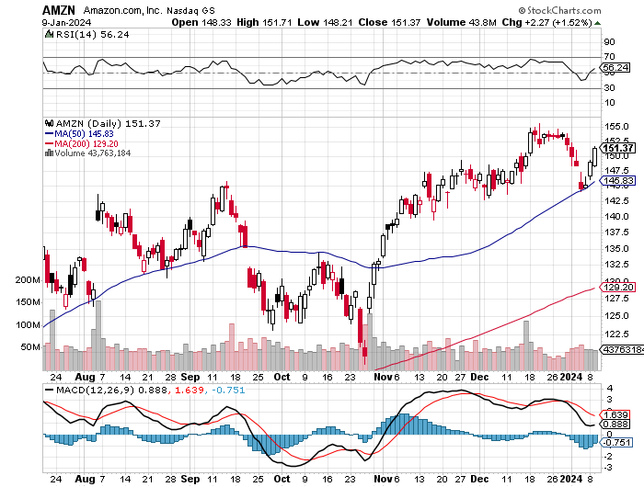
Amazon (AMZN) – Jeff Bezos Sells Amazon, some 1.673 million shares worth $244 million. He still has 988 million shares left worth $144 billion long 2/$130-$135 bull call spread took profits on long 2/$3,400-$3,500 bear put spread took profits on long 9/$2,800-$2,900 bull call spread

Slide 30
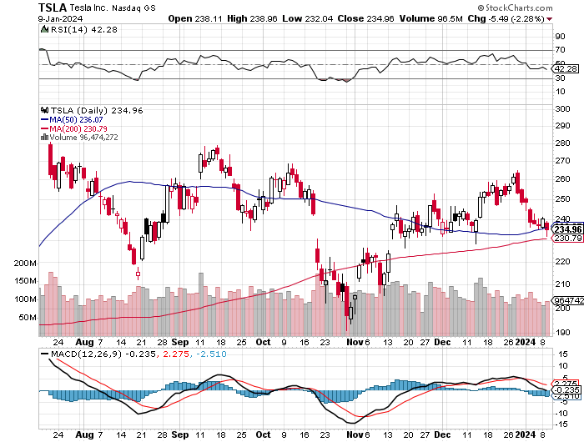
Tesla (TSLA) – The Price War Continues Tesla is Still the World’s Largest EV Maker. BYD delivered 1.57 million EV’s in 2023 compared to 1.8 million for Tesla (TSLA) 59% of car buyers considering an EV, EV market doubled in 2023 took profits on long 10/$200-$210 call spread took profits on long 6/$120-$130 call spread, stopped out of long 6/$210-$220 put spread took profits on long 5/$110-$120 call spread, took profits on long 5/$220-$230 put spread

Slide 31
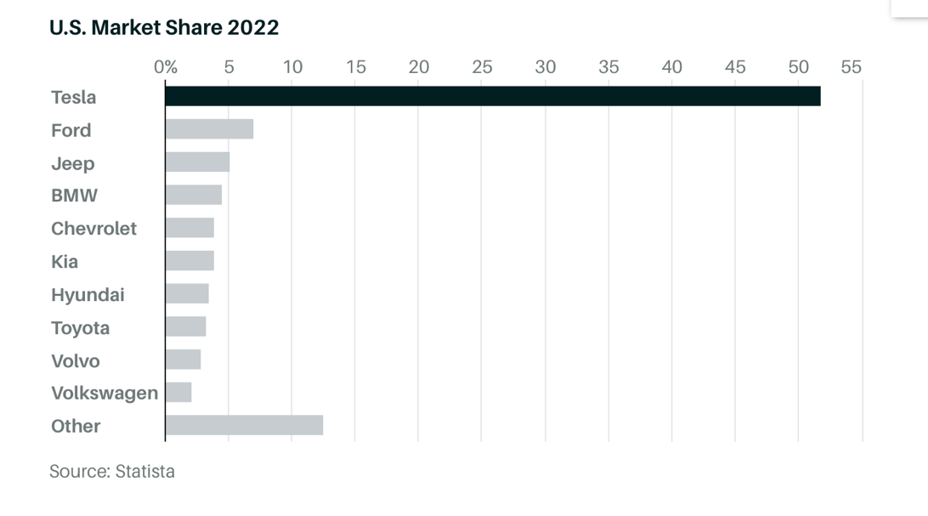

Slide 32
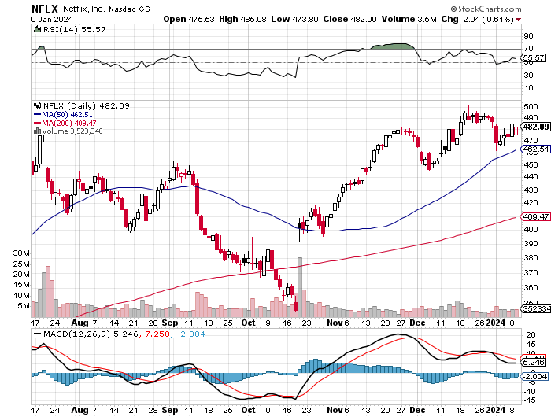
Netflix (NFLX) – Netflix subscribers beat - Netflix Password Sharing Crackdown Goes Global

Slide 33
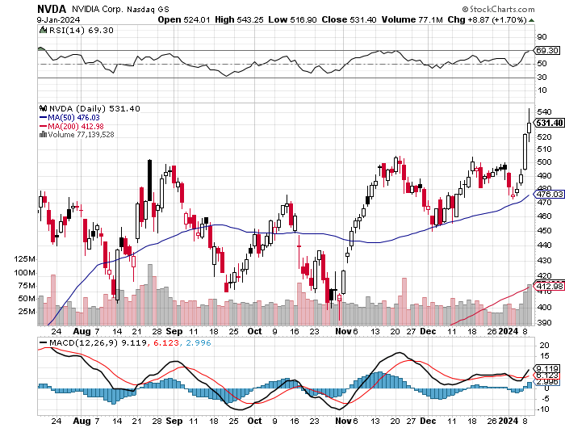
NVIDIA (NVDA) – Double Position long 2/$350-$360 call spread –long 2/$360-$370 call spread took profits on long 10/$370-$380 call spread – took profits on long 11/$370-$380 call spread took profits on long 3/$260-$270 put spread, took profits on long 10/$95-$100 call spread took profits on long 7/$120-$130 call spread, took profits on long 6/$120-$130 call spread

Slide 34
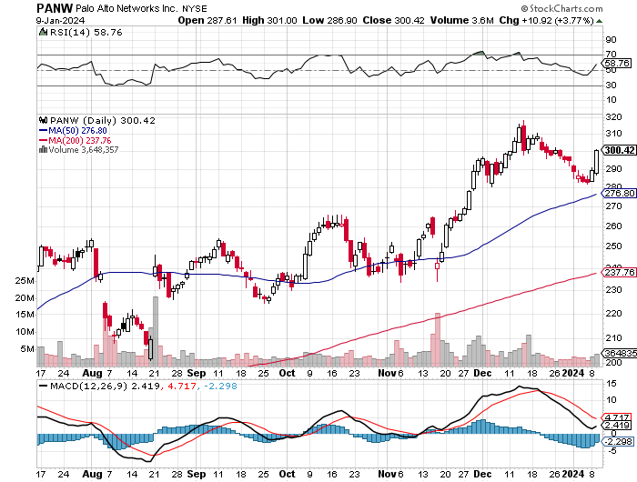
Palo Alto Networks (PANW)- Hacking never goes out of fashion Palo Alto Networks Dives on Weak Guidance, even though reported earnings were great took profits on long 10/$130-$140 call spread

Slide 35
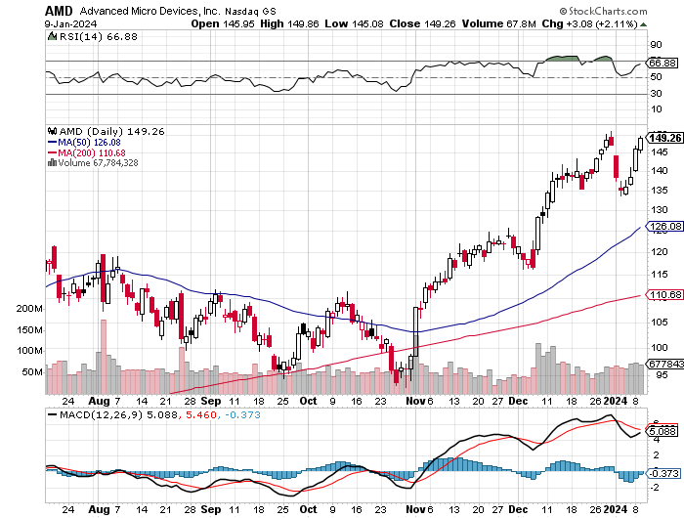
Advanced Micro Devices (AMD)- Recession fears programable logic devices took profits on long 2/$75-$80 call spread

Slide 36
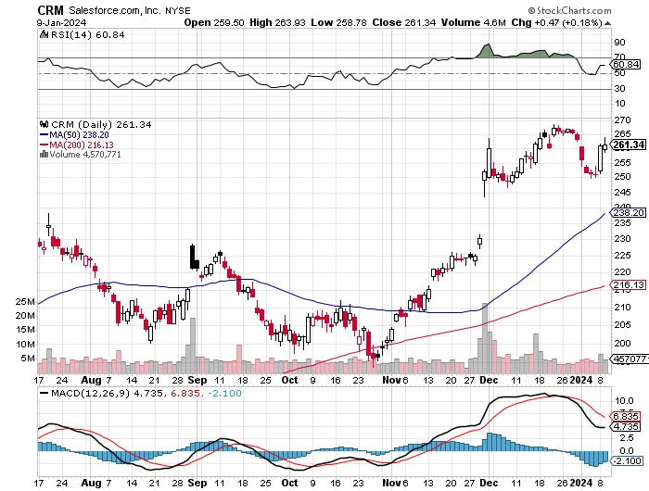
Salesforce (CRM)- Massive Online Migration Salesforce Soars 16%, on better-than-expected guidance took profits on long 12/$185-$195 call spread took profits on long 9/$125-$130 vertical bull call spread took profits on long 8/$125-$130 vertical bull call spread

Slide 37
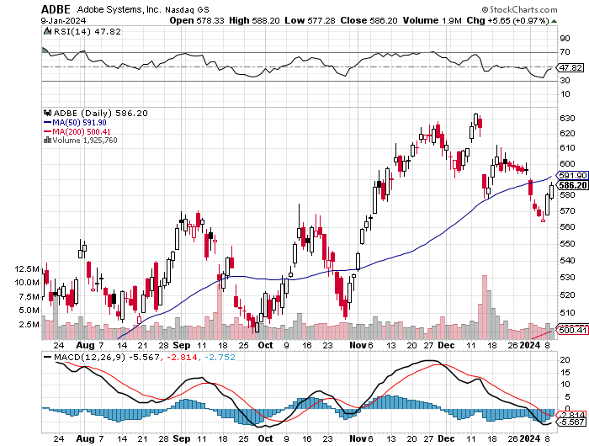
Adobe (ADBE)- Cloud play The Quality Non-China tech play

Slide 38
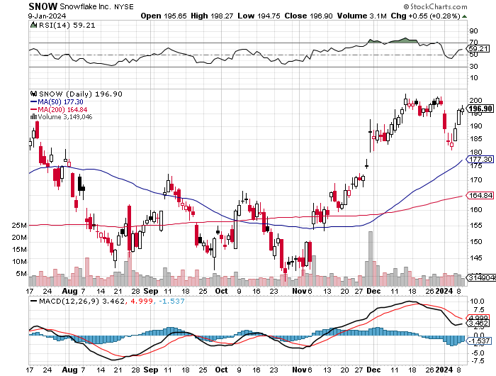
Snowflake (SNOW)- Blockbuster AI Earnings took profits on long 12/$135-$140 call spread

Slide 39
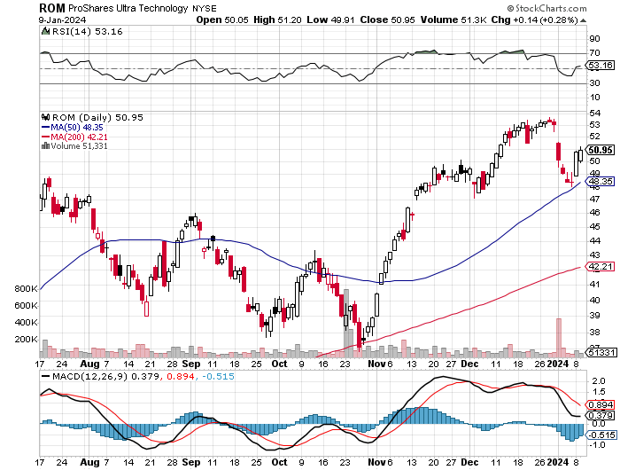
ProShares Ultra Technology ETF (ROM) – 2X Long Technology ETF took profits on long 10/$62-65 call spread

Slide 41
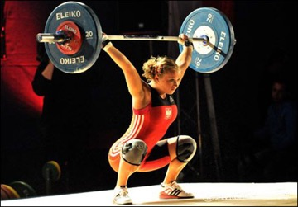
The Second Half of the Barbell
*Bets on a domestic recovery in 2024 H2 *Upside potential for domestics in 2024 far greater than tech *Some of these have not moved for 5 or 10 years *Focuses on economically sensitive cyclical industries *Makes a great counterweight to high-growth technology *We could spend all of next ten years rotating between the two groups

Slide 42
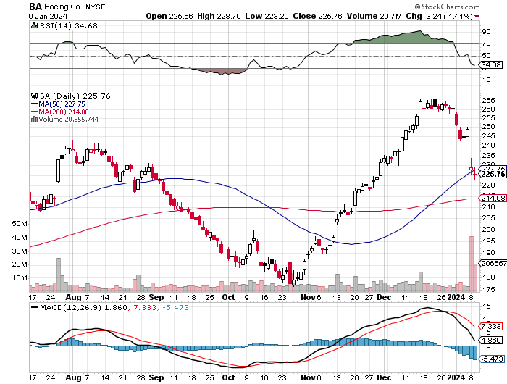
Boeing (BA) – Boeing's single-aisle deliveries up to 351 units for the year so far long 2/$190-$200 call spread, took profits on long 5/$17-$175 call spread

Slide 43
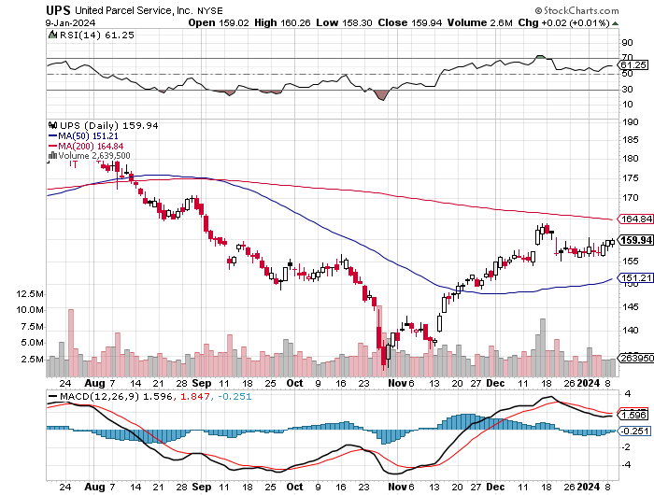
Package Delivery- United Parcel Service (UPS) – strike averted took profits on long 11/$130-$140 call spread

Slide 44
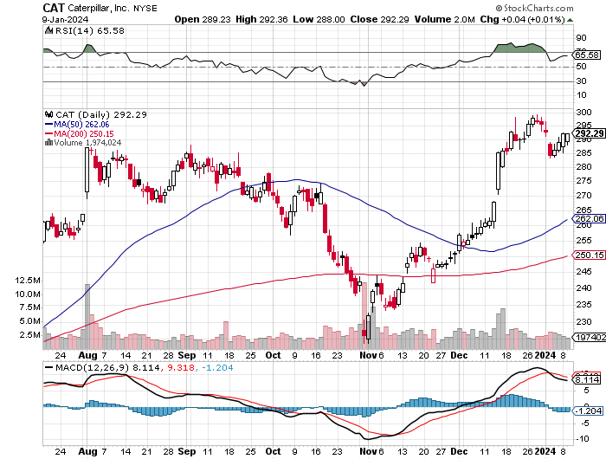
Caterpillar (CAT)- Ag + Infrastructure + Housing long 12/$220-$230 calls – expires in 2 trading days took profits on long 12/$145-$150 call spread took profits on long 11/$125-$135 call spread

Slide 45
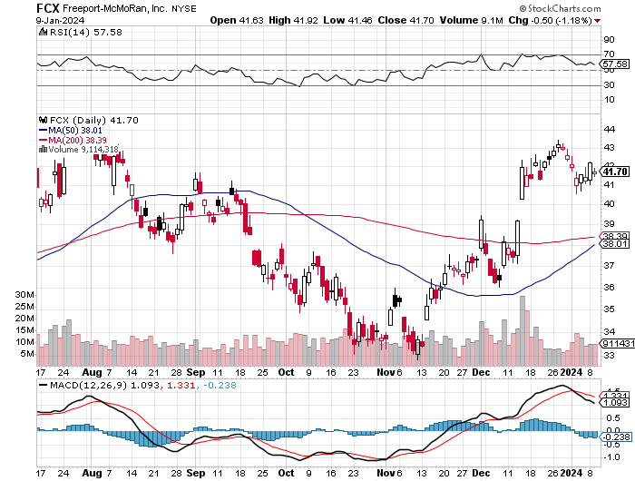
Freeport McMoRan - (FCX)- Coming Copper Crisis took profits on long 6/$32-$35 call spread took profits on long 4/$30-$33 call spread, took profits on long 10/$20-$23 call spread

Slide 46
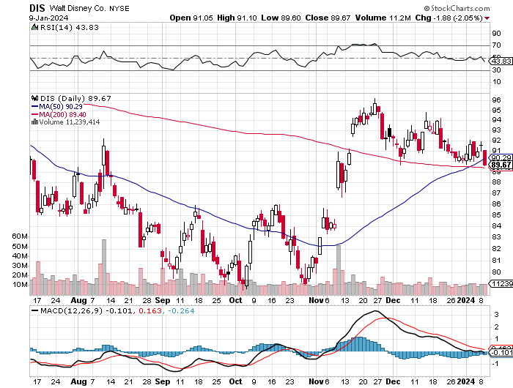
Walt Disney (DIS) -Disney Beats The big profit boost came from the parks

Slide 47
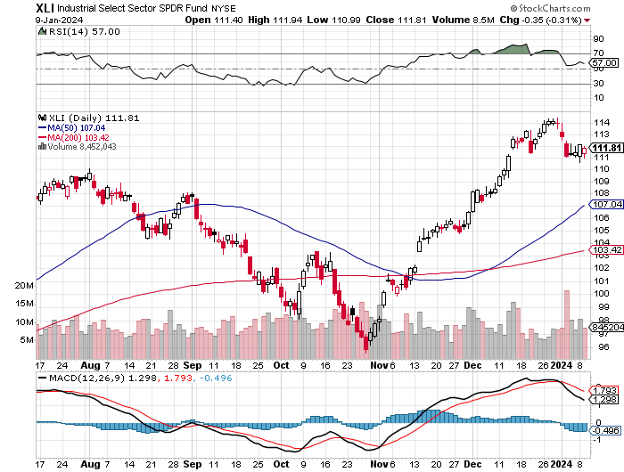
Industrials Sector SPDR (XLI)- (GE), (MMM), (UNP), (UTX), (BA), (HON)

Slide 48
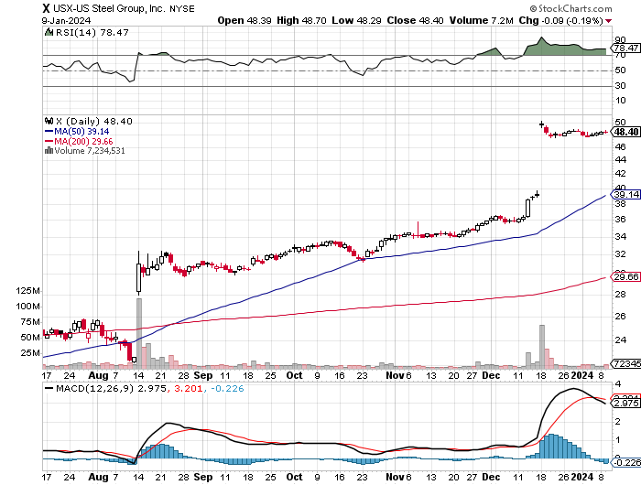
US Steel (X) – Nippon Steel Takeover Bid at $55 Goodbye

Slide 49
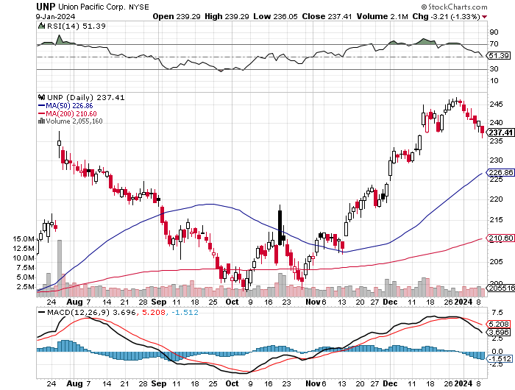
Union Pacific RR (UNP)- Big Stuff to Ship took profits on long 5/$200-$210 call spread took profits on 11/$150-$160 call spread

Slide 50
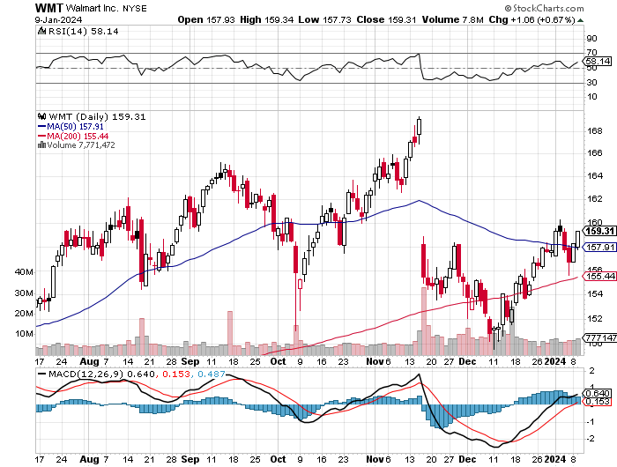
Wal-Mart (WMT)- took profit on Long 11/$125-$130 bear put spread took profit on Long 10/$119-$121 bear put spread took profits on Long 8/$114-$117 bear put spread

Slide 51
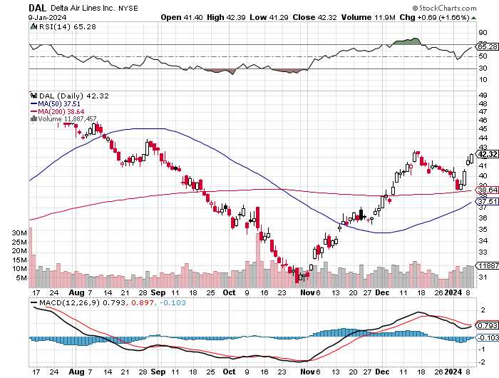
Delta Airlines (DAL) – Travel is Back! Delta Posts Strong Earnings on Robust international travel long 2/$35-$38 call spread

Slide 52
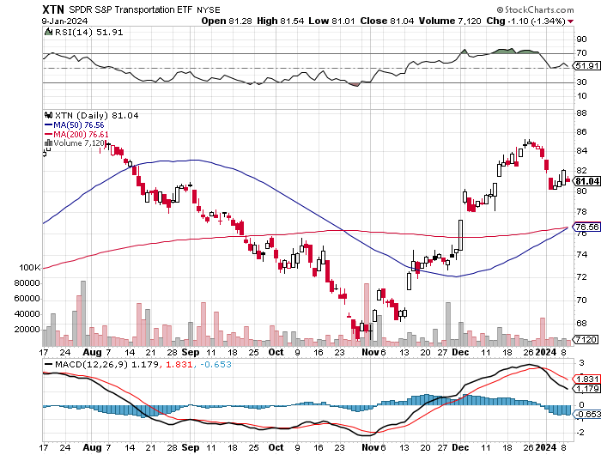
Transports Sector SPDR (XTN)- Worst Hit Sector (ALGT), (ALK), (JBLU), (LUV), (CHRW), (DAL)

Slide 53
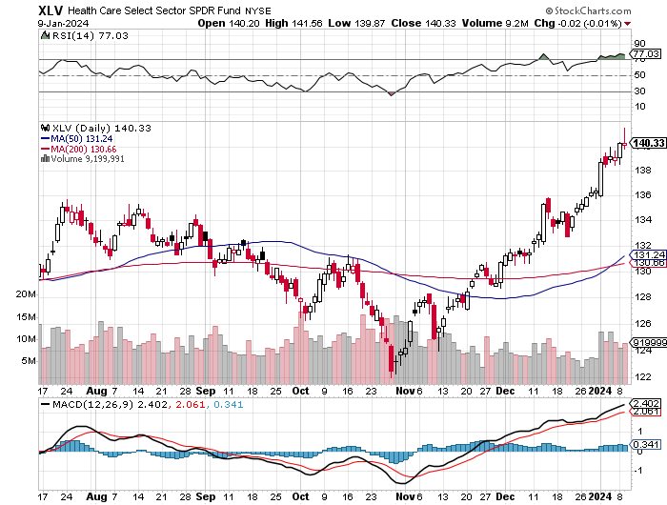
Health Care Sector (XLV) (JNJ), (PFE), (MRK), (GILD), (ACT), (AMGN)

Slide 54
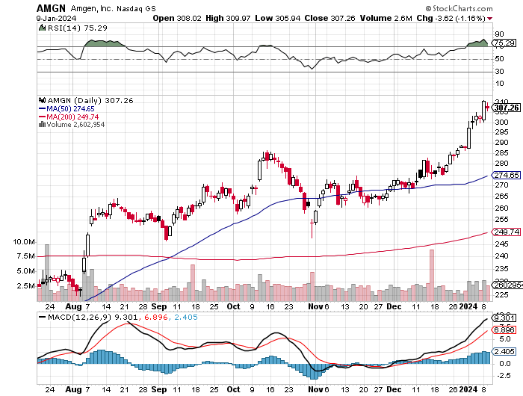
Amgen (AMGN) took profits on long 11/$185-$200 bull call spread

Slide 55
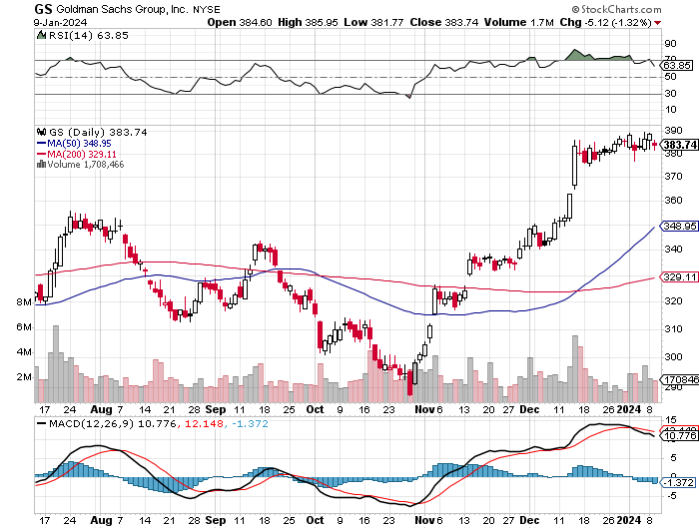
Goldman Sachs (GS) – Earnings Down but Less than Expected took profits 12/$330-$350 call spread took profits 11/$330-$350 call spread stop loss on long 11/$385-$395 call spreads

Slide 56
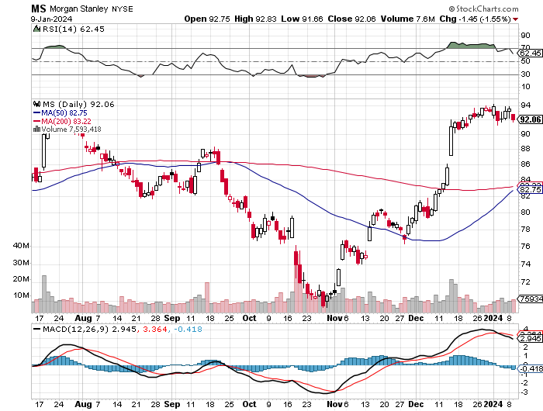
Morgan Stanley (MS) – Highest Capital ratio net of mark to market CEO to Step Down in a Year took profits on long 4/$65-$70 call spread

Slide 57
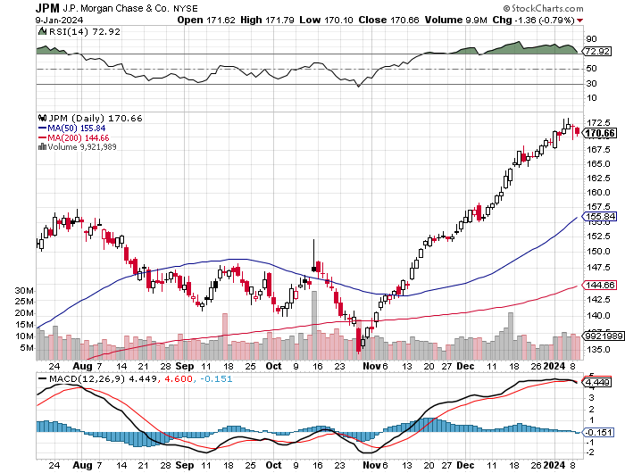
JP Morgan Chase (JPM) – Monster Earnings Surprise took profits on long 4/$105-$115 call spread

Slide 58
Bank of America (BAC) – Bank of America Rips, on a great earnings report took profits on long 4/$20-$23 call spread

Slide 59
Citigroup (C) – took profits on long 4/$30-$35 call spread

Slide 60
Charles Schwab (SCHW) – LEAPS up 67% in three months took profits on long 4/$30-$35 call spread

Slide 61
Interactive Brokers (IBKR) – Best Risk Control took profits on long 4/$60-$65 call spread

Slide 62
SPDR Metals & Mining ETF (XME) – long 2/$28-$30 call spread

Slide 63
Blackrock (BLK)-Asset Collection Boom took profits on long 3/$770-$790 call spread took profits on long 3/$310-$340 call spread

Slide 64
Visa (V) – Inflation boost Transaction grew by an inflationary 10% back to pre-pandemic levels took profits on long 10/$160-$170 bull call spread took profits on long 6/$150-$160 bull call spread

Slide 65
Consumer Discretionary SPDR (XLY) (DIS), (AMZN), (HD), (CMCSA), (MCD), (SBUX)

Slide 66
Berkshire Hathaway (BRKB)- Natural Barbell Berkshire Hathaway Knocks it Out of the Park, with a 41% gain in operating earnings took profits on long 12/$320-$330 call spread took profits on long 4/$260-$270 call spread, took profits on long 1/$290-$300 call spread took profits on long 10/$220-$230 call spread, took profits on long 7/$220-$230 call spread took profits on long 7/$220-$230 call spread, took profits on long 6/$260-$270 call spread

Slide 67
Europe Hedged Equity (HEDJ)-

Slide 68
Japan (DXJ)-

Slide 69
Emerging Markets (EEM) - Pro trade, Weak Dollar, Long Recovery Play

Slide 71
Bonds – Taking a Break
*Bonds Could be the Big Trade of 2024 *After the sharpest 19-point two month rise in market history, markets are taking a break *The Federal Reserve will cut interest rates sharply in 2024 *Markets are discounting six times, but three are more likely *Swap contracts are pricing in almost six quarter-point cuts and see a more than 70% chance of a quarter-point policy-rate decrease in March *Junk bond ETF’s (JNK) and (HYG) are holding up extremely well with a 6.50% yield and 18 month high *I’m looking for an $18-$28 point gain in 2024 with interest *Buy (TLT) on the dip.

Slide 72
Treasury ETF (TLT) – Taking a Break took profits on long 12/$95-$98 put spread took profits on long 12/$79-$82 call spread, took profits on long 11/$76-79 call spread, took profits on long 10/$89-92 put spread, took profits on long 5/$98-$101 call spread took profits on long 5/$97-$100 call spread, long 2/$98-$101 call spread, took profits on long 4/$96-$99 call spread

Slide 73
Ten Year Treasury Yield ($TNX) – 4.00%

Slide 74
Junk Bonds (JNK) 6.42% Yield

Slide 75
Municipal Bonds (MUB) 3.79% Yield-

Slide 76
Emerging Market Debt (ELD) 6.69% Yield-

Slide 77
2X Short Treasuries (TBT)-Out of Favor

Slide 78
Anally Capital Management (NLY) – Leveraged REIT Play took profits on long 12/$15-$16 call spread

Slide 80
Foreign Currencies – Dollar is Toast
*Falling interest rates guarantee a falling dollar for 2024 *Bank of Japan Eases Grip on Bond Yields, ending its unlimited buying operation to keep interest rates down *Japan is the last country to allow rates to rise *Expect the Japanese yen to take off like a rocket. *(FXA) is rally on coming bull markets in commodities *Buy (FXY) on dips

Slide 81
THE MAD HEDGE FUND TRADER
Australian Dollar (FXA) - Major Long-Term Bottom is In Targeting Parity – A call option on a global synchronized recovery
1:1
BUY

Slide 82
Japanese Yen (FXY)

Slide 83
Euro (FXE)-
2023 Target 25%

Slide 84
British Pound (FXB)-
2023 Target 15%

Slide 85
Emerging Market Currencies (CEW)
2023 Target 40%

Slide 87
Energy & Commodities –No friends
*Straights of Hormuz closing threat deliver modest dollar rally *Gaza has also ceased to have an impact *If you throw good news on a commodity and it fails to rally you get rid of it *This is despite the US government coming in to buy 1-3 million barrels daily for the SPR *US Gasoline Prices Hit Three Year Low, on recession fears and replacement concerns by EV’s *Copper to Rise 75% in 2024, say industry analysts *There is a “BUY” setting up here in energy when the global economy reaccelerates on a lower interest rates world. Watch (XOM) and (OXY). * New export terminals create boom in natural gas (UNG) up 45% in three weeks, keep LEAPS

Slide 88
Oil-($WTIC)

Slide 89
United States Oil Fund (USO)

Slide 90
Energy Select Sector SPDR (XLE)-No Performance! (XOM), (CVX), (SLB), (KMI), (EOG), (COP)

Slide 91
ExxonMobile (XOM)- Exxon Moves Big into Lithium, with the construction of a major mining operation in Arkansas stopped out of Long 12/$97-$100 call spread took profits on long 12/$120-$125 put spread

Slide 92
Occidental Petroleum (OXY)- Buffet’s a Buyer took profits on long 2/$55-$60 call spread took profits on long 12/$77.50-$82.50 put spread

Slide 93
Natural Gas (UNG) – Gone Ballistic Long January 2025 $8-$9 Call Spread LEAPS – Double in 2 weeks

Slide 94
Freeport McMoRan (FCX) - Codelco Sees Profit Slump, the world’s largest copper producer based in Chile

Slide 95
Cameco (CCJ) – Global Uranium Renaissance France to build additional 14 new Nuclear power plants long 12/$35-$38 call spread – expires in 12 trading days took profits on long 5/$20-$23 bull call spread

Slide 97
Precious Metals – A New 10 Year Bull Market
*Gold to Hit New High in 2024 *With fundamentals of a dovish pivot in U.S. interest rates, continued geopolitical risk, and central bank buying are expected to support the market after a volatile 2023 *Spot gold to posted a 13% annual rise in 2023, its best year since 2020, trading around $2,060 per ounce *Investors are picking up gold as a hedge for 2024 volatility *Gold headed for $3,000 by 2025, but back off first from new all-time highs *Silver is the better play with a higher beta *Russia and China are also stockpiling gold to sidestep international sanctions

Slide 98
Gold (GLD) - Deflation call took profits on long 5/$165-$170 bull call spread

Slide 99
Market Vectors Gold Miners ETF- (GDX) –

Slide 100
Barrick Gold (GOLD) took profit on long 1/$15.50-$16.50 call spread

Slide 101
Newmont Mining- (NEM)- took profits on long $55-60 call spread

Slide 102
Silver- (SLV)- took profits on long 11/$19-$20 call spread

Slide 103
Silver Miners - (SIL)-

Slide 104
Wheaton Precious Metals - (WPM)- took profits on long 1/$36-$39 call spread

Slide 105
Platinum- (PPLT)- 556,000-ounce shortage this year took profits on long 1/$36-$39 call spread

Slide 107
Real Estate – Coming Back
*Pending Home Sales were Unchanged in November *Real estate is far stronger than people realize *Mortgage rates are now solidly in the mid-6% range, but the supply of homes for sale is still very low *REMAX CEO Nick Baily says the market is short 4.5 to 5 million homes which will take a decade to build *Home Prices Hit New All-Time Highs, with nine consecutive months of gains *Refi Demand Rockets, as interest rates plunge to four-month lows *Tight supply and still-strong demand have kept pressure on home prices, which not only continue to hit new highs

Slide 108
S&P Case Shiller Turns Hot S&P Case Shiller Rises to +4.60% YOY in October, with its National Home Price Index Detroit gained +8.1%, San Diego +7.2%, and New York +7.1%.

Slide 109
Crown Castle International (CCI) – 5.45% yielding 5G cell phone tower REIT Eliot Management Pushes up stock with activist bid

Slide 110
US Home Construction Index (ITB) (DHI), (LEN), (PHM), (TOL), (NVR)

Slide 112
Trade Sheet- So What Do We Do About All This?
*Stocks – buy any dips *Bonds – buy dips *Commodities-buy dips *Currencies- sell dollar rallies, buy currencies *Precious Metals – buy dips *Energy – buy dips *Volatility - buy $12 *Real estate – buy dips

Slide 113
Next Strategy Webinar 12:00 EST Wednesday, January 24 from Silicon Valley email me questions at support@madhedgefundtrader.com
Good Luck and Good Trading!
Notes:
*

