Slide 1
The Mad Hedge Fund Trader “NVIDIA Fever”
With John Thomas Silicon Valley February 21, 2024 www.madhedgefundtrader.com
Notes:
*

Slide 2
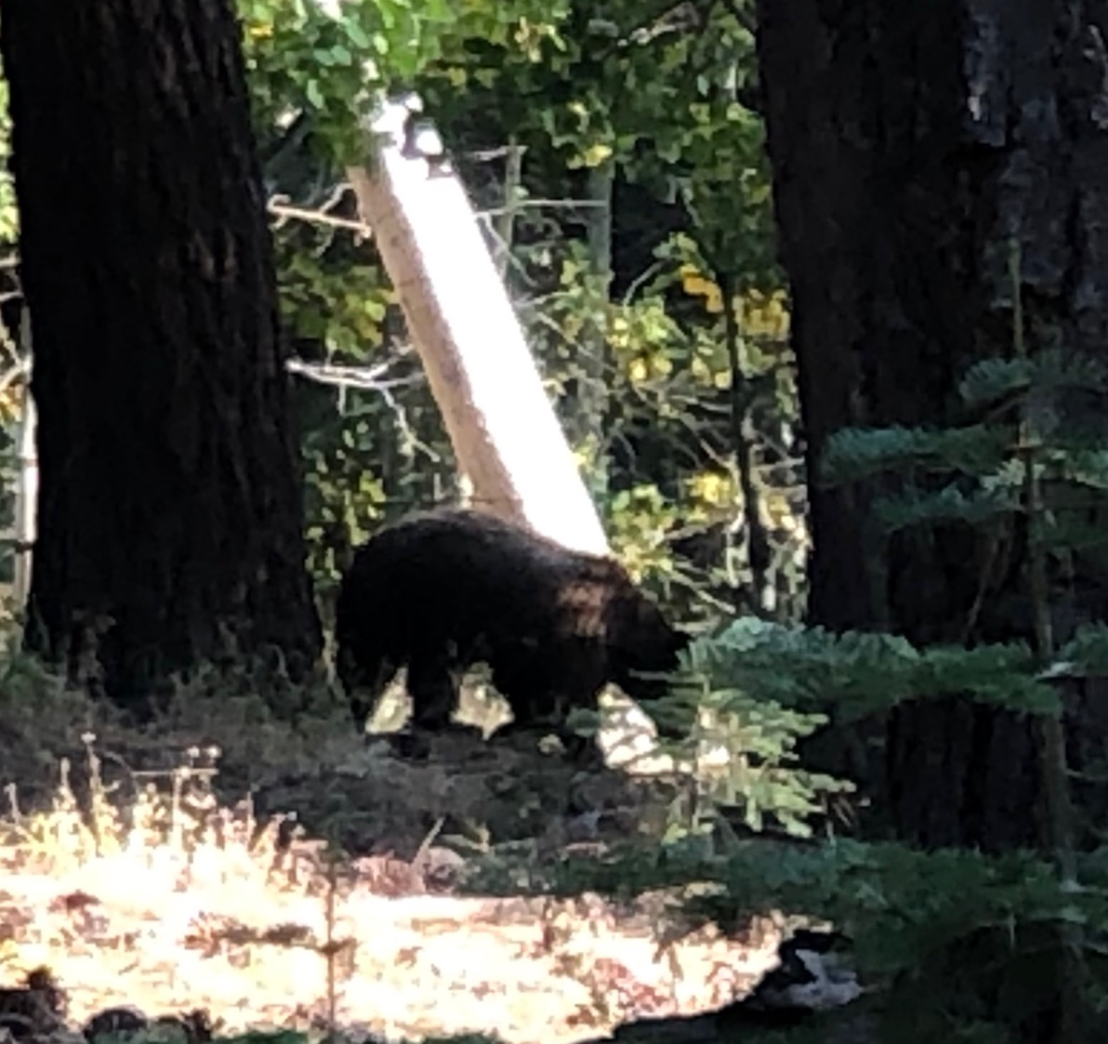

Slide 3
Trade Alert Performance Beating 2022 – Best in 16 years 60 out of 66 trade alerts profitable
*January -4.28% Final *July +0.44% Final *February +3.41% MTD *August -4.70% Final *March +20.85% Final *September +00% Final *April +15.13% Final *October -5.37% Final *May +0.30%% Final *November +15.37 Final *June +3.01% Final *December -2.27% Final *2024 YTD -0.86%, versus +4.56% for the S&P 500 and +675.77% since inception *Versus 84.63% for all of 2022 *Versus 79.79% for all of 2023 *Average annualized return of +51.32% for 16 years

Slide 4
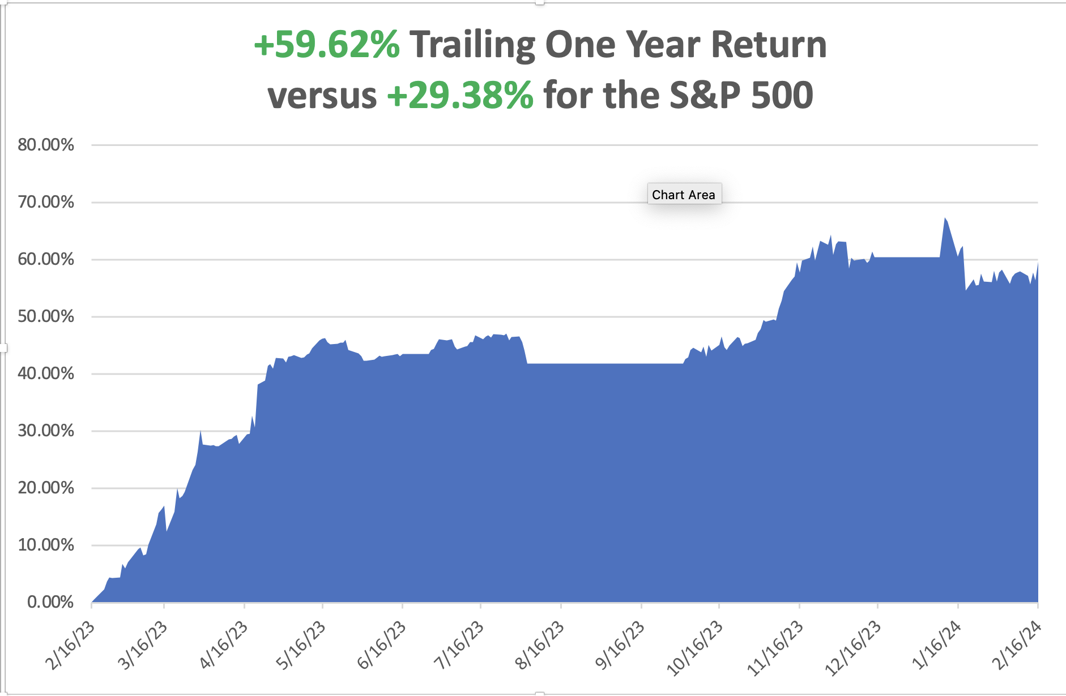

Slide 5
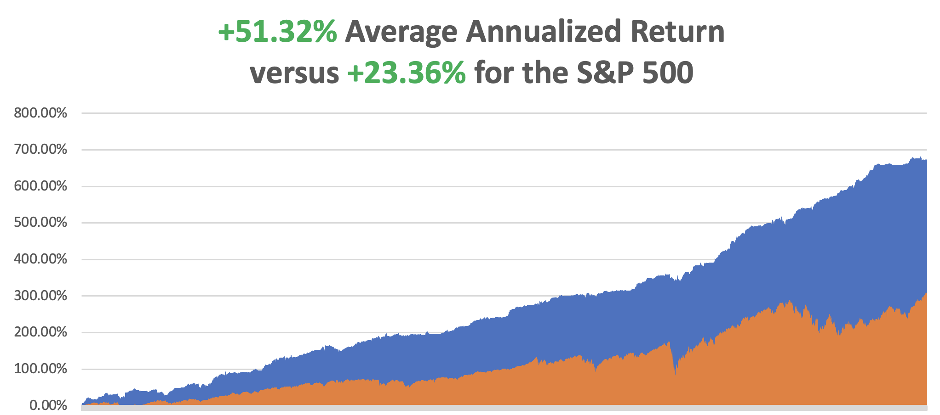

Slide 6
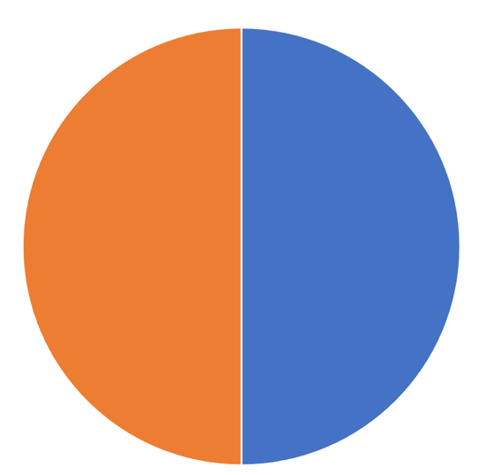
Portfolio Review – Aggressive Long 20% Long, 80% cash
Risk On
(NVDA) 3/$600-$610 call spread | 10.00%
(NVDA) 3/$600-$610 call spread | 10.00%
Risk Off
NO POSITIONS
Total Net Position | 20.00%
Total Aggregate Position | 20.00%
Expiration Value +1.54%

Slide 7
The Method to My Madness
*Overheating risk is rising *That postpones Fed interest rate cuts and cap stocks, putting all interest rate sensitive sectors back to sleep *All economic data is globally slowing, except for the US, with the only good economy in the world *Red Sea War continuex and the price of oil could care less *Domestic plays have gone silent awaiting actual rate cuts *Buy stocks and bonds but only after substantial dips *Commodities and industrials are a second half play, we will keep rotating back and forth all year with tech

Slide 8
The Global Economy – Heating Up
Reheating is Becoming an Issue, with a strong US economy and record low unemployment rate possibly prompting the Fed to delay interest rate cuts *Nonfarm Payroll Report Comes in Hot, at 353,000, Headline Unemployment at 3.7% *CPI Smacks Market, coming in at 0.3% in January instead of the expected 0.2%. *US Retail Sales Dive 0.8% in January, *US Industrial Production Comes in Weak, down 0.1% *Early Retirements are Soaring, thanks to a stock market at new all-time highs. *Electricity Costs Soar in California, up 10% as of January 1

Slide 9
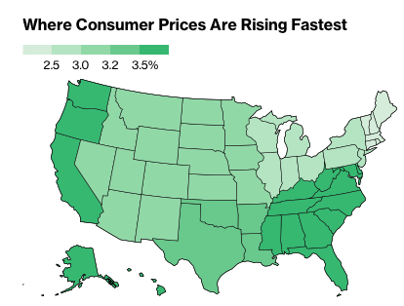

Slide 10
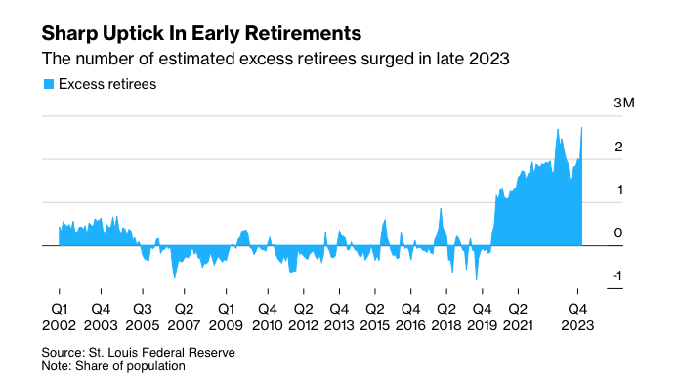

Slide 11
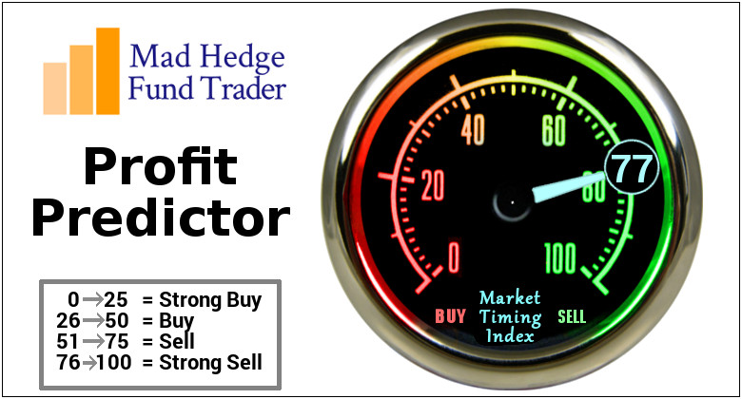
The Mad Hedge Profit Predictor Market Timing Index – At top end of historic range An artificial intelligence driven algorithm that analyzes 30 different economic, technical, and momentum driven indicators

Slide 12
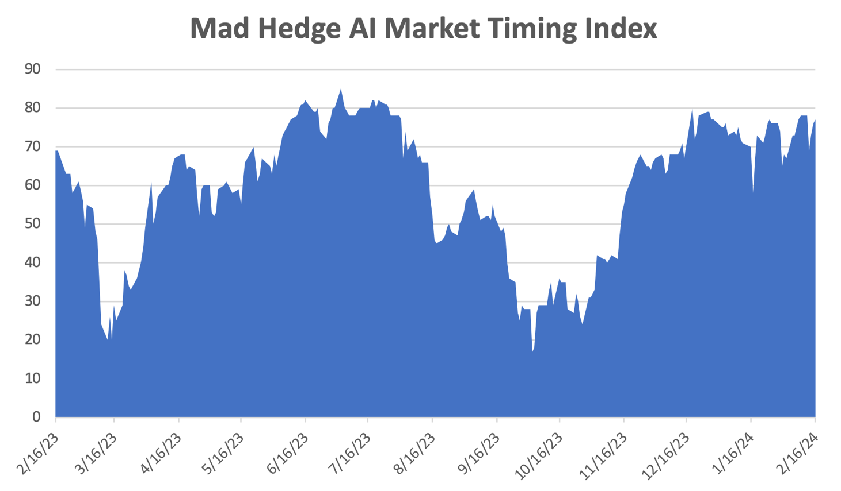
Sell Territory!! – Severe Overbought Territory
SELL
BUY

Slide 13
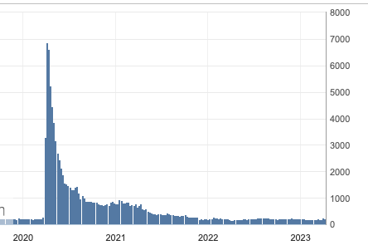
Weekly Jobless Claims – Falling 212,000 – +8,000

Slide 14
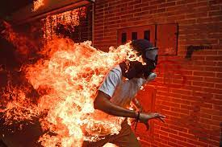
Stocks – On Fire
*SPY breaks to new all-time highs almost every day *Analysts are ratcheting up yearend targets, with me now at (SPX) 6,000 *Big tech continues to dominate, but NVIDIA earnings out after close today could mark short term top *Market will continue to revalue all AI plays *Market is over rewarding winners like Meta (META) (+25%) and over punishing losers, like Hasbro (HAS) (-15%). *$929 Billion in US Commercial Real Estate Loans are Due this Year, or 20% of the total, so Avoid regional banks like the plague *The flip flop continues between tech and domestics

Slide 15
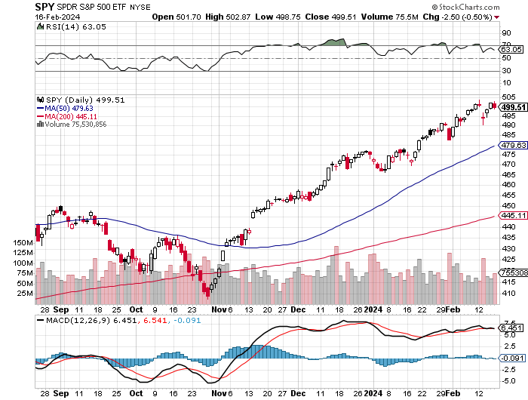
S&P 500 – New High stopped out of short 2/$485-$490 put spread,
Yearend Target $600 +25%
$465 -7% 1st support

Slide 16
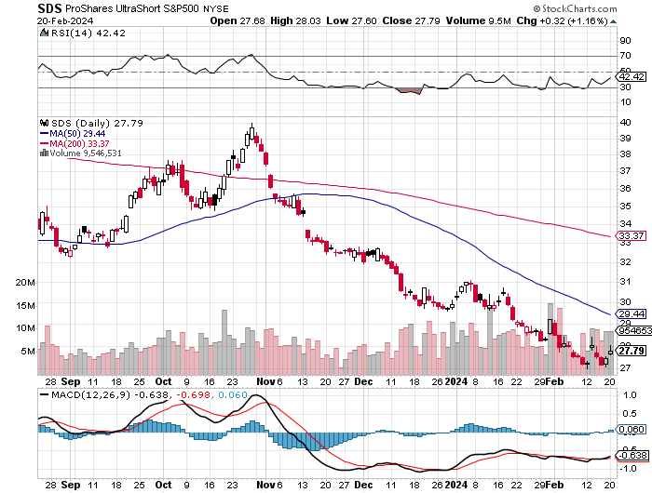
ProShares Ultra Short S&P 500 (SDS)- a great hedge for long stocks and bonds long 2X position has a hedge against longs and bond shorts

Slide 17
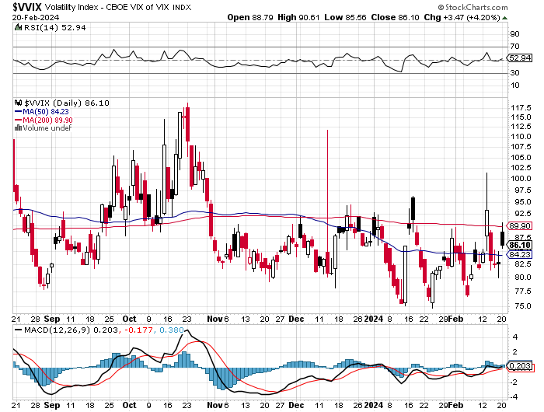
(VIX) – Bargain of the Century

Slide 18
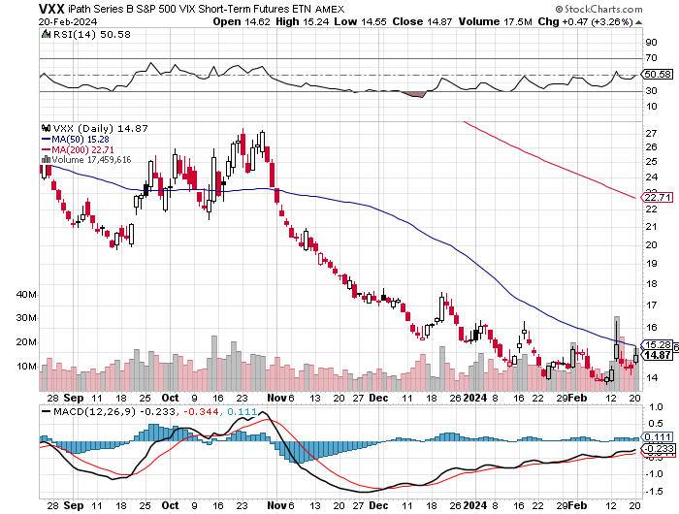
(VXX)-

Slide 19
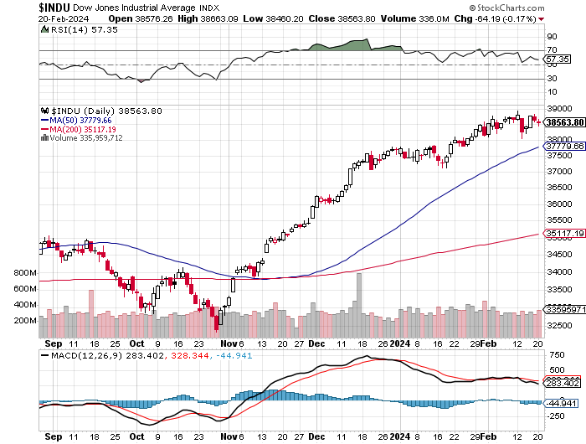
Dow Average ($INDU)-

Slide 20
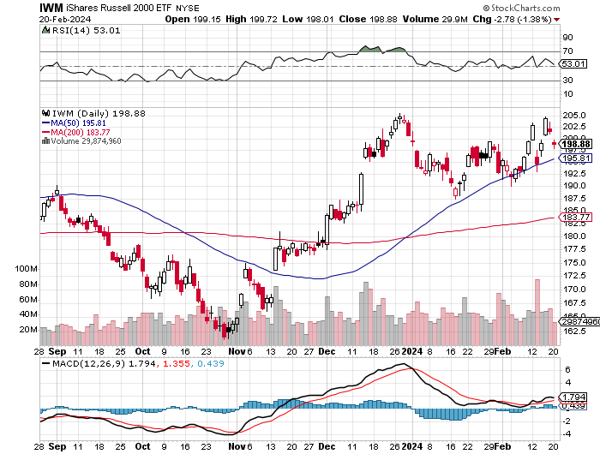
Russell 2000 (IWM)- took profits on Long 10/$137-$142 vertical bull call spread took profits on Long 10/$153-$156 vertical bear put spread

Slide 21
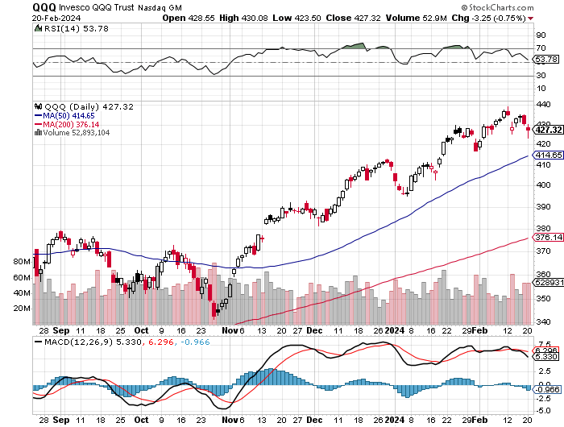
NASDAQ (QQQ) – took profits on Long 5/$335-$345 put spread took profits on long (QQQ) 1/$290-$300 put spread, took profits on long (QQQ) 4/$330-$335 put spread took profits on long (QQQ) 3/$340-$345 put spread, covered long (QQQ) $325-$330 put spread

Slide 22
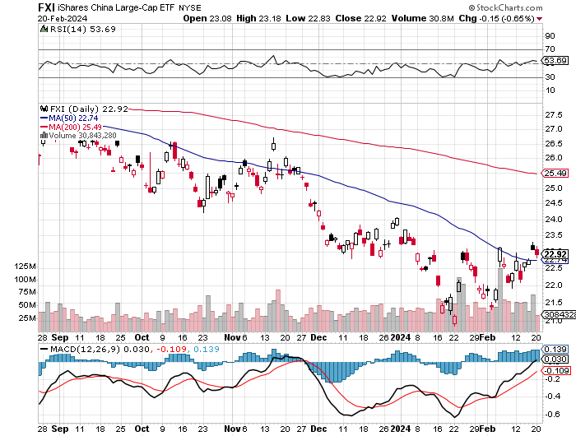
China (FXI)

Slide 23
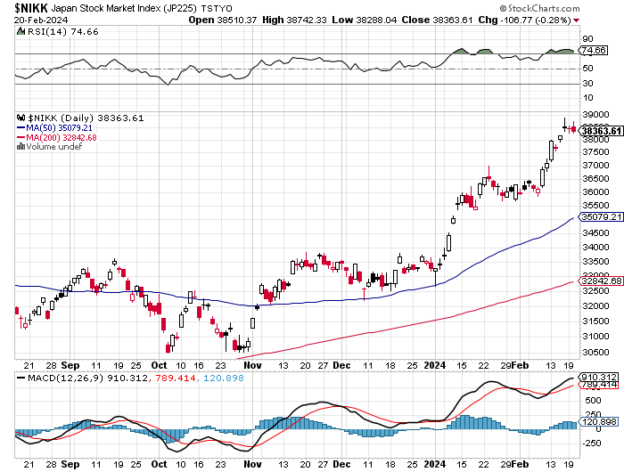
Japan ($NIKK)

Slide 25
THE MAD HEDGE FUND TRADER
The Barbell Portfolio
*75% Big Tech – 2% of US workforce, 25% of market cap and 25% of US earnings 25% Domestic Recovery, including: Railroads, airlines, cruise lines, Couriers, steel companies Banks, commodities Construction Credit Card Companies Hotels, casinos Online Ticket Sales

Slide 26
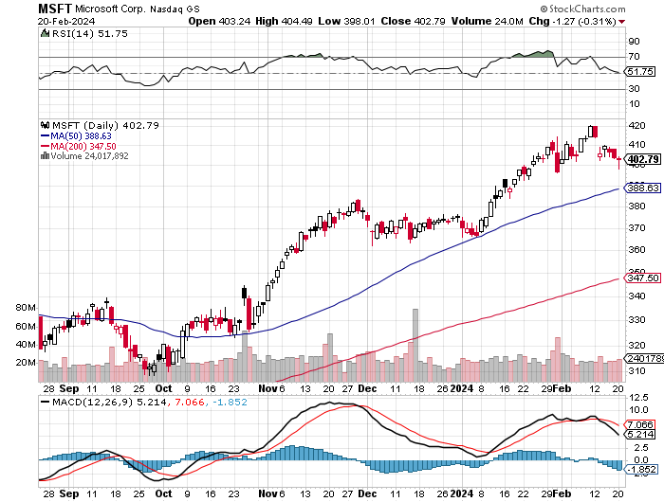
Microsoft (MSFT)- Microsoft Beats Estimates, with the steady growth of its azure cloud business Microsoft Tops $3 Trillion Valuation, cementing its hold on the AI lead. Took profits on long 2/$330-$340 call spread, took profits on long 12/$320-$330 call spread took profits on long 9/$235-$245 call spread, took profits on long 7/$220-$210 call spread, took profits on long 6/$220-$230 call spread, took profits on long 2/$200-$210 bear put spread

Slide 27
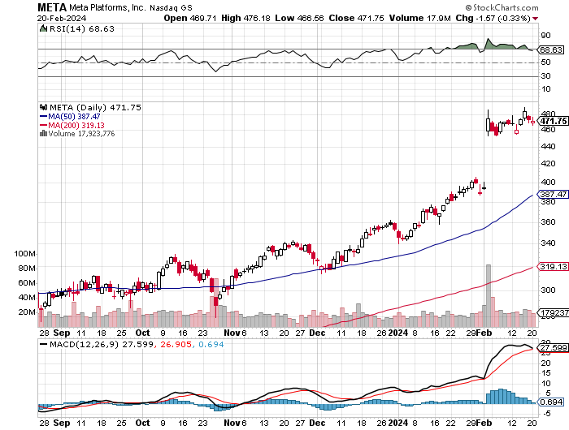
Meta (META) Meta Rockets 21%, on a $50 billion stock buyback and its first ever dividend took profits on Long 9/$290-$300 vertical bear put spread stopped out of Long 9/$190-$200 vertical bear put spread

Slide 28
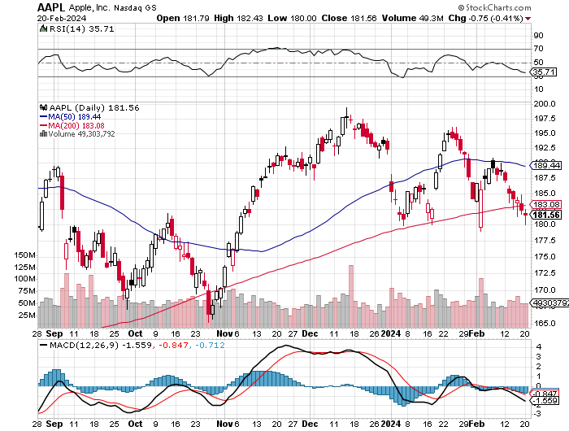
Apple (AAPL) Apple Beats, But Stock Drops 4% took profits on long 1/$145-$155 put spread, Took profits on long 10/$165-$175 put spread took profits on long 6/$155-$165 put spread, stopped out of long 6/$125-135 call spread, took profits on long 6/$110-$120 call spread, took profits on long 2/$180-$190 put spread

Slide 29
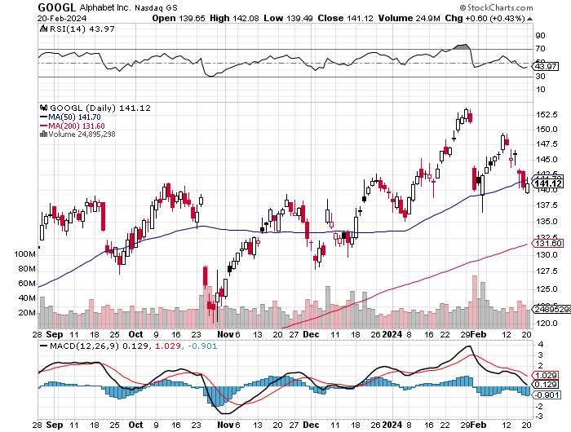
Alphabet (GOOGL) – Google Ramps Up AI Effort Traders Trash Google, down 7%, on the company’s lack of AI specifics in its earnings report took profits on long 12/$110-$120 call spread took profits on long 12/$1,200-$1,230 bull call spread, took profits on long 9/$1,030-$1,080 vertical bull call spread

Slide 30
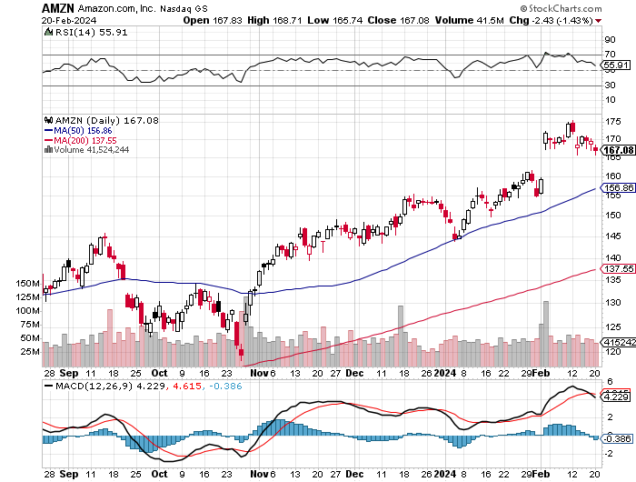
Amazon (AMZN) – Jeff Bezos Sell’s $4 Billion Worth of Amazon Shares took profits on long 2/$130-$135 bull call spread took profits on long 2/$3,400-$3,500 bear put spread, took profits on long 9/$2,800-$2,900 bull call spread

Slide 31
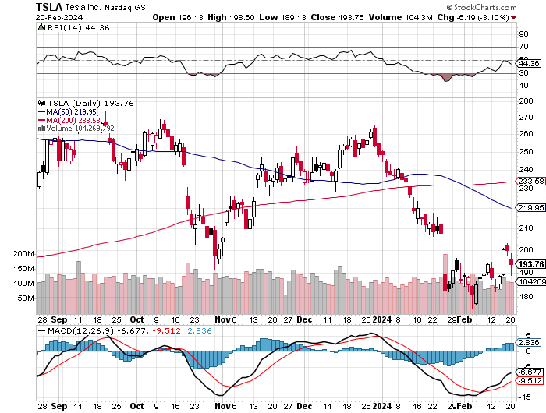
Tesla (TSLA) – The Price War Continues Biden to Ban Chinese EV Car Imports took profits on long 10/$200-$210 call spread took profits on long 6/$120-$130 call spread, stopped out of long 6/$210-$220 put spread took profits on long 5/$110-$120 call spread, took profits on long 5/$220-$230 put spread

Slide 32
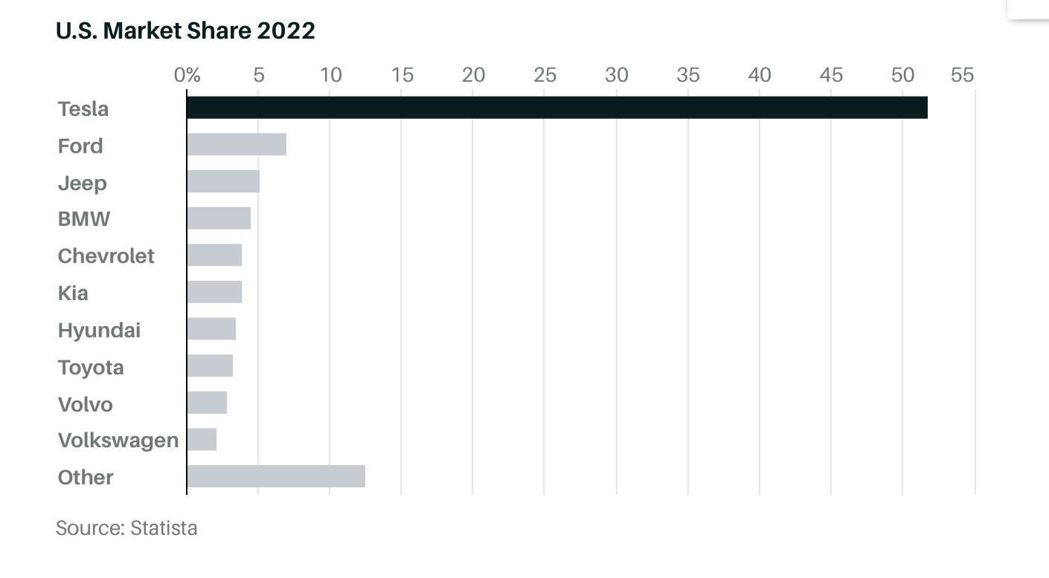

Slide 33
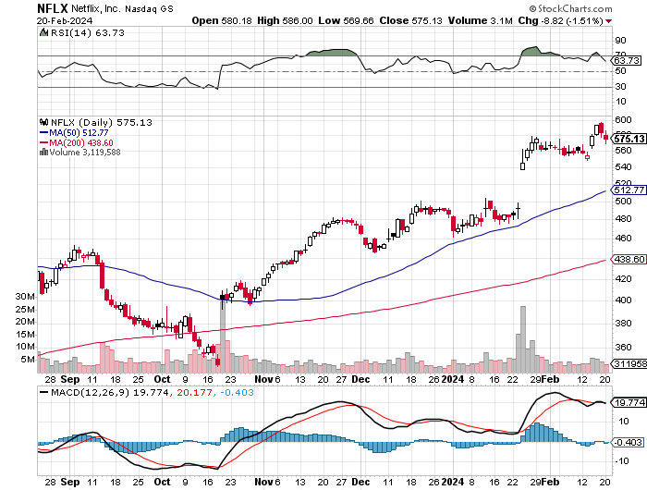
Netflix (NFLX) – Netflix Soars on Big Subscriber Beat, up 8.6% on an add of 13 million new subscribers

Slide 34
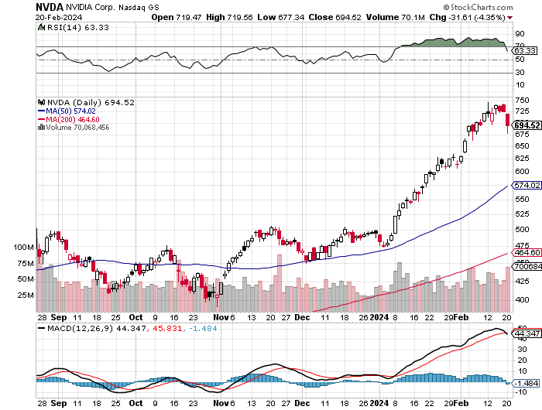
NVIDIA (NVDA) – Double Position-63% Implied on options NVIDIA tops $1.2 trillion now the fourth most valuable company in the US long 3/$600-$610- call spread, took profits on long 2/$350-$360 call spread, took profits on long 2/$360-$370 call spread took profits on long 10/$370-$380 call spread – took profits on long 11/$370-$380 call spread took profits on long 3/$260-$270 put spread, took profits on long 10/$95-$100 call spread took profits on long 7/$120-$130 call spread, took profits on long 6/$120-$130 call spread

Slide 35
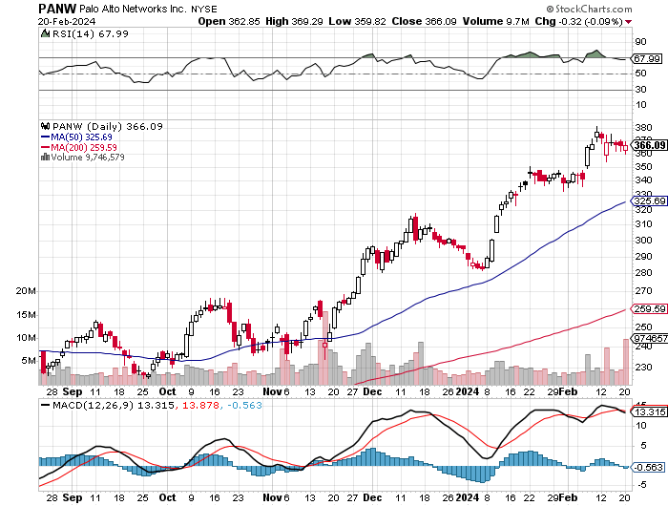
Palo Alto Networks (PANW)- Hacking never goes out of fashion Ransome Attacks Topped $1 Billion in 2023 took profits on long 2/$260-$270 call spread, took profits on long 10/$130-$140 call spread

Slide 36
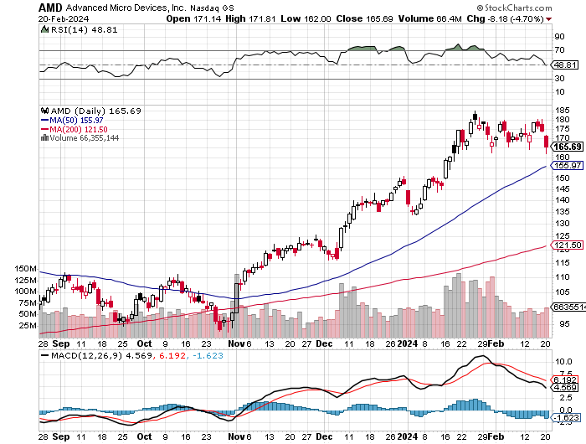
Advanced Micro Devices (AMD)- Recession fears programable logic devices took profits on long 2/$75-$80 call spread

Slide 37
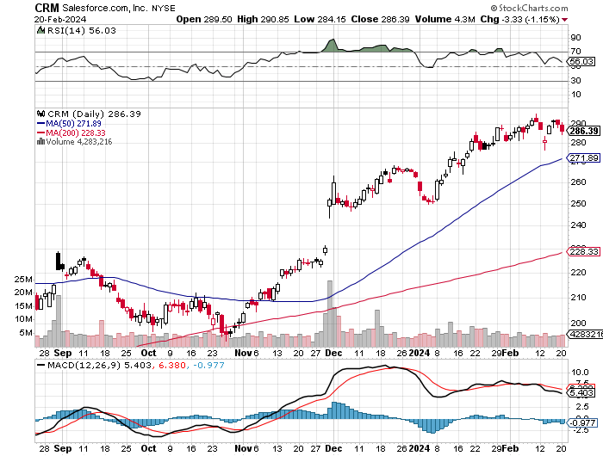
Salesforce (CRM)- Massive Online Migration Salesforce Soars 16%, on better-than-expected guidance took profits on long 12/$185-$195 call spread took profits on long 9/$125-$130 vertical bull call spread took profits on long 8/$125-$130 vertical bull call spread

Slide 38
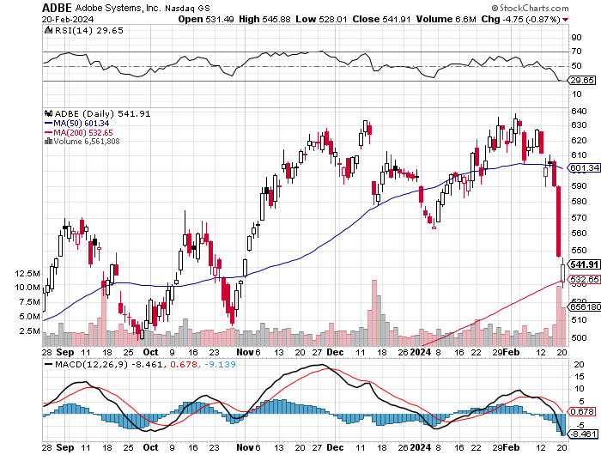
Adobe (ADBE)- Cloud play The Quality Non-China tech play

Slide 39
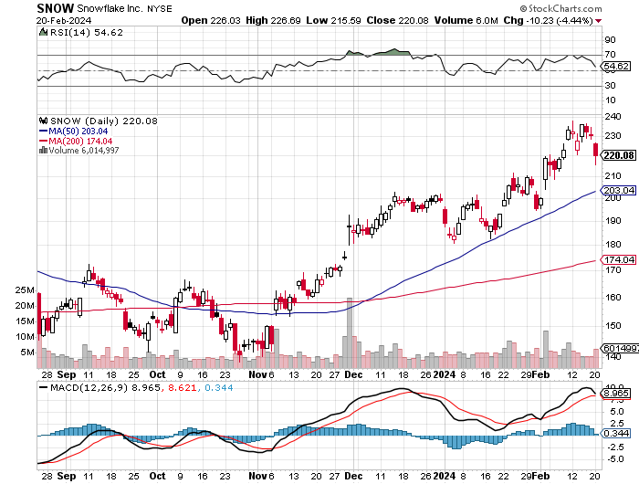
Snowflake (SNOW)- Blockbuster AI Earnings took profits on long 12/$135-$140 call spread

Slide 40
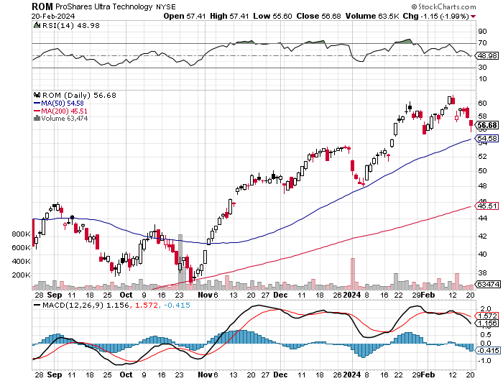
ProShares Ultra Technology ETF (ROM) – 2X Long Technology ETF took profits on long 10/$62-65 call spread

Slide 41
The Second Half of the Barbell
*Bets on a domestic recovery in 2022 Q4 *Upside potential in 2024 far greater than tech *Some of these have not moved for 5 or 10 years *Focuses on economically sensitive cyclical industries *Makes a great counterweight to high-growth technology *We could spend all of next ten years rotating between the two groups

Slide 42
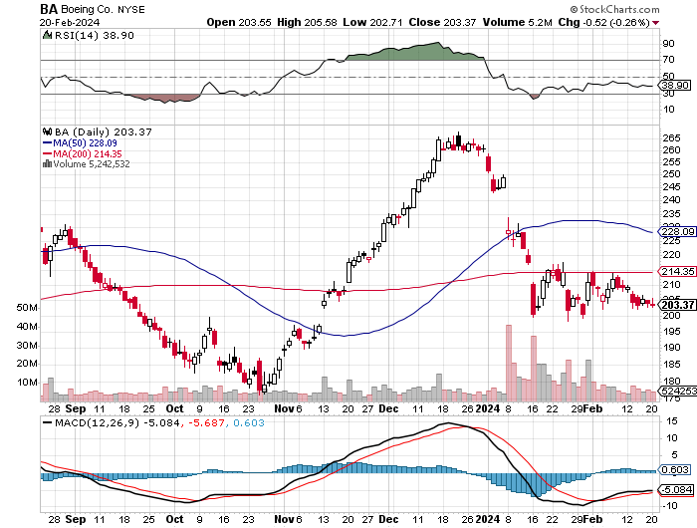
Boeing (BA) – Boeing is Back in China, its largest customer stopped out of long 2/$190-$200 call spread, took profits on long 5/$17-$175 call spread

Slide 43
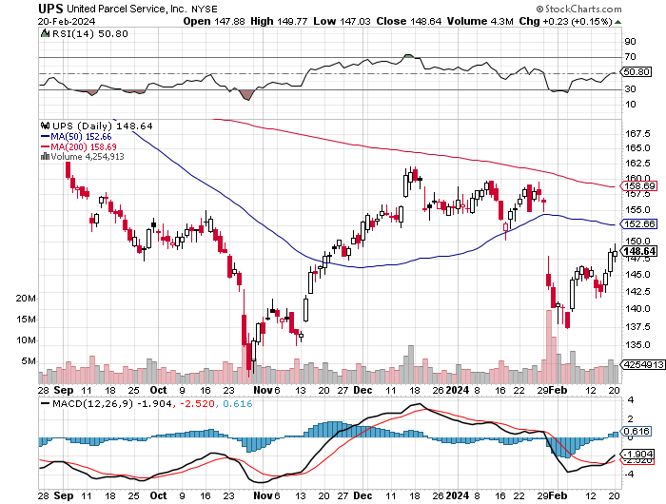
Package Delivery- United Parcel Service (UPS) – strike averted took profits on long 11/$130-$140 call spread

Slide 44
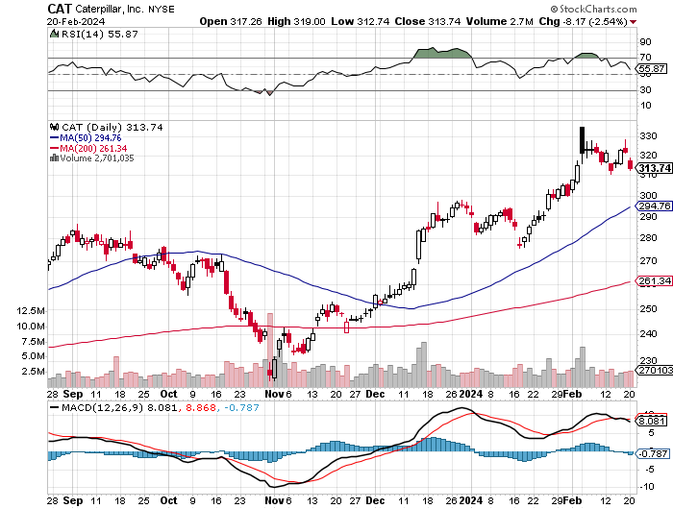
Caterpillar (CAT)- Ag + Infrastructure + Housing long 12/$220-$230 calls – expires in 2 trading days took profits on long 12/$145-$150 call spread took profits on long 11/$125-$135 call spread

Slide 45
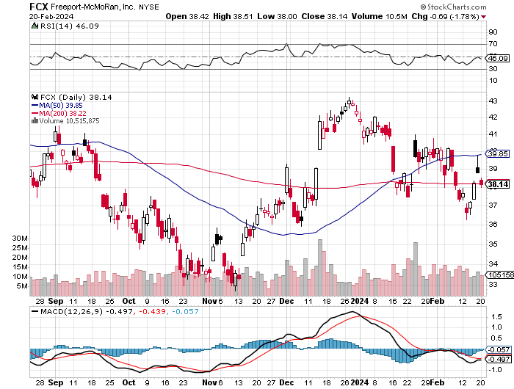
Freeport McMoRan - (FCX)- Coming Copper Crisis took profits on long 6/$32-$35 call spread took profits on long 4/$30-$33 call spread, took profits on long 10/$20-$23 call spread

Slide 46
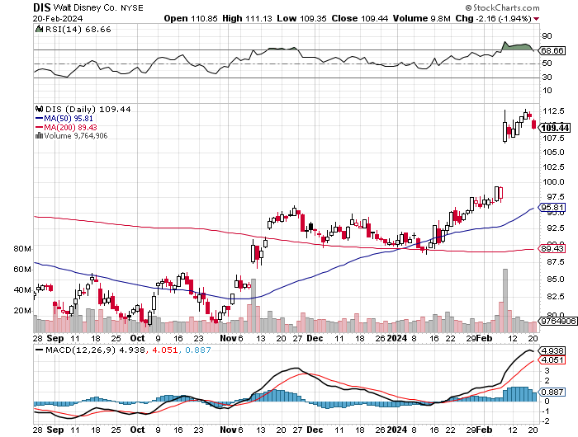
Walt Disney (DIS) -Disney Beats Disney Buys Stake Fortnight, on of the leading online games

Slide 47
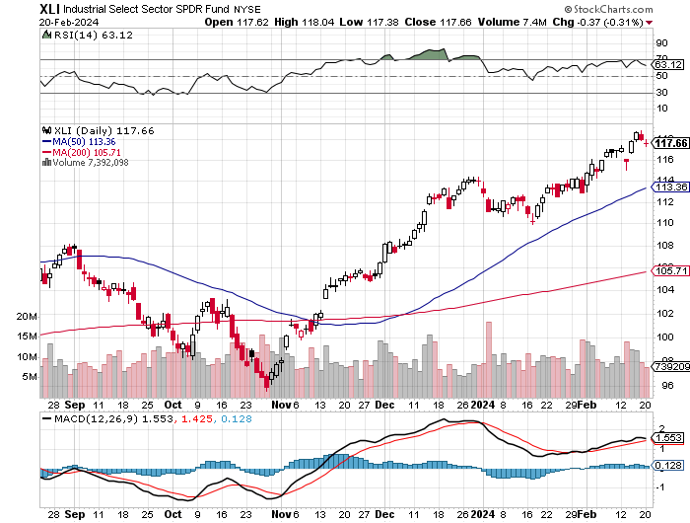
Industrials Sector SPDR (XLI)- (GE), (MMM), (UNP), (UTX), (BA), (HON)

Slide 48
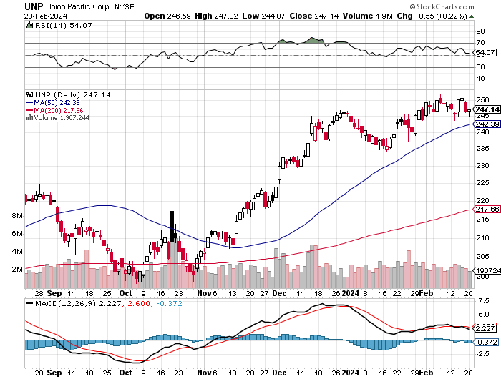
Union Pacific RR (UNP)- Big Stuff to Ship took profits on long 5/$200-$210 call spread took profits on 11/$150-$160 call spread

Slide 49
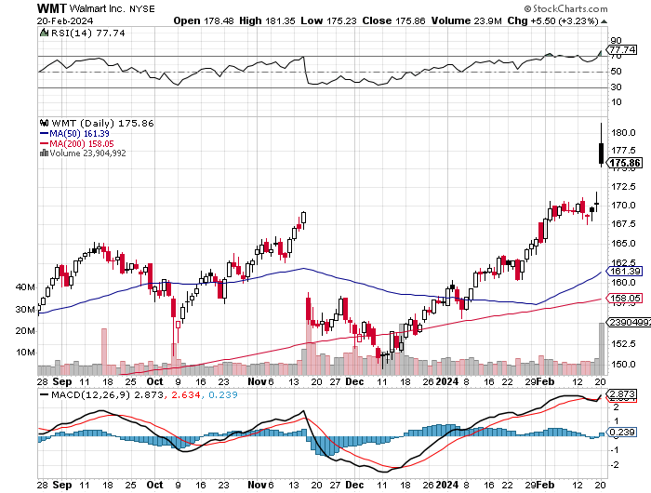
Wal-Mart (WMT)- took profit on Long 11/$125-$130 bear put spread took profit on Long 10/$119-$121 bear put spread took profits on Long 8/$114-$117 bear put spread

Slide 50
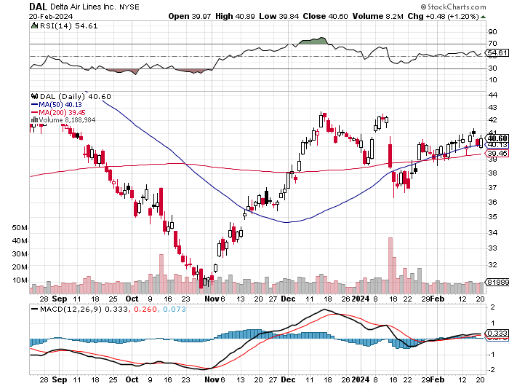
Delta Airlines (DAL) – Travel is Back! Delta Posts Strong Earnings on Robust international travel stopped out of long 2/$35-$38 call spread

Slide 51
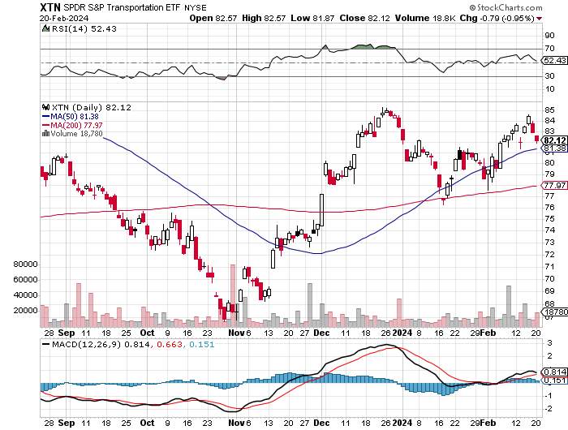
Transports Sector SPDR (XTN)- Worst Hit Sector (ALGT), (ALK), (JBLU), (LUV), (CHRW), (DAL)

Slide 52
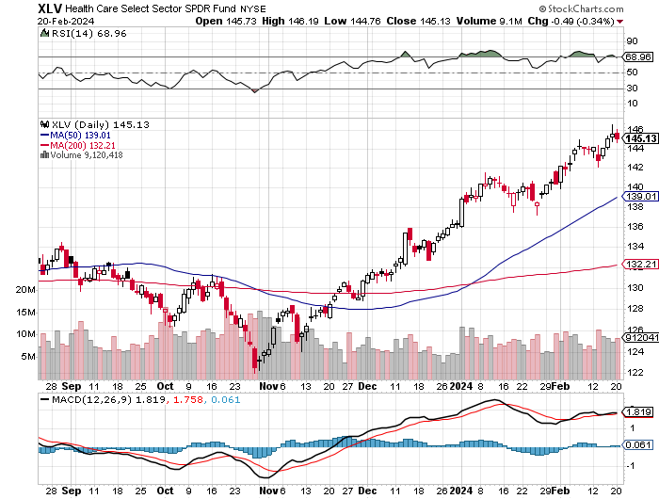
Health Care Sector (XLV) (JNJ), (PFE), (MRK), (GILD), (ACT), (AMGN)

Slide 53
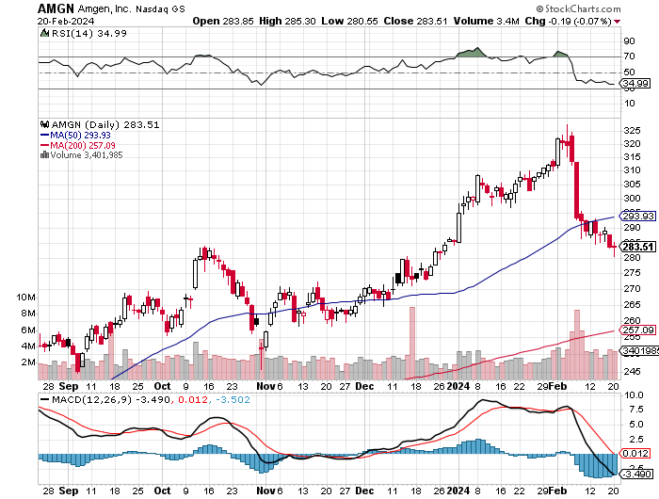
Amgen (AMGN) took profits on long 11/$185-$200 bull call spread

Slide 54
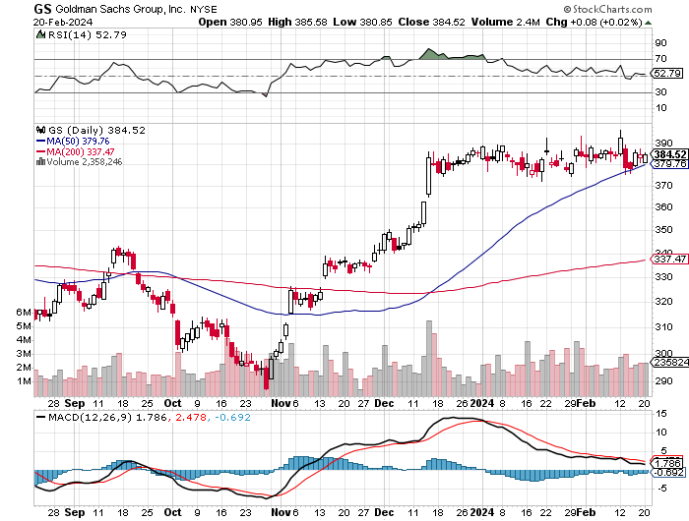
Goldman Sachs (GS) – Earnings Down but Less than Expected took profits 12/$330-$350 call spread took profits 11/$330-$350 call spread stop loss on long 11/$385-$395 call spreads

Slide 55
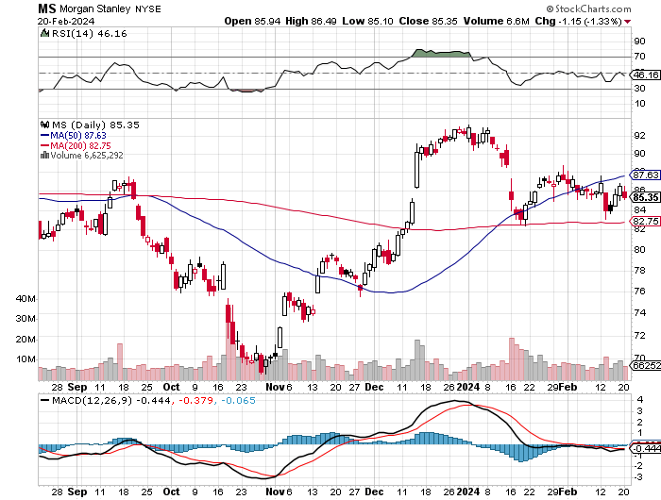
Morgan Stanley (MS) – Highest Capital ratio net of mark to market CEO to Step Down in a Year took profits on long 4/$65-$70 call spread

Slide 56
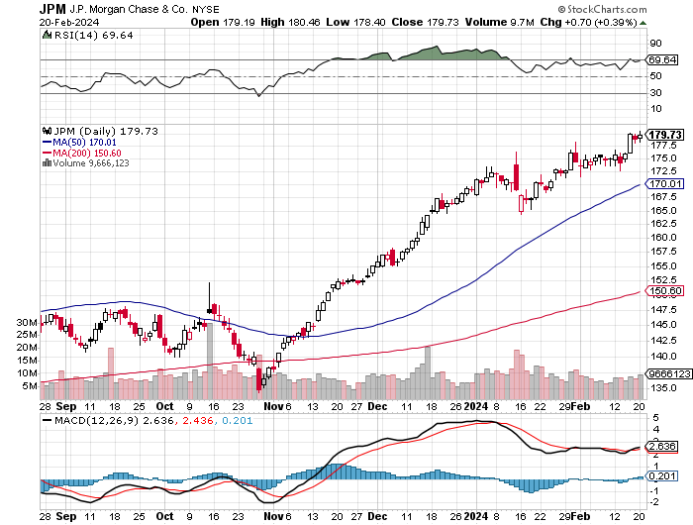
JP Morgan Chase (JPM) – Monster Earnings Surprise took profits on long 4/$105-$115 call spread

Slide 57
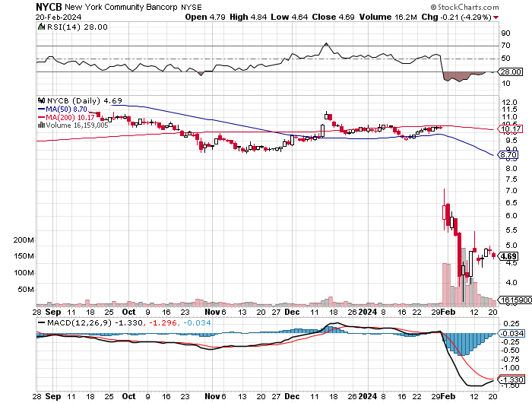
New York Community Bank (NYCB) – Dividend Cut -62% took profits on long 4/$105-$115 call spread

Slide 58
Bank of America (BAC) – Bank of America Rips, on a great earnings report took profits on long 4/$20-$23 call spread

Slide 59
Citigroup (C) – took profits on long 4/$30-$35 call spread

Slide 60
Charles Schwab (SCHW) – LEAPS up 67% in three months took profits on long 4/$30-$35 call spread

Slide 61
Interactive Brokers (IBKR) – Best Risk Control took profits on long 4/$60-$65 call spread

Slide 62
SPDR Metals & Mining ETF (XME) – long 2/$28-$30 call spread

Slide 63
Blackrock (BLK)-Asset Collection Boom took profits on long 3/$770-$790 call spread took profits on long 3/$310-$340 call spread

Slide 64
Visa (V) – Inflation boost Transaction grew by an inflationary 10% back to pre-pandemic levels took profits on long 2/$240-$250 bull call spread took profits on long 10/$160-$170 bull call spread, took profits on long 6/$150-$160 bull call spread

Slide 65
Consumer Discretionary SPDR (XLY) (DIS), (AMZN), (HD), (CMCSA), (MCD), (SBUX)

Slide 66
Berkshire Hathaway (BRKB)- Natural Barbell Berkshire Hathaway Knocks it Out of the Park, with a 41% gain in operating earnings took profits on long 12/$320-$330 call spread took profits on long 4/$260-$270 call spread, took profits on long 1/$290-$300 call spread took profits on long 10/$220-$230 call spread, took profits on long 7/$220-$230 call spread took profits on long 7/$220-$230 call spread, took profits on long 6/$260-$270 call spread

Slide 67
Europe Hedged Equity (HEDJ)-

Slide 68
Japan (DXJ)-

Slide 69
Emerging Markets (EEM) - Pro trade, Weak Dollar, Long Recovery Play Traders are Lining up for a Big Emerging Market Bet. Falling US interest rates will bring a weak US dollar and runaway bull markets in most emerging markets, which have remained unchanged for more than a decade

Slide 71
Bonds – Retesting Lows
*Reheating of US economy knocks the wind out of bonds, possibly delaying interest rate cuts *90-Day T-bills at 5.47% still offer attractive alternative *US Budget Funded only until March 8 *IRS Finds $834 Billion, over the next decade through enhanced enforcement focused on tax dodging billionaires *Markets are discounting three cuts Starting in May in 2024 more likely *Junk bond ETF’s (JNK) and (HYG) are holding up extremely well with a 6.37% yield and 18 month high *I’m looking for an $18-$28 point gain in (TLT) during 2024 with interest *Buy (TLT) on the dip.

Slide 72
Treasury ETF (TLT) – On Fire Long 2/$90-$93 call spread, took profits on long 12/$95-$98 put spread took profits on long 12/$79-$82 call spread, took profits on long 11/$76-79 call spread,

Slide 73
Ten Year Treasury Yield ($TNX) – 4.10%

Slide 74
Junk Bonds (JNK) 7.33% Yield

Slide 75
Municipal Bonds (MUB) 3.07% Yield-

Slide 76
Emerging Market Debt (ELD) 6.35% Yield-

Slide 77
2X Short Treasuries (TBT)-Out of Favor

Slide 78
Anally Capital Management (NLY) – Leveraged REIT Play Yield 13.63% took profits on long 12/$15-$16 call spread

Slide 80
Foreign Currencies – On Top Again
*US Dollar Hits Three Month High, on the hot CPI *You need a falling CPI to get a weak buck. *The Euro plunged to $1.07, the British pound to $1.25, the Australian dollar to 65 cents, and the Japanese yen to ¥151 *A dollar rally could last a couple of months, so a new currency entry point is approaching *However, eventual falling interest rates guarantee a falling dollar for 2024

Slide 81
THE MAD HEDGE FUND TRADER
Australian Dollar (FXA) - Major Long-Term Bottom is In Targeting Parity – A call option on a global synchronized recovery
1:1
BUY

Slide 82
Japanese Yen (FXY)

Slide 83
Euro (FXE)-
2023 Target 25%

Slide 84
British Pound (FXB)-
2023 Target 15%

Slide 85
Emerging Market Currencies (CEW)
2023 Target 40%

Slide 87
Energy & Commodities –New Natural Gas Lows
*Slow Chinese growth still drags on the global oil market *Natural gas hits new 20-year lows at $1.61 MM BTU *Over production, warm weather, and rail problems impeding exports are the cause *Saudi Production will be capped at 12 million barrels indefinitely *Electrification of the US economy will continue to be a driving theme. *There is a “BUY” setting up here in energy when the global economy reaccelerates on a lower interest rate world. Watch (XOM) and (OXY).

Slide 88
Oil-($WTIC)

Slide 89
United States Oil Fund (USO)

Slide 90
Energy Select Sector SPDR (XLE)-No Performance! (XOM), (CVX), (SLB), (KMI), (EOG), (COP)

Slide 91
ExxonMobile (XOM)- Exxon Moves Big into Lithium, with the construction of a major mining operation in Arkansas stopped out of Long 12/$97-$100 call spread took profits on long 12/$120-$125 put spread

Slide 92
Occidental Petroleum (OXY)- Buffet’s a Buyer took profits on long 2/$55-$60 call spread took profits on long 12/$77.50-$82.50 put spread

Slide 93
Natural Gas (UNG) – Free Fall on Warm Winter took profits on Long January 2025 $7-8 Call Spread LEAPS

Slide 94
Freeport McMoRan (FCX) - Codelco Sees Profit Slump, the world’s largest copper producer based in Chile

Slide 95
Cameco (CCJ) – Global Uranium Renaissance Uranium Goes Nuclear, with yellow cake prices up 45% since May long 12/$35-$38 call spread – expires in 12 trading days took profits on long 5/$20-$23 bull call spread

Slide 97
Precious Metals – Interest Rate Hit
*Gold is taken down on rising interest rates *Gold needs a return of falling interest rates to resume rally *Miners are lagging gold performance but will play catch up *Investors are picking up gold as a hedge for 2024 volatility *Gold headed for $3,000 by 2025, but back off first from new all-time highs *Silver is the better play with a higher beta *Russia and China are also stockpiling gold to sidestep international sanctions

Slide 98
Gold (GLD) - Deflation call took profits on long 5/$165-$170 bull call spread

Slide 99
Market Vectors Gold Miners ETF- (GDX) –

Slide 100
Barrick Gold (GOLD) took profit on long 1/$15.50-$16.50 call spread

Slide 101
Newmont Mining- (NEM)- took profits on long $55-60 call spread

Slide 102
Silver- (SLV)- took profits on long 11/$19-$20 call spread

Slide 103
Silver Miners - (SIL)-

Slide 104
Wheaton Precious Metals - (WPM)- took profits on long 1/$36-$39 call spread

Slide 105
Platinum- (PPLT)- 556,000-ounce shortage this year took profits on long 1/$36-$39 call spread

Slide 107
Real Estate – Extreme Shortage of Supply
*Home Mortgage Interest Rates Return to 7.0%, in the wake of the bond markets four-point meltdown *S&P Case Shiller Falls, in November for the first time in nine months *This was back when mortgage rates was peaking at 8.0% *New Homes Sales Recover, on a falling interest rate push, up 8.0% to 664,000 *Sales increased 4.4% on a year-on-year basis in December. *Tight supply and still-strong demand have kept pressure on home prices, which not only continue to hit new highs *No one wants to give up their 2.75% mortgages so no one is selling

Slide 108
S&P Case Shiller Turns Hot S&P Case Shiller Rises to +4.60% YOY in October, with its National Home Price Index Detroit gained +8.2%, San Diego +8.0%, and New York +7.1%.

Slide 109
Crown Castle International (CCI) – 5.45% yielding 5G cell phone tower REIT Eliot Management Pushes up stock with activist bid

Slide 110
US Home Construction Index (ITB) (DHI), (LEN), (PHM), (TOL), (NVR)

Slide 112
Trade Sheet- So What Do We Do About All This?
*Stocks – buy any dips *Bonds – buy dips *Commodities-buy dips *Currencies- sell dollar rallies, buy currencies *Precious Metals – buy dips *Energy – buy dips *Volatility - buy $12 *Real estate – buy dips

Slide 114
Next Strategy Webinar 12:00 EST Wednesday, March 6 from Silicon Valley email me questions at support@madhedgefundtrader.com
Good Luck and Good Trading!
Notes:
*

