Slide 1
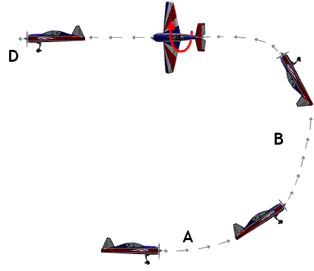
The Mad Hedge Fund Trader “Reversal of Fortune”
With John Thomas Incline Village, NV June 12, 2024 www.madhedgefundtrader.com
Notes:
*

Slide 2
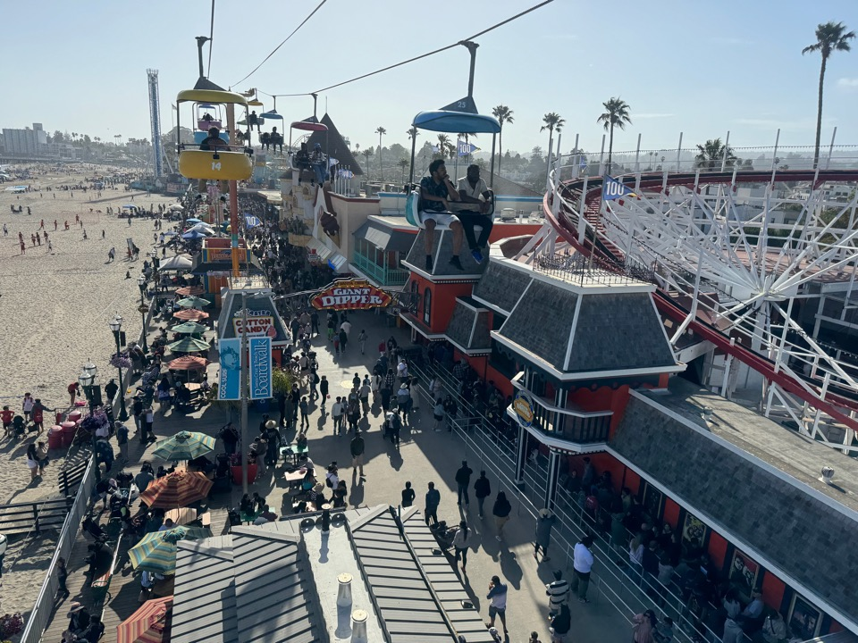

Slide 3
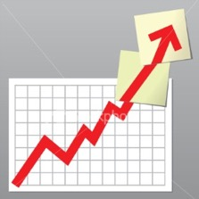
Trade Alert Performance New All-Time Highs!
*January -4.28% Final *July +0.44% Final *February +7.42% Final *August -4.70% Final *March +6.23% Final *September +00% Final *April +5.24% Final *October -5.37% Final *May +3.74% Final *November +15.37 Final *June +1.94% MTD *December -2.27% Final *2024 YTD +20.31%, versus +12.31% for the S&P 500 and +696.94% since inception *Versus 84.63% for all of 2022 *Versus 79.79% for all of 2023 *Average annualized return of +51.53% for 16 years

Slide 4
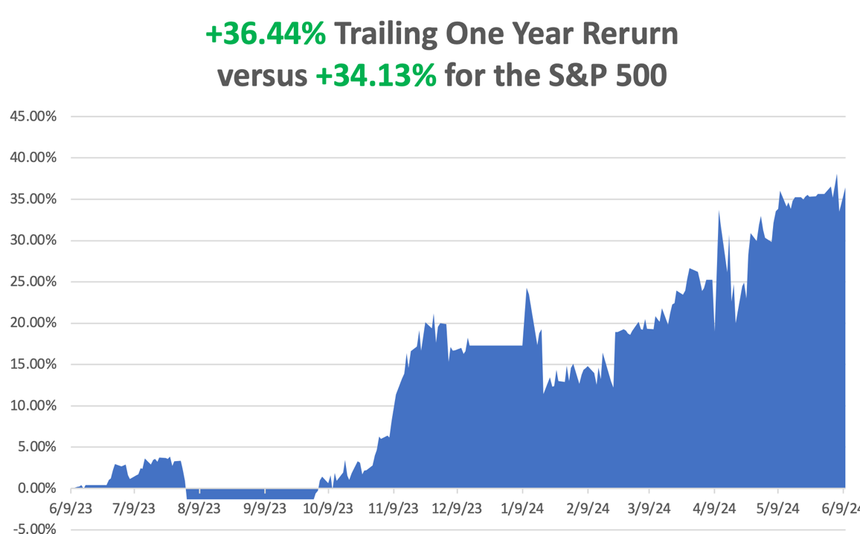

Slide 5
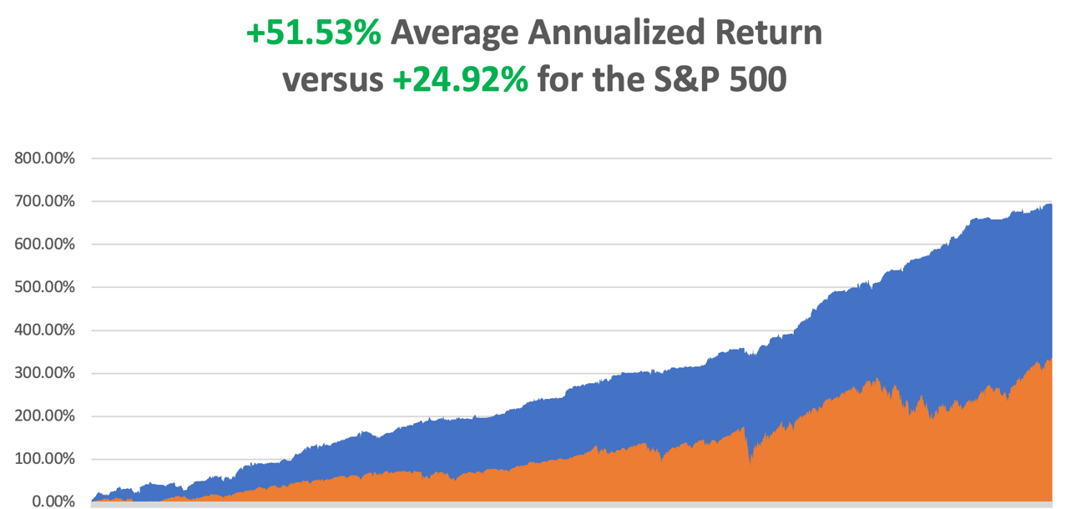

Slide 6
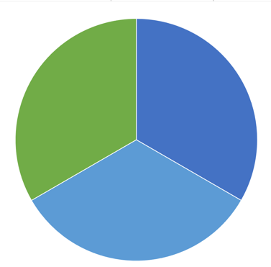
Portfolio Review – Aggressively Neutral 10% risk on, long, 20% risk off, 70% cash
Risk On
(AMZN) $160-$170 call spread | 10.00%
Risk Off
(GLD) $200-$205 call spread | -10.00%
(SLV) $23-$25 call spread | -10.00%
Total Net Position | -10.00%
Total Aggregate Position | 30.00%
Expiration Value +20.31%

Slide 7
The Method to My Madness
*Now that NVIDIA has split, what’s next? *The next focus is on the first interest rate cut in five years, no matter how long it takes *The general downside is limited to 5%-8% with $8 trillion in cash on the sidelines and a further $26.8 trillion in short-term US treasury Bills *Technology stocks won’t crash, just have a sideways “time” correction *All economic data is globally slowing, including the US, with the only good economy in the world. The May Nonfarm Payroll Report was an anomaly. *Interest rates are higher for longer, but September is back on the plate in view of recent date releases *Buy stocks and bonds on dips

Slide 8
The Global Economy – Flip Flopping
*May Nonfarm Payroll Report Comes in Hot, at 272,000, double expectations *The Headline Unemployment Rate reached 4.0%, a 2 1/2 year high *Job gains were concentrated in health care, government, and leisure and hospitality, consistent with recent trends *The Fed’s Favorite Inflation Gauge Cools by 0.2% in April, with the PCE, or the Personal Consumer Inflation Expectations Price Index *ADP Private Payrolls Drops to Only 152,000, a sharp drop from last month’s 188,000 *JOLTS Job Openings Report Dive in April, down 296,000 to 8.059 million, a three-year low *Europe Cuts Interest Rates, for the first time in five years *Money Supply Rises for the First Time in More than a Year *

Slide 9
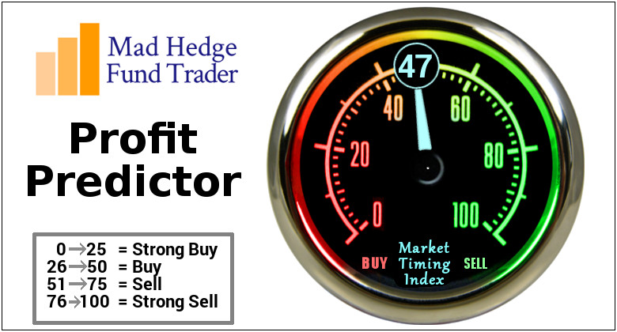
The Mad Hedge Profit Predictor Market Timing Index – Approaching low end of historic range An artificial intelligence driven algorithm that analyzes 30 different economic, technical, and momentum driven indicators

Slide 10
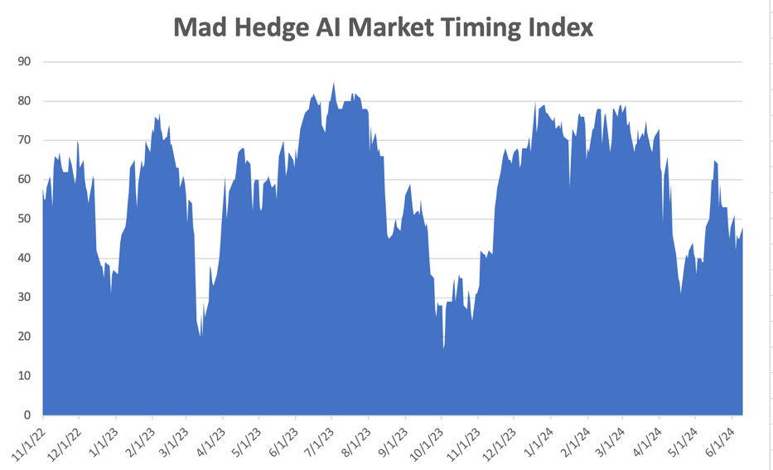
NEUTRAL Territory
SELL
NOW
BUY

Slide 11
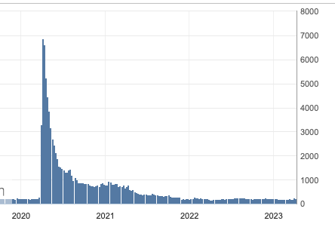
Weekly Jobless Claims – Rising 229,000 +9,000

Slide 12
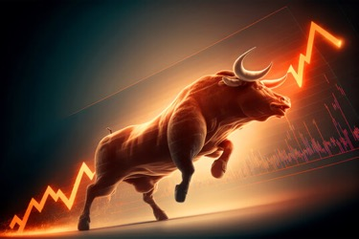
Stocks – The Bull Lives
*Goldman Sachs Sees “Wall of Money” Flooding the stock market this summer *Since 1928, the first 15 days of July have been the best two-week trading period of the year for equities, and they tend to fade after July 17 *Cruise lines are suddenly offering great deals because more vessels are flooding into popular Caribbean and Alaskan destinations as they reroute ships away from Red Sea destinations due to the ongoing conflict between Israel and Hamas *AMD Launches New AI Chips, and detailed its plan to develop AI chips over the next two years in a bid to challenge industry leader Nvidia *Roaring Kitty is Back, after publicizing a $289 million long position in GameStop (GME). Avoid (GME) *American Airlines Gets Slaughtered, down 15% yesterday, and will slash its capacity growth in the second half of the year

Slide 13
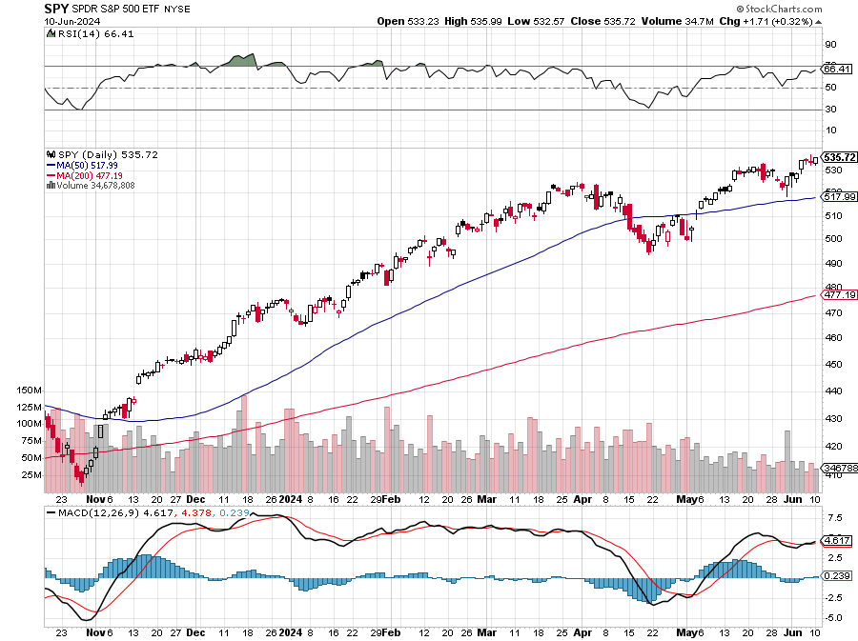
S&P 500 – Upside Breakout Here
Yearend Target $600 +25%
$495 -6.4% 1st support

Slide 14
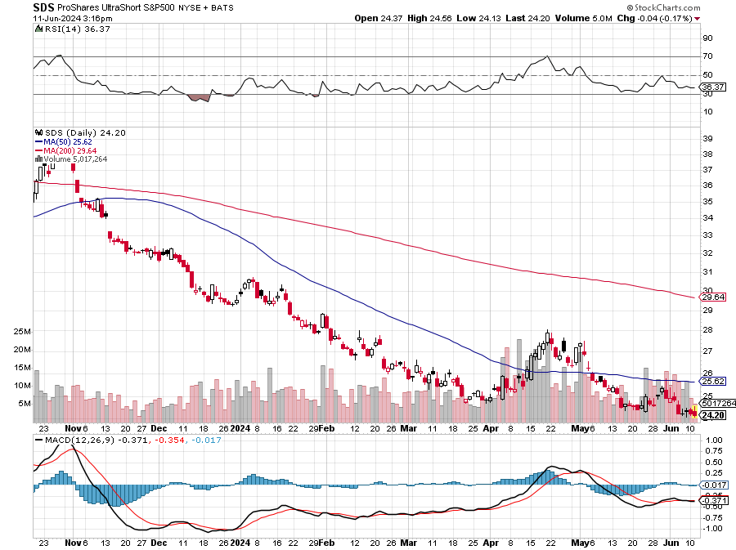
ProShares Ultra Short S&P 500 (SDS)- a great hedge for long stocks and bonds long 2X position has a hedge against longs and bond shorts

Slide 15
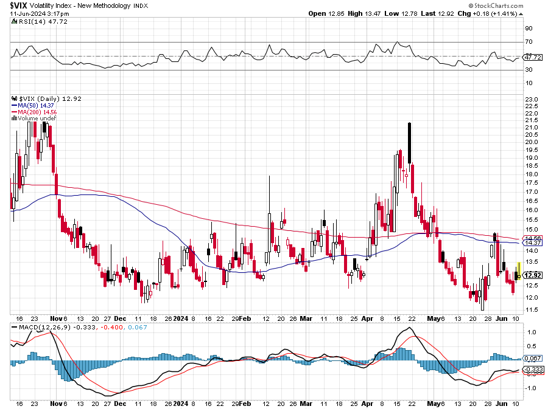
(VIX) – Bargain of the Century

Slide 16
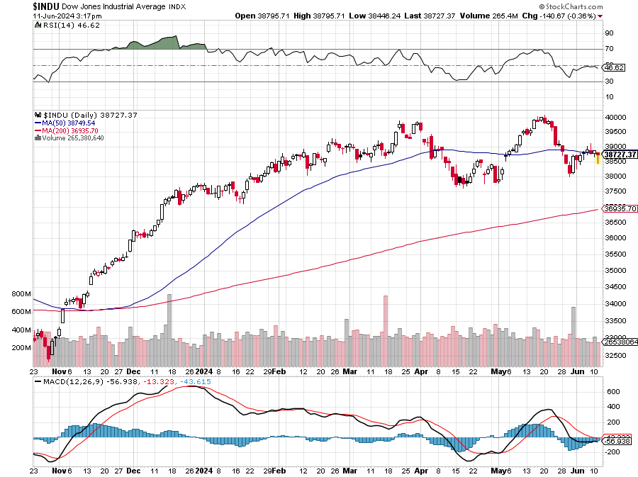
Dow Average ($INDU)-

Slide 17
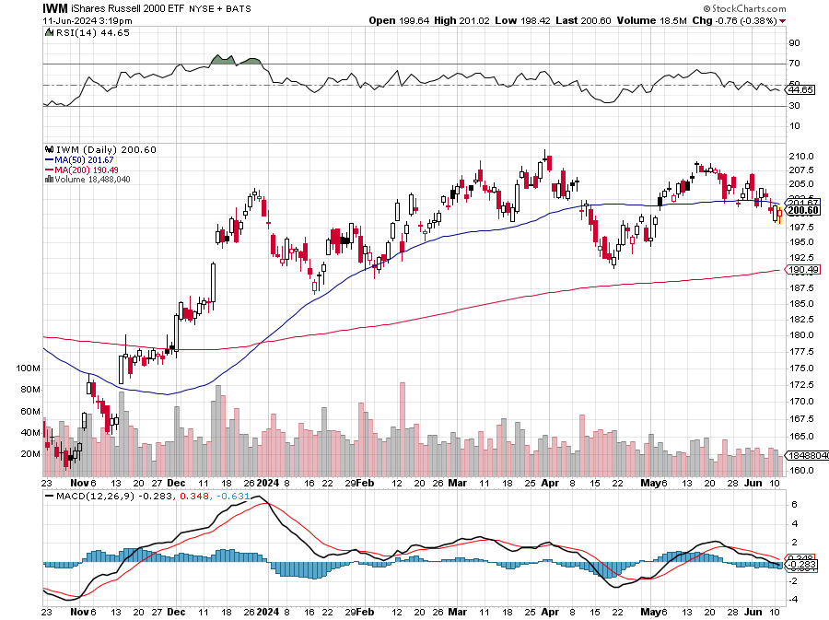
Russell 2000 (IWM)- took profits on Long 10/$137-$142 vertical bull call spread took profits on Long 10/$153-$156 vertical bear put spread

Slide 18
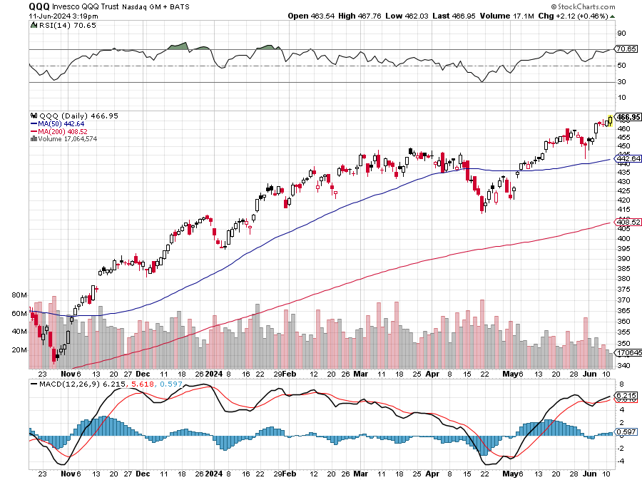
NASDAQ (QQQ) – took profits on Long 5/$335-$345 put spread took profits on long (QQQ) 1/$290-$300 put spread, took profits on long (QQQ) 4/$330-$335 put spread took profits on long (QQQ) 3/$340-$345 put spread, covered long (QQQ) $325-$330 put spread

Slide 19
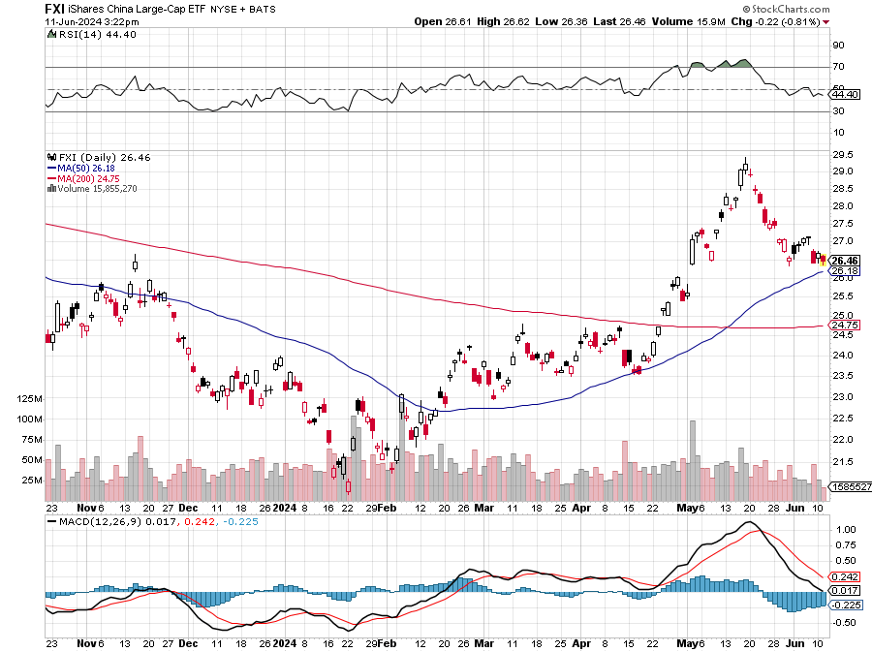
China (FXI)

Slide 20
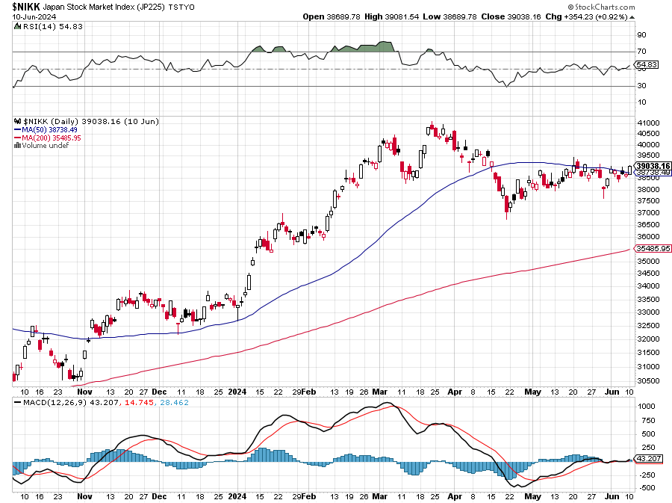
Japan ($NIKK)

Slide 21
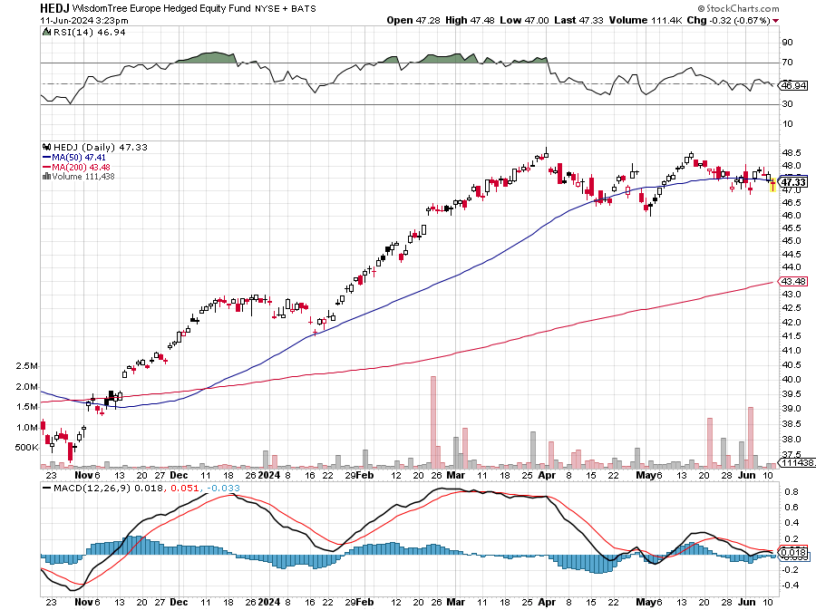
Europe Hedged Equity (HEDJ)-

Slide 22
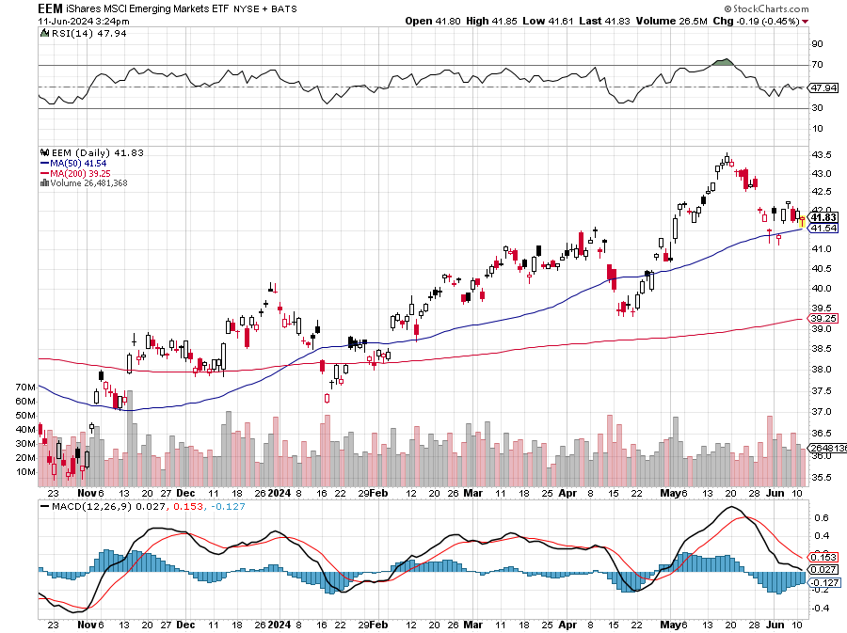
Emerging Markets (EEM) - Pro trade, Weak Dollar, Long Recovery Play Traders are Lining up for a Big Emerging Market Bet. Falling US interest rates will bring a weak US dollar and runaway bull markets in most emerging markets, which have remained unchanged for more than a decade

Slide 23
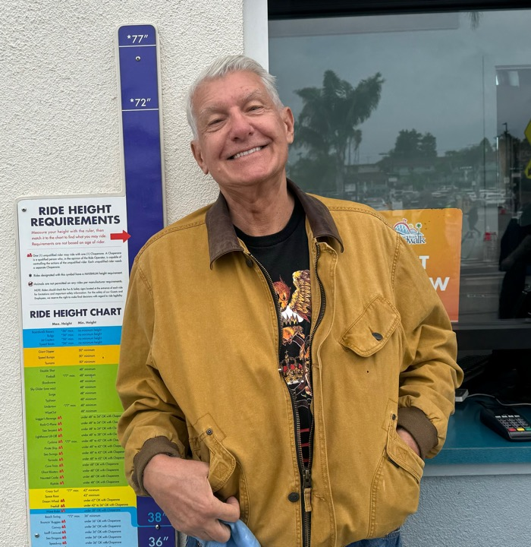

Slide 24
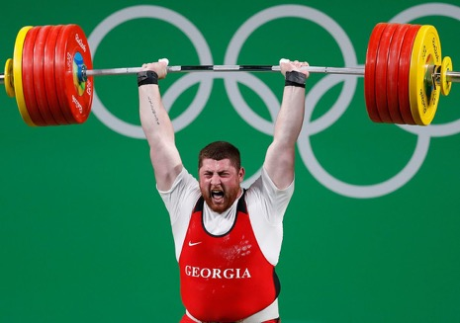
THE MAD HEDGE FUND TRADER
The Barbell Portfolio
*75% Big Tech – 2% of US workforce, 25% of market cap and 25% of US earnings 25% Domestic Recovery, including: Railroads, airlines, cruise lines, Couriers, steel companies Banks, commodities Construction Credit Card Companies Hotels, casinos Online Ticket Sales

Slide 25
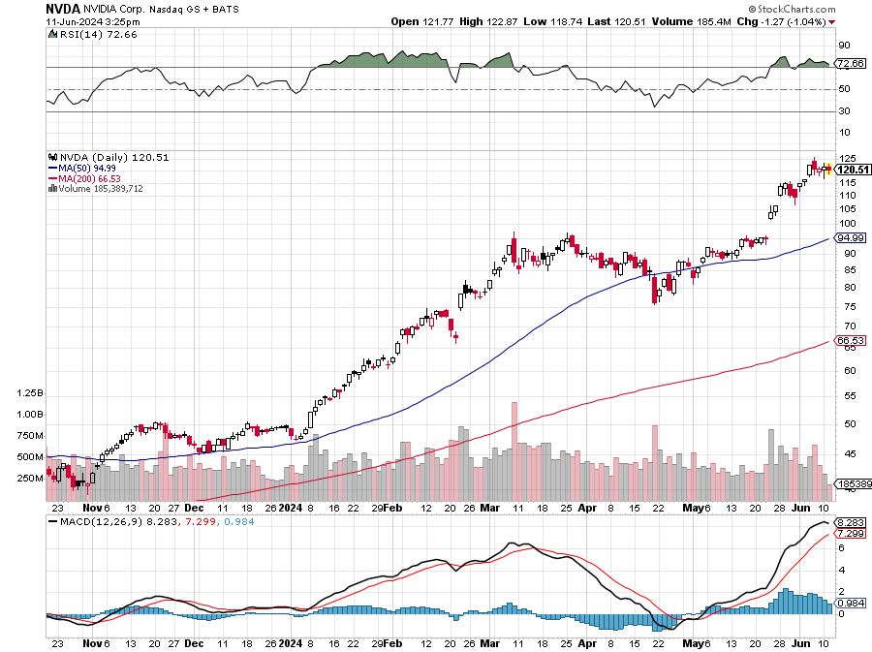
NVIDIA (NVDA) – Blowout Top At $3.1 trillion (NVDA) is the largest publicly traded company in the world took profits on long 5/980-$990 put spread stopped out of long 5/960-$970 put spread took profits on long 5/710-$720 call spread, stopped out of long 5/740-$750 call spread, took profits on long 3/$600-$610, took profits on long 3/$600-$610

Slide 26
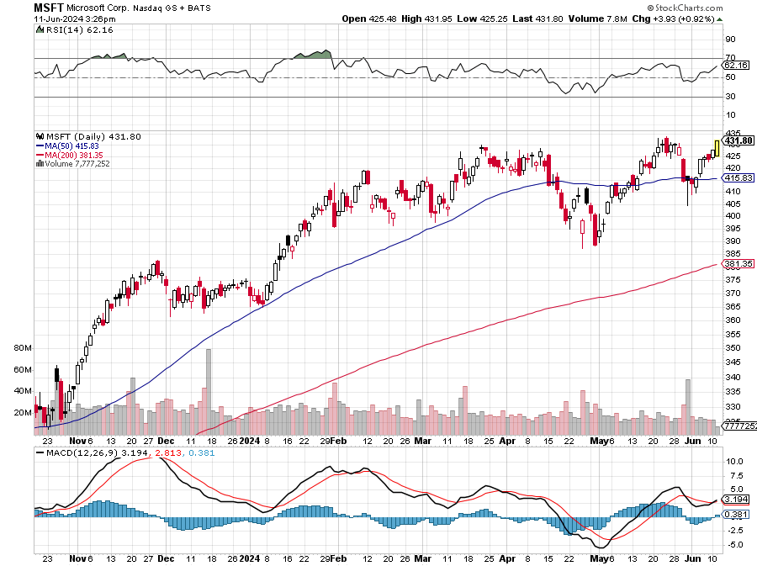
Microsoft (MSFT)- Microsoft Beats Estimates, with the steady growth of its azure cloud business Microsoft Holds Developer Conference aimed at AI Products took profits on long 5/$430-$440 put spread Took profits on long 2/$330-$340 call spread, took profits on long 12/$320-$330 call spread took profits on long 9/$235-$245 call spread, took profits on long 7/$220-$210 call spread, took profits on long 6/$220-$230 call spread, took profits on long 2/$200-$210 bear put spread

Slide 27
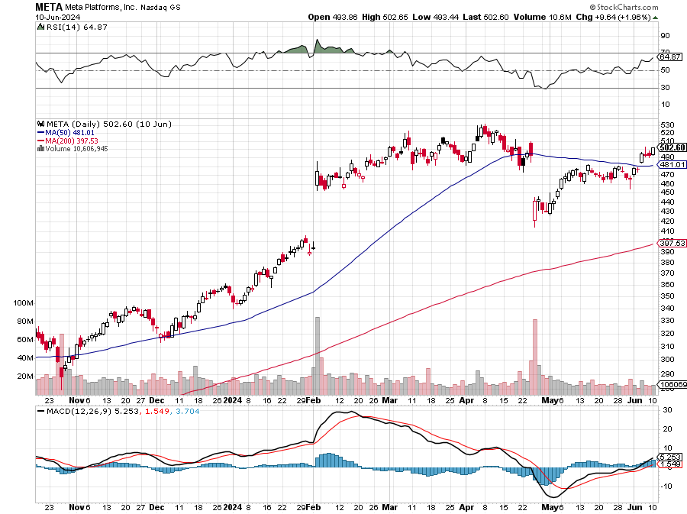
Meta (META) Announces Partnership with Google took profits on Long 5/$360-$370 vertical bull call spread, took profits on Long 9/$290-$300 vertical bear put spread stopped out of Long 9/$190-$200 vertical bear put spread

Slide 28
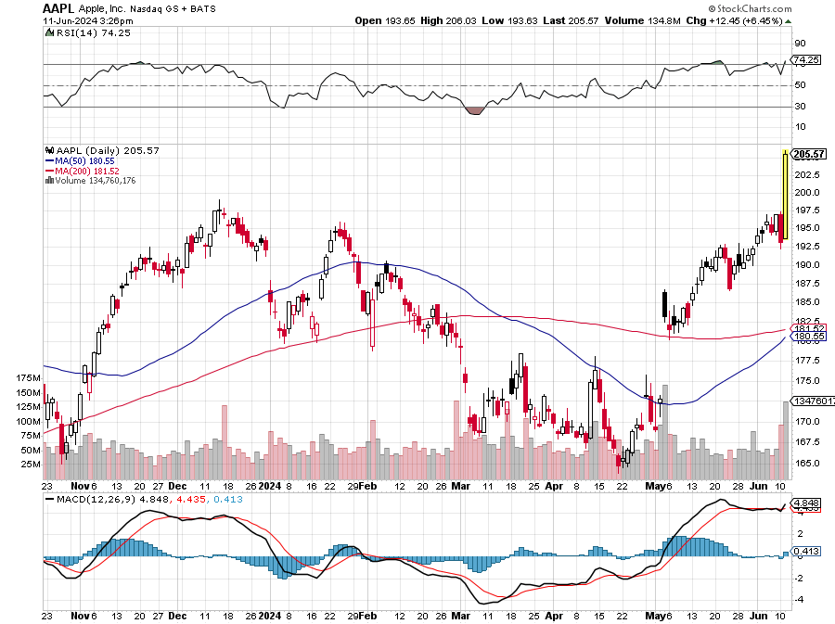
Apple (AAPL) Slashes iPhone Prices in China to Fight Flagging Sales took profits on Long 6/$200-$210 bear put spread, stopped out of Long 5/$185-$195 vertical bear put spread took profits on long 1/$145-$155 put spread, Took profits on long 10/$165-$175 put spread took profits on long 6/$155-$165 put spread, stopped out of long 6/$125-135 call spread, took profits on long 6/$110-$120 call spread, took profits on long 2/$180-$190 put spread

Slide 29
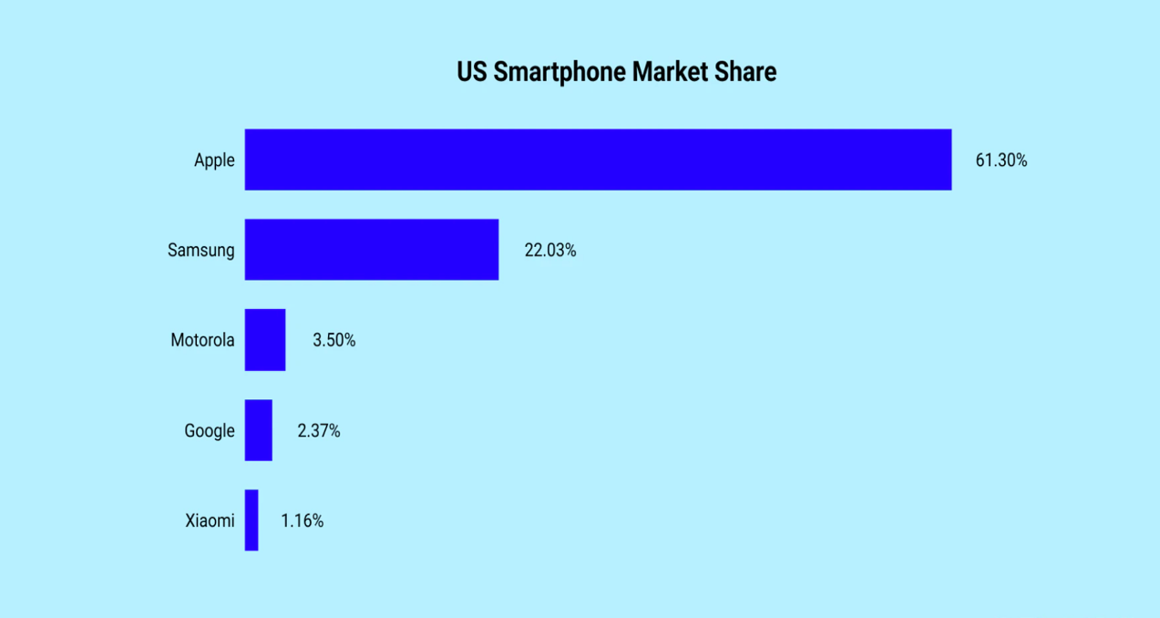

Slide 30
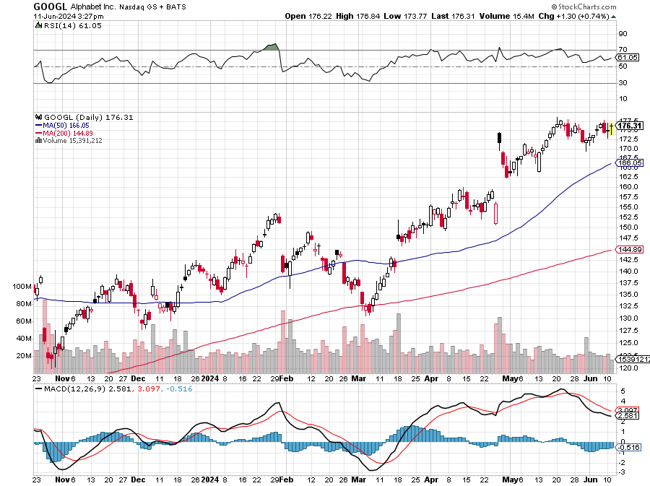
Alphabet (GOOGL) – Back in Play Alphabet Earnings Beat Delivers Monster 10% Move, recovering a $2 trillion market cap took profits on long 12/$110-$120 call spread took profits on long 12/$1,200-$1,230 bull call spread, took profits on long 9/$1,030-$1,080 vertical bull call spread

Slide 31
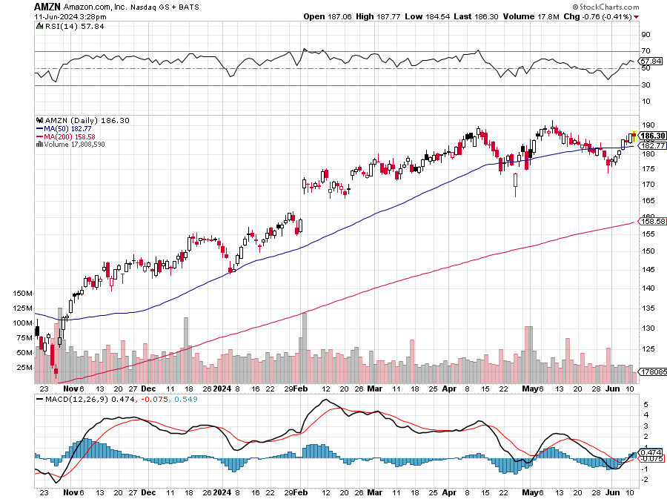
Amazon (AMZN) – Amazon Blows Out Earnings, Undervalued AI leader with tons of data long 6/$160-$170 call spread – expires in 6 trading days took profits on long 3/$155-$160 bull call spread , took profits on long 2/$130-$135 bull call spread

Slide 32
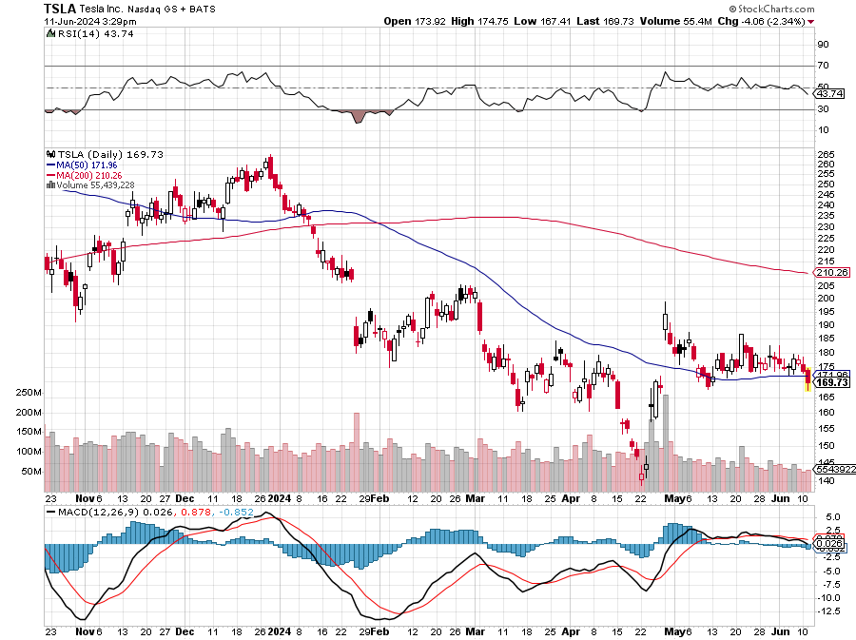
Tesla (TSLA) – $56 Billion Pay Package to be voted down- Will Elon Quit? Stopped out of long 4/$140-4150 call spread, took profits on long 10/$200-$210 call spread took profits on long 6/$120-$130 call spread, stopped out of long 6/$210-$220 put spread took profits on long 5/$110-$120 call spread, took profits on long 5/$220-$230 put spread

Slide 33
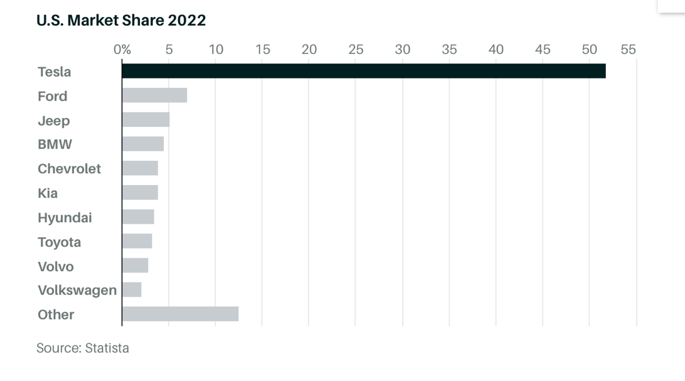

Slide 34
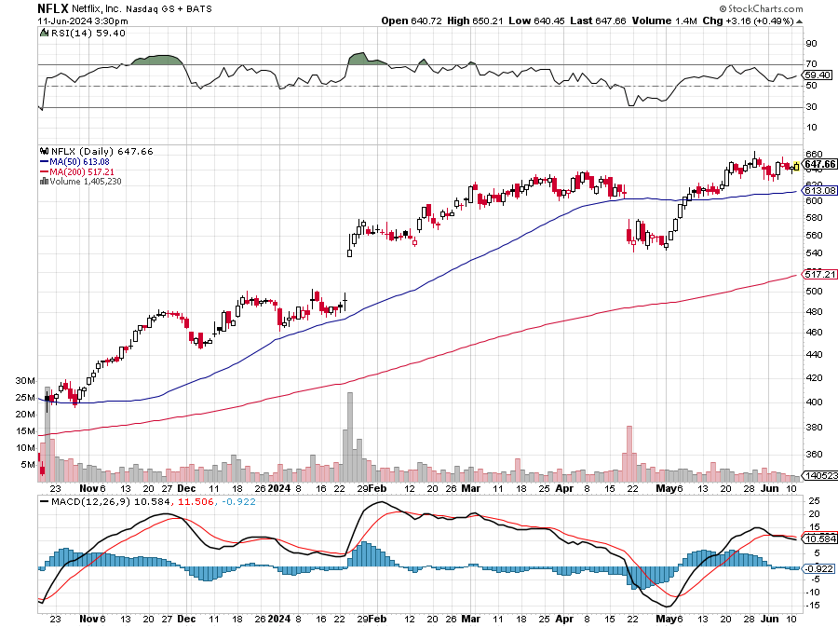
Netflix (NFLX) – Netflix to Stream NFL Games from Christmas, creating another huge revenue stream for the dominant player in the sector

Slide 35
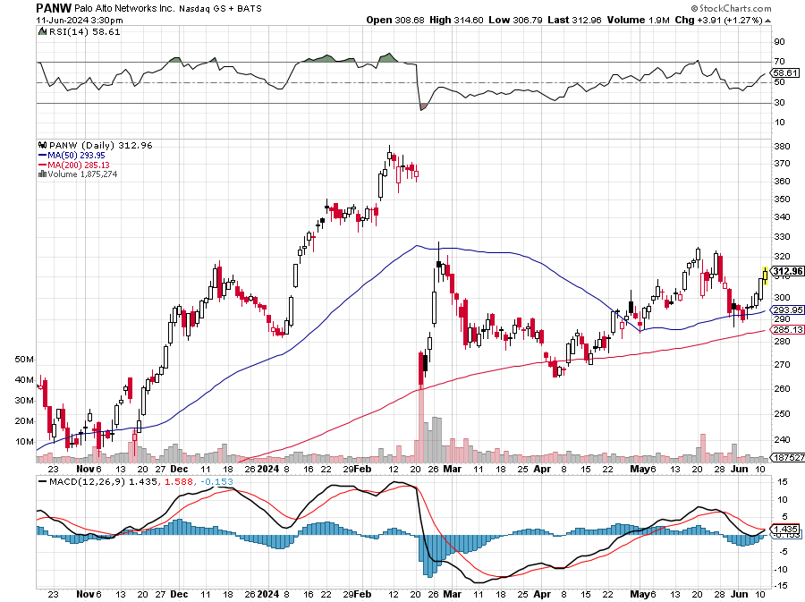
Palo Alto Networks (PANW)- Hacking never goes out of fashion Palo Alto Networks Disappoints took profits on long 2/$260-$270 call spread, took profits on long 10/$130-$140 call spread

Slide 36
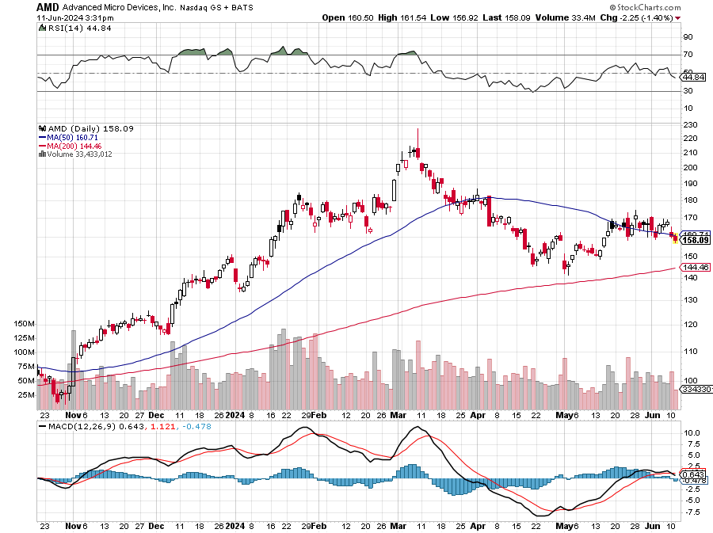
Advanced Micro Devices (AMD)- Recession fears programable logic devices took profits on long 2/$75-$80 call spread

Slide 37
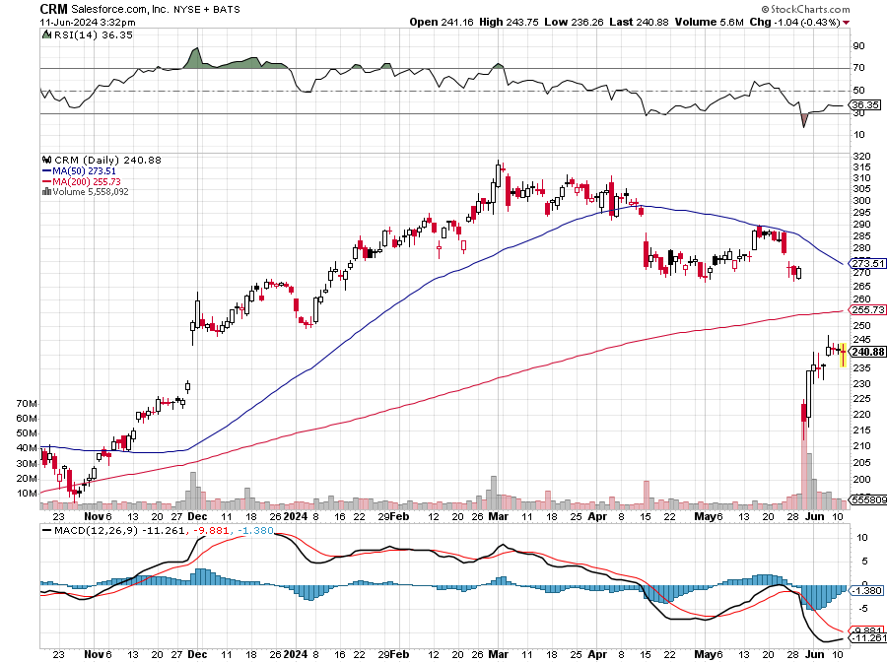
Salesforce (CRM)- Massive Online Migration Salesforce Soars 16%, on better-than-expected guidance took profits on long 12/$185-$195 call spread took profits on long 9/$125-$130 vertical bull call spread took profits on long 8/$125-$130 vertical bull call spread

Slide 38
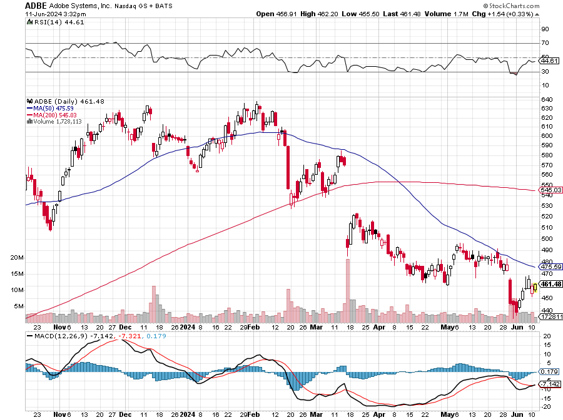
Adobe (ADBE)- Cloud play The Quality Non-China tech play

Slide 39
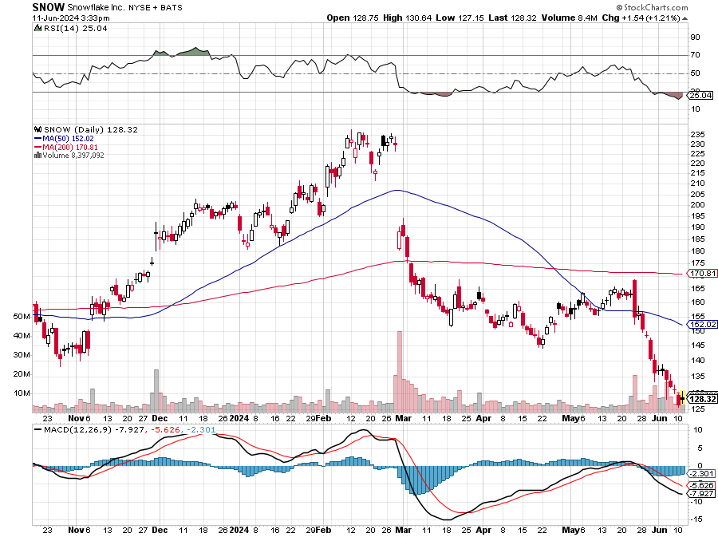
Snowflake (SNOW)- Blockbuster AI Earnings Snowflake Crashes, down 20%, on weak guidance. CEO Frank Slootman is retiring stopped out of long 4/$150-$255 call spread, took profits on long 12/$135-$140 call spread

Slide 40
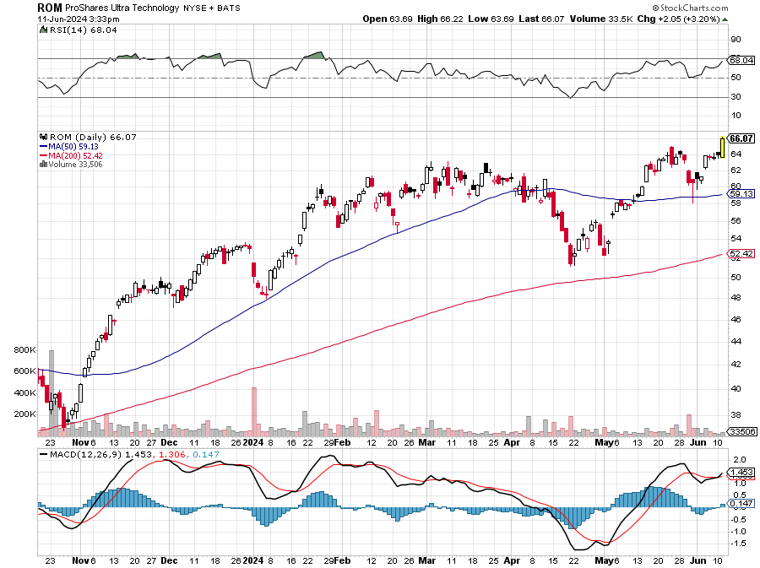
ProShares Ultra Technology ETF (ROM) – 2X Long Technology ETF took profits on long 10/$62-65 call spread

Slide 42
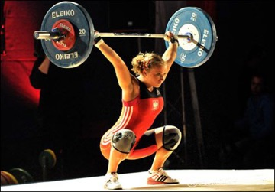
The Second Half of the Barbell
*Bets on a domestic recovery in 2022 Q4 *Upside potential in 2024 far greater than tech *Some of these have not moved for 5 or 10 years *Focuses on economically sensitive cyclical industries *Makes a great counterweight to high-growth technology *We could spend all of next ten years rotating between the two groups

Slide 43
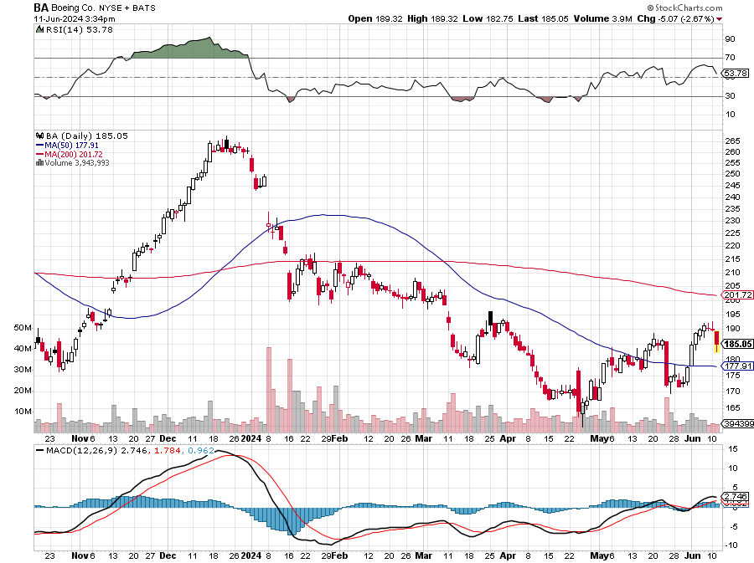
Boeing (BA) – FAA Caps Boeing at 38 Deliveries per Month Boeing Boss Gets $33 Million Golden Parachute “il pesce marcisce dalla testa” stopped out of long 2/$190-$200 call spread, took profits on long 5/$17-$175 call spread

Slide 44
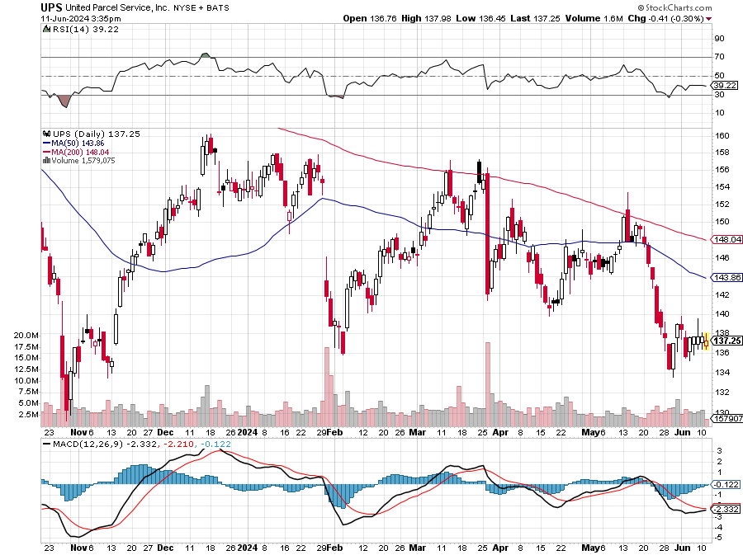
Package Delivery- United Parcel Service (UPS) – strike averted took profits on long 11/$130-$140 call spread

Slide 45
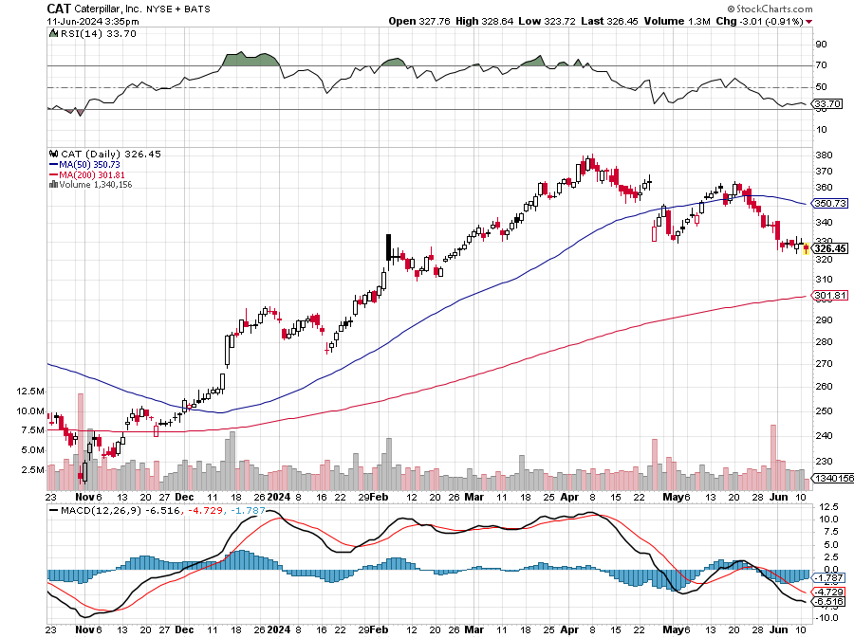
Caterpillar (CAT)- Ag + Infrastructure + Housing took profits on long 12/$220-$230 calls took profits on long 12/$145-$150 call spread, took profits on long 11/$125-$135 call spread

Slide 46
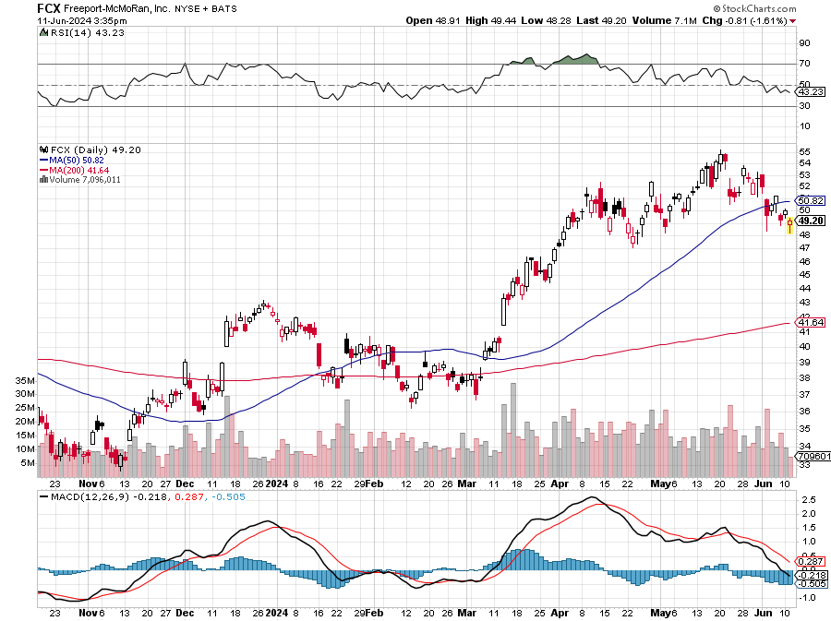
Freeport McMoRan - (FCX)- Coming Copper Crisis Freeport McMoRan Beats, helped by higher production and easing costs took profits on long 4/$37-$40 call spread, took profits on long 5/$42-$45 call spread, stopped out of long $48-$51 put spread, profits on long 6/$32-$35 call spread took profits on long 4/$30-$33 call spread, took profits on long 10/$20-$23 call spread

Slide 47
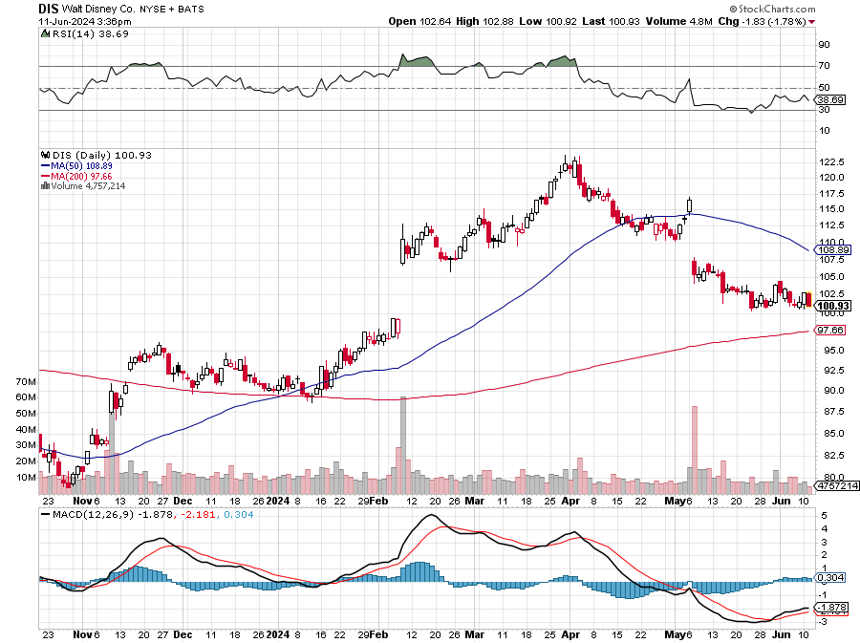
Walt Disney (DIS) -Disney Beats Disney Dives on Earnings Bust, although streaming broke even versus an expected loss

Slide 48
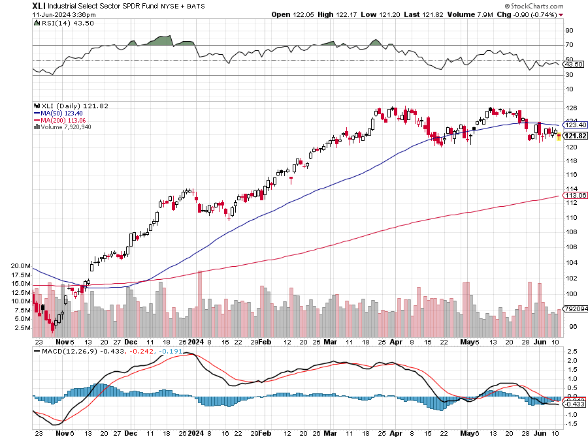
Industrials Sector SPDR (XLI)- (GE), (MMM), (UNP), (UTX), (BA), (HON)

Slide 49
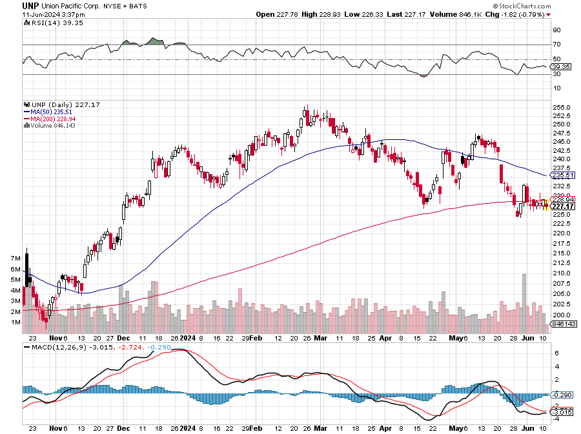
Union Pacific RR (UNP)- Big Stuff to Ship took profits on long 5/$200-$210 call spread took profits on 11/$150-$160 call spread

Slide 50
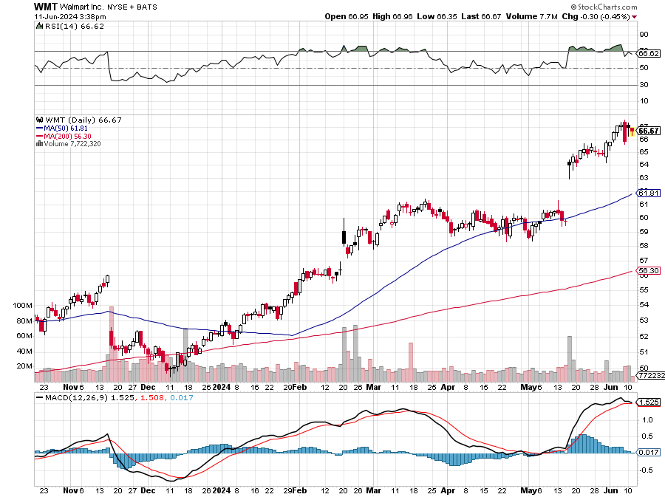
Wal-Mart (WMT)- took profit on Long 11/$125-$130 bear put spread took profit on Long 10/$119-$121 bear put spread took profits on Long 8/$114-$117 bear put spread

Slide 51
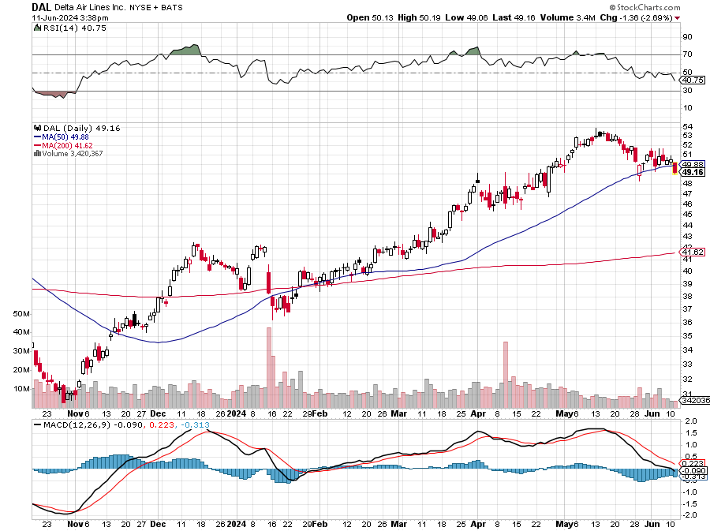
Delta Airlines (DAL) – Travel is Back! The Non-Boeing Airline – uses Airbuses stopped out of long 2/$35-$38 call spread

Slide 52
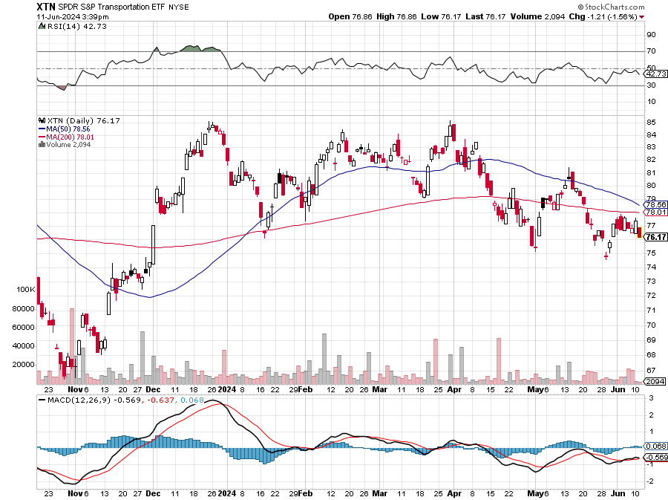
Transports Sector SPDR (XTN)- Worst Hit Sector (ALGT), (ALK), (JBLU), (LUV), (CHRW), (DAL)

Slide 53
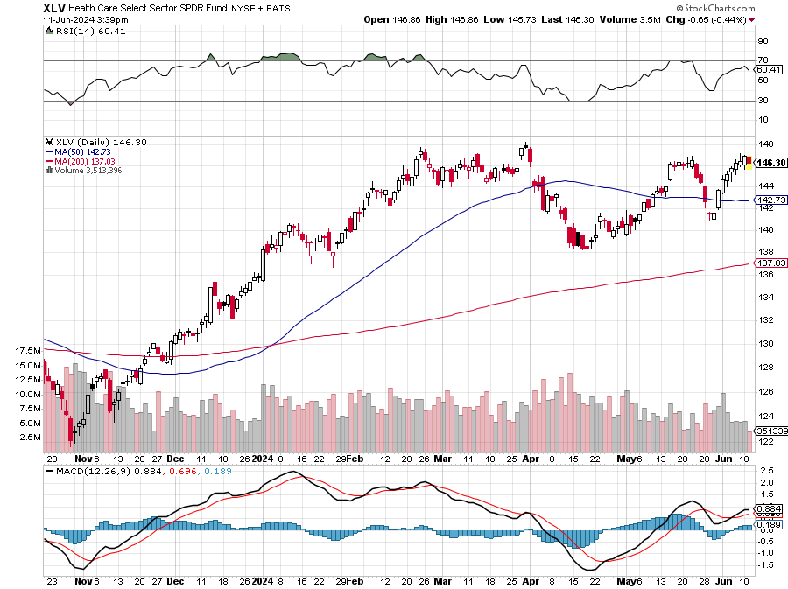
Health Care Sector (XLV) (JNJ), (PFE), (MRK), (GILD), (ACT), (AMGN)

Slide 54
Amgen (AMGN) took profits on long 11/$185-$200 bull call spread

Slide 55
Goldman Sachs (GS) – Goldman Sachs Blows Out Earnings on a surge in bond trading took profits 12/$330-$350 call spread took profits 11/$330-$350 call spread stop loss on long 11/$385-$395 call spreads

Slide 56
Morgan Stanley (MS) Morgan Stanley Beats, on surge in investment banking business took profits on long 4/$65-$70 call spread

Slide 57
JP Morgan Chase (JPM) – JP Morgan Misses on Earnings, tanking the shares by $10 took profits on long 4/$105-$115 call spread

Slide 58
Bank of America (BAC) – Bank of America Rips, on a great earnings report took profits on long 4/$20-$23 call spread

Slide 59
Citigroup (C) – took profits on long 4/$30-$35 call spread

Slide 60
Charles Schwab (SCHW) – LEAPS expire at Max profit took profits on long 4/$30-$35 call spread

Slide 61
Interactive Brokers (IBKR) – LEAPS expire at Max Profit took profits on long 4/$60-$65 call spread

Slide 62
SPDR Metals & Mining ETF (XME) – long 2/$28-$30 call spread

Slide 63
Blackrock (BLK)-Asset Collection Boom took profits on long 3/$770-$790 call spread took profits on long 3/$310-$340 call spread

Slide 64
Visa (V) – Inflation boost Visa Pops on Earnings Beat, showing a 10% revenue increase YOY took profits on long 2/$240-$250 bull call spread took profits on long 10/$160-$170 bull call spread, took profits on long 6/$150-$160 bull call spread

Slide 65
Consumer Discretionary SPDR (XLY) (DIS), (AMZN), (HD), (CMCSA), (MCD), (SBUX)

Slide 66
Berkshire Hathaway (BRKB)- Natural Barbell Announces Blockbuster earnings at $93 billion for 2023 took profits on long 12/$320-$330 call spread took profits on long 4/$260-$270 call spread, took profits on long 1/$290-$300 call spread took profits on long 10/$220-$230 call spread, took profits on long 7/$220-$230 call spread took profits on long 7/$220-$230 call spread, took profits on long 6/$260-$270 call spread

Slide 68
Bonds – Cut Off at the Knees
*Hot Nonfarm Payroll Reports Slams bonds, earlier rallies were based on weak economic data *Funds are Pouring into Corporate Bonds at Four Year Highs *Global investors Hoovered up $3.6 billion into investment grade corporate bond funds in the week to Wednesday in the 31st straight week of inflows, the longest streak since 2019 *Bonds are becoming respectable again after a long winter. Buy (TLT) on dips

Slide 69
Treasury ETF (TLT) – took profits on long 6/$$94-$97 put spread, took profits on long 5/$82-$85 calls spread took profits on long 4/$87-$90 call spread took profits on long 2/$90-$93 call spread, Took profits in $100-$103 put spread, took profits on long 12/$95-$98 put spread took profits on long 12/$79-$82 call spread, took profits on long 11/$76-79 call spread,

Slide 70
Ten Year Treasury Yield ($TNX) – 4.29%

Slide 71
Junk Bonds (JNK) 7.47% Yield

Slide 72
Municipal Bonds (MUB) 3.38% Yield-

Slide 73
Emerging Market Debt (ELD) 6.56% Yield-

Slide 74
2X Short Treasuries (TBT)-Out of Favor

Slide 75
Anally Capital Management (NLY) – Leveraged REIT Play Yield 14.10% took profits on long 12/$15-$16 call spread

Slide 76
Foreign Currencies – Dollar Catches a Bid
*Red hot May Nonfarm Payroll Report gives dollar a new bid *Right wing wins in European elections deliver currencies a second punch on economic destabilization fears *Japanese yen still looking for a bottom at Y160 *Bank of Japan intervened with a $62 billion yen buy, dollar sell. Avoid (FXY). *Chinese Yuan remains weak. International trade is collapsing *Higher for Longer Rates means higher for Longer Greenback *You need a falling interest rates to get a falling dollar for 2024

Slide 77
THE MAD HEDGE FUND TRADER
Australian Dollar (FXA) - Major Long-Term Bottom is In Targeting Parity – A call option on a global synchronized recovery
1:1
BUY

Slide 78
Japanese Yen (FXY)

Slide 79
Euro (FXE)-
2023 Target 25%

Slide 80
British Pound (FXB)-
2023 Target 15%

Slide 81
Emerging Market Currencies (CEW)
2023 Target 40%

Slide 83
Energy & Commodities – Out of Favor
*AI Creating Nuclear Power Demand Surge, with its voracious demand for power *OPEC Maintains Production Caps into 2025, with US production hitting a 2024 high at 19.9 million barrels/day *AT&T’s Copper is Worth More Than the Company, and with plans to convert half its copper network to fiber by 2025 could free up billions of tons of the red metal to sell on the market *Copper prices have doubled over the past two years, and they could double again by next year *Conoco Phillips Buys Marathon Oil for $22.5 Billion, in a further consolidation of the oil industry *Porsche Goes for a Hybrid, bringing out a new model for $164,900, the last to do so. Look for a 20-year death spiral for oil prices.

Slide 84
Oil-($WTIC)

Slide 85
United States Oil Fund (USO)

Slide 86
Energy Select Sector SPDR (XLE)-No Performance! (XOM), (CVX), (SLB), (KMI), (EOG), (COP)

Slide 87
ExxonMobile (XOM)- Exxon Moves Big into Lithium, with the construction of a major mining operation in Arkansas took profits on Long 4/$100-$105 call spread, took profits on long 12/$120-$125 put spread

Slide 88
Occidental Petroleum (OXY)- Buffet’s a Buyer took profits on long 4/$59-$62 call spread took profits on long 2/$55-$60 call spread, took profits on long 12/$77.50-$82.50 put spread

Slide 89
Natural Gas (UNG) – Free Fall on Warm Winter took profits on Long January 2025 $7-8 Call Spread LEAPS

Slide 90
Cameco (CCJ) – Global Uranium Renaissance Uranium Goes Nuclear, with yellow cake prices up 45% since May took profits on long 12/$35-$38 call spread, took profits on long 5/$20-$23 bull call spread

Slide 91
Precious Metals – Reality Check
*Red hot May Nonfarm Payroll Report kills gold trade *When the Chinese enter a trade, the volatility increases, and this is a perfect example *Higher for longer interest rates mean lower for longer gold and silver *Buy Precious metals on the dip because rates have to fall eventually *Miners are expanding their operations and ramping up production as prices for the precious metal climb to decade highs Buy (GLD), (SLV) and (WPM) on dips.

Slide 92
Gold (GLD) – China and Millennial call worst day in three years Long 7/$200-205 call spread, stopped out of Long 6/$207.5-$212.5 call spread took profits on Long 4/$194-$197 call spread, took profits on long 5/$165-$170 bull call spread

Slide 93
Market Vectors Gold Miners ETF- (GDX) –

Slide 94
Barrick Gold (GOLD) took profit on long 1/$15.50-$16.50 call spread

Slide 95
Newmont Mining- (NEM)- took profits on long $55-60 call spread

Slide 96
Silver- (SLV)- long 6/$23-$25 call spread, took profits on long 11/$19-$20 call spread

Slide 97
Silver Miners - (SIL)-

Slide 98
Wheaton Precious Metals - (WPM)- LEAPS Approaching Max Profit took profits on long 4/$39-$42 call spread , took profits on long 1/$36-$39 call spread

Slide 99
Platinum- (PPLT)- 556,000-ounce shortage this year took profits on long 1/$36-$39 call spread

Slide 101
Real Estate – Trending Up
*US Construction Spending Falls, off 0.1% after slipping 0.2% in March *Pending Home Sales Dive, down 7.7% in April, the worst since the Covid market three years ago *AI is Soaking Up San Francisco Office Space Faster Than You Think *S&P Case Shiller Jumps to New All-Time High, with its National Home Price Index *The index rose by 6.5% YOY, the fastest growth since April 2023. All 20 major metro cities were up * Home Equity Hits All-Time High at $17 Trillion according to Corelogic. *Total home equity for U.S. homeowners with and without a mortgage is $34 trillion. That is a lot of cash that could potentially end up in the stock market.

Slide 102
S&P Case Shiller Turns Hot S&P Case Shiller Rises to +6.50% YOY in March, with its National Home Price Index San Diego gained +11.4%, Chicago +8.9%, and Detroit +8.9%.

Slide 103
Crown Castle International (CCI) – 5.45% yielding 5G cell phone tower REIT Eliot Management Pushes up stock with activist bid

Slide 104
US Home Construction Index (ITB) (DHI), (LEN), (PHM), (TOL), (NVR)

Slide 106
Trade Sheet- So What Do We Do About All This?
*Stocks – buy any dips *Bonds – buy dips *Commodities-buy dips *Currencies- sell dollar rallies, buy currencies *Precious Metals – buy dips *Energy – buy dips *Volatility - buy $12 *Real estate – buy dips

Slide 108
Next Strategy Webinar 12:00 EST Wednesday, July 10 from Incline Village, Nevada email me questions at support@madhedgefundtrader.com
Good Luck and Good Trading!
Notes:
*

