Slide 1
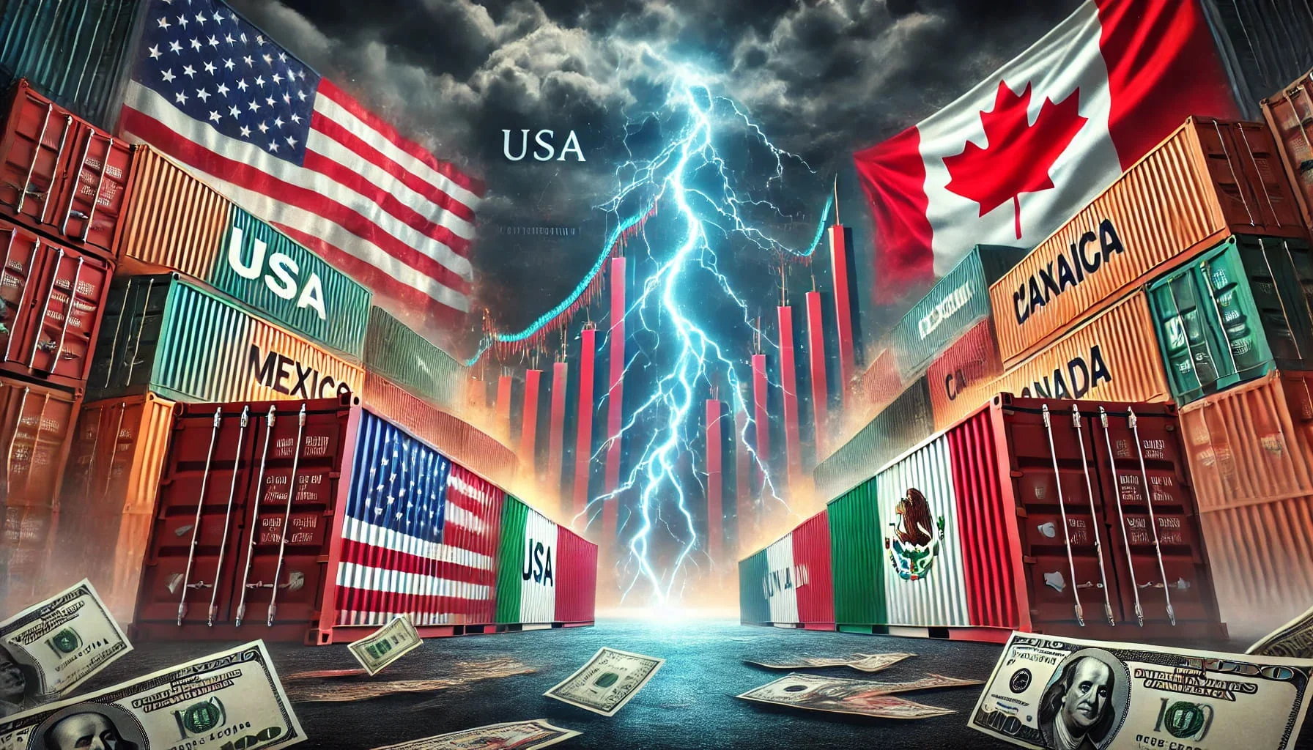
The Mad Hedge Fund Trader “Trade Wars”
With John Thomas Incline Village, NV February 12, 2025 www.madhedgefundtrader.com
Notes:
*

Slide 2
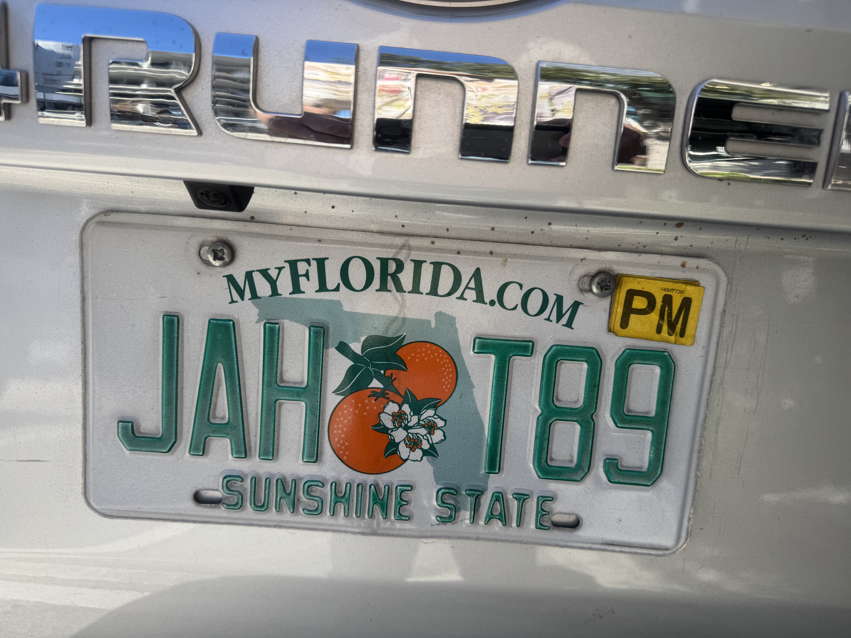

Slide 3
Trade Alert Performance New All-Time Highs!
*January +5.80% Final *July +10.92% Final *February +0.48% MTD *August +3.74% Final *March +6.23% Final *September +10.28% Final *April +5.24% Final *October +7.59% Final *May +3.74% Final *November +18.96 Final *June +1.94% Final *December +3.26% Final *2025 Year To Date +6.23% +758.14% since inception *Versus 84.63% for all of 2022 *Versus 79.79% for all of 2023 *Versus 75.29% for all of 2024

Slide 4
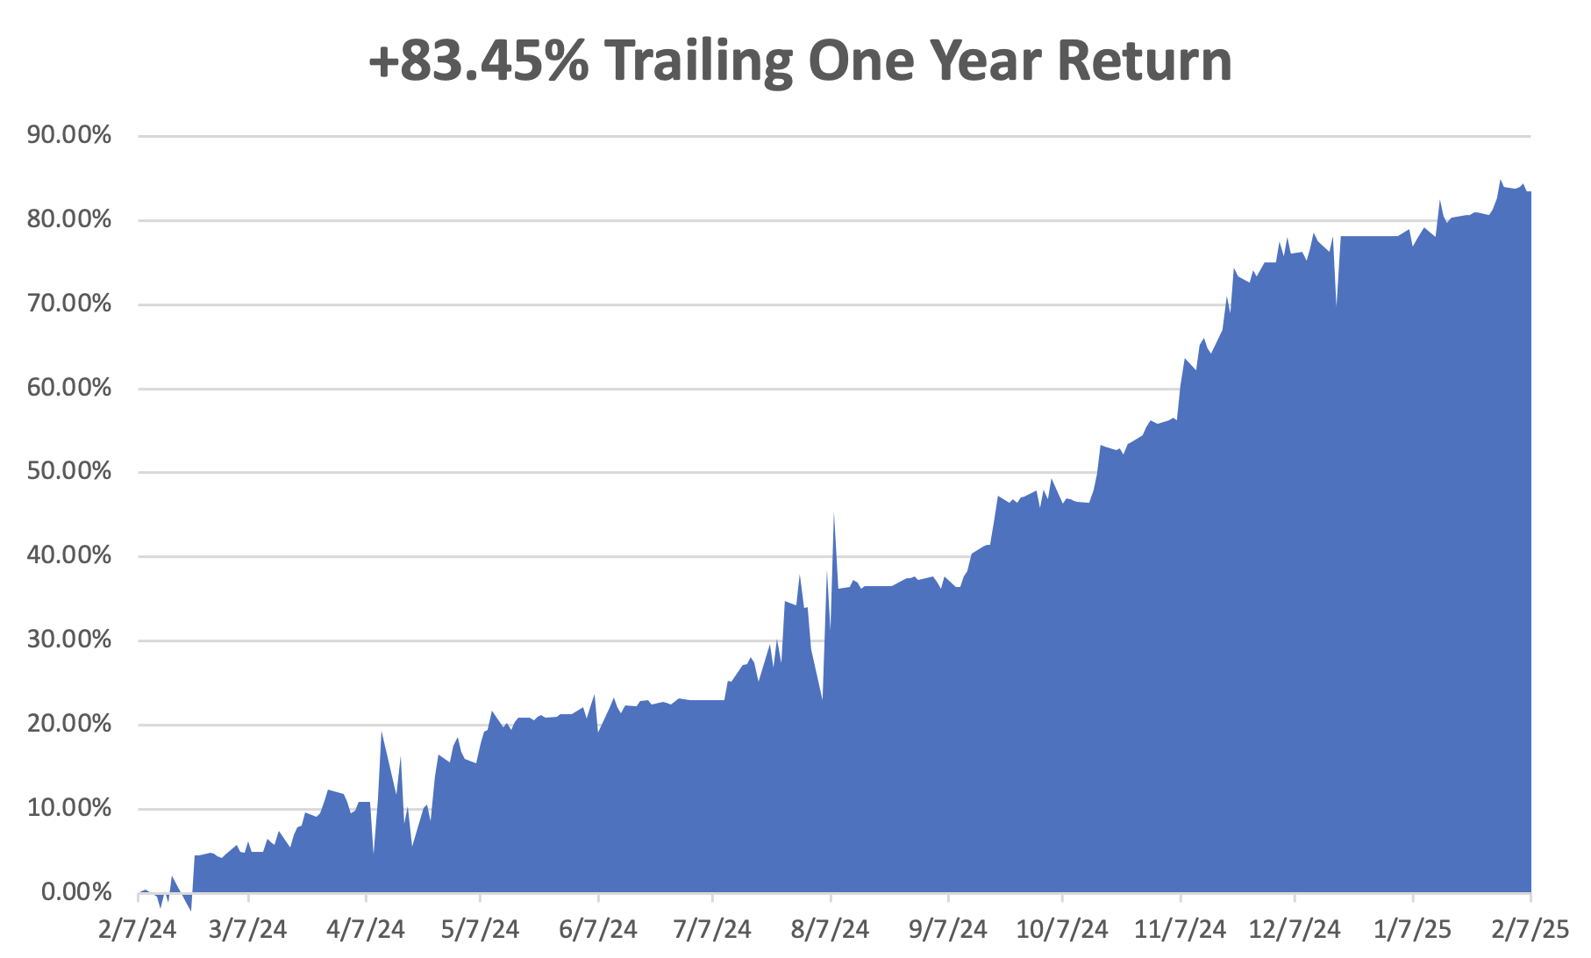

Slide 5
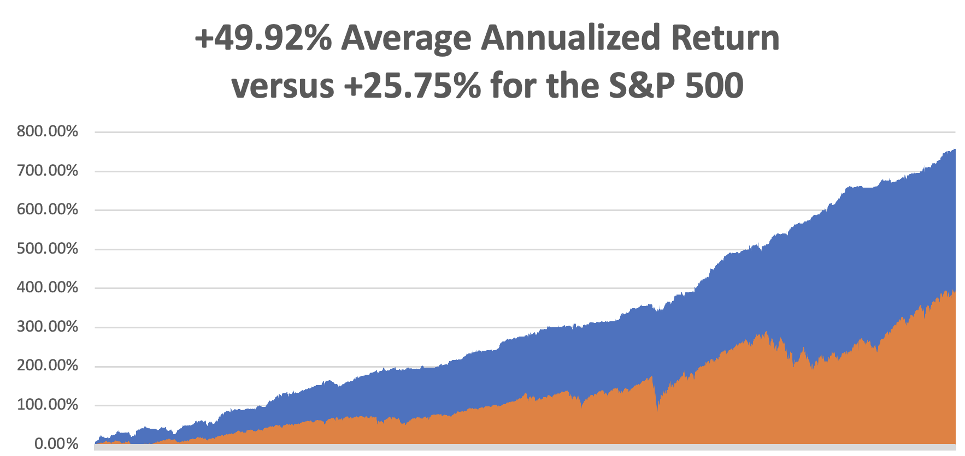

Slide 6
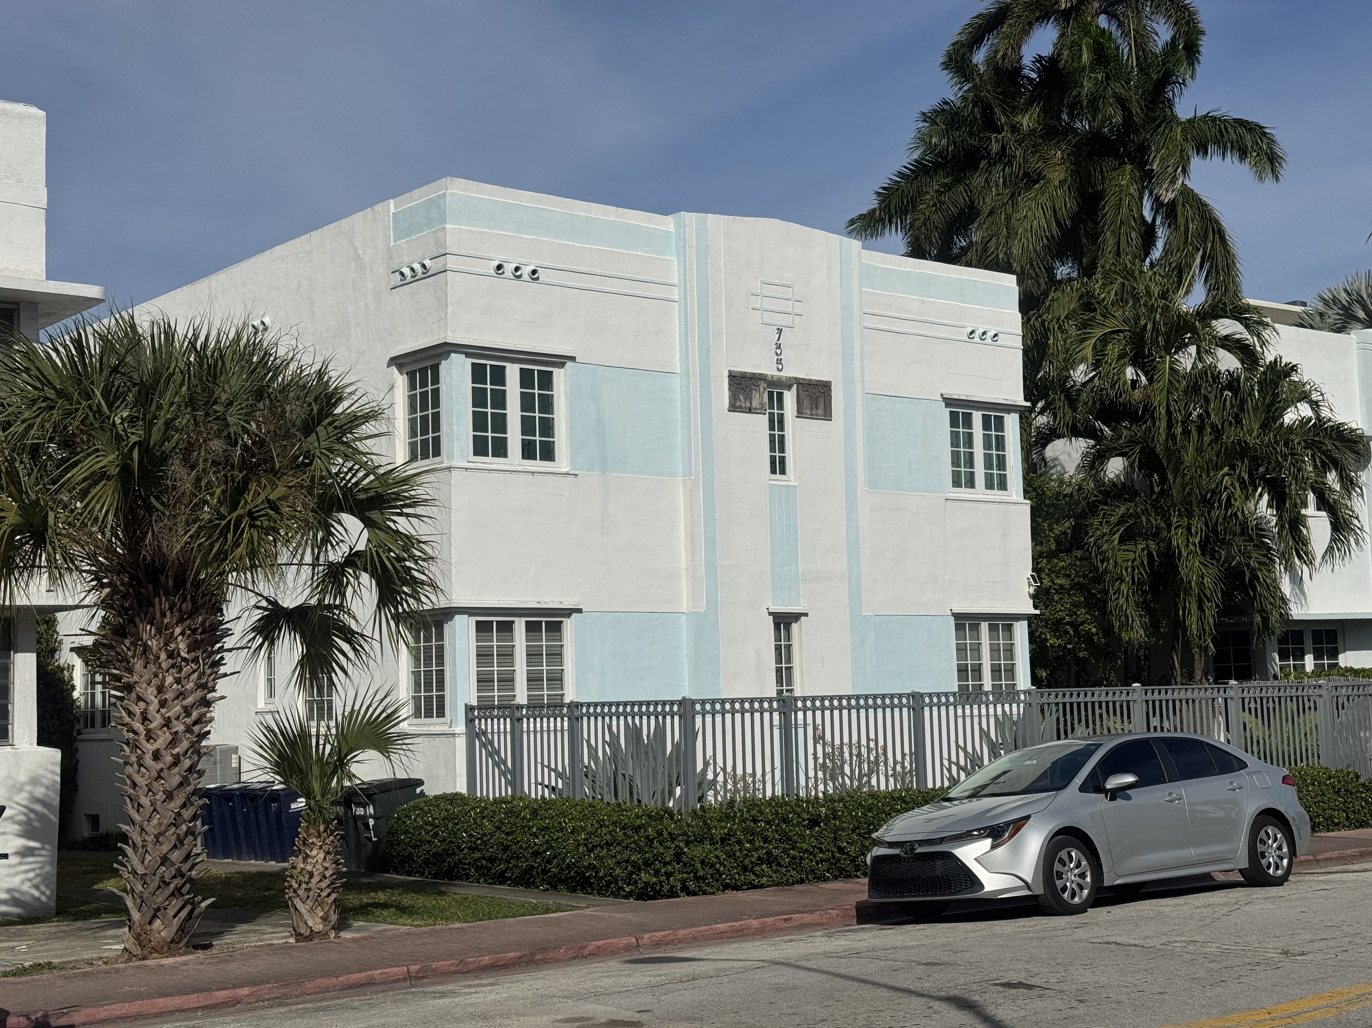

Slide 7
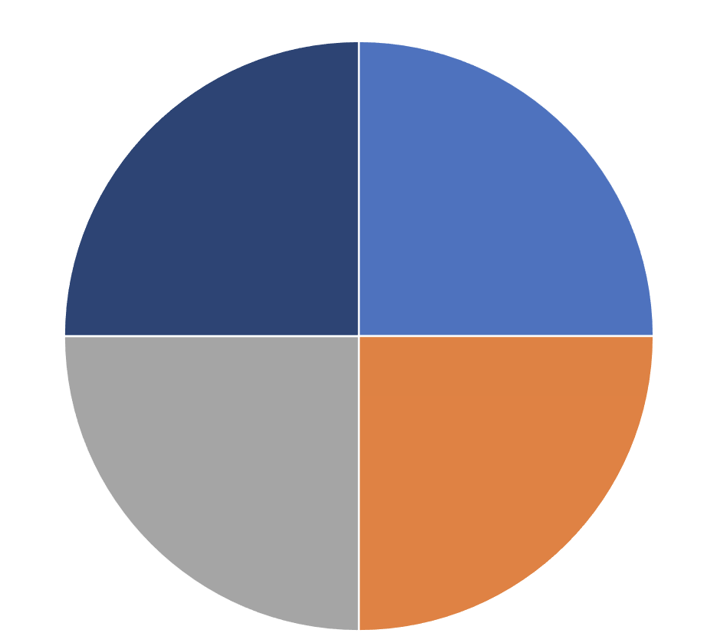
Portfolio Review – Aggressively Cash 30% risk on, -10% risk off, 60% cash
Current Capital at Risk
Risk On
(TSLA) 2/$300-$310 call spread | 10.00%
(NVDA) 2/$90-$95 call spread | 10.00%
(VST) 2/$100-$110 call spread | 10.00%
Risk Off
(TSLA) 2/$540-$550 spread | -10.00%
Total Net Position | 20.00%
Total Aggregate Position | 40.00%
Expiration Value +7.10%

Slide 8
The Method to My Madness
*All classes see momentum stall on continued uncertainty about everything *Financials are still leading on deregulation play, but M&A has yet to start *All interest rate plays remain dead in the water, including gold, silver, homebuilders, bonds, and REITS. *US Dollar remains bid on trade war *Big Technology stalling *Energy sells off on trade wars *Buy financial as the only sure thing this year *Keep discipline, don’t look for trades that aren’t there

Slide 9
The Global Economy – Confused
*Fed Leaves Interest Rates Unchanged at 4.25%, may remain there for the rest of 2025 *NonFarm Payroll Plunges to 146,000, in January *The headline Unemployment Rate came in at 4.0%. *US Job Openings Hit 14-Month Low, or JOLTS *Consumer Sentiment Falls, according to the University of Michigan. *China Counter Attacks in Trade War *US Factory Orders Fall *Consumer Inflation Expectations Comes in Soft. *US GDP Finishes 2024 at 2.3%, less than expected

Slide 10
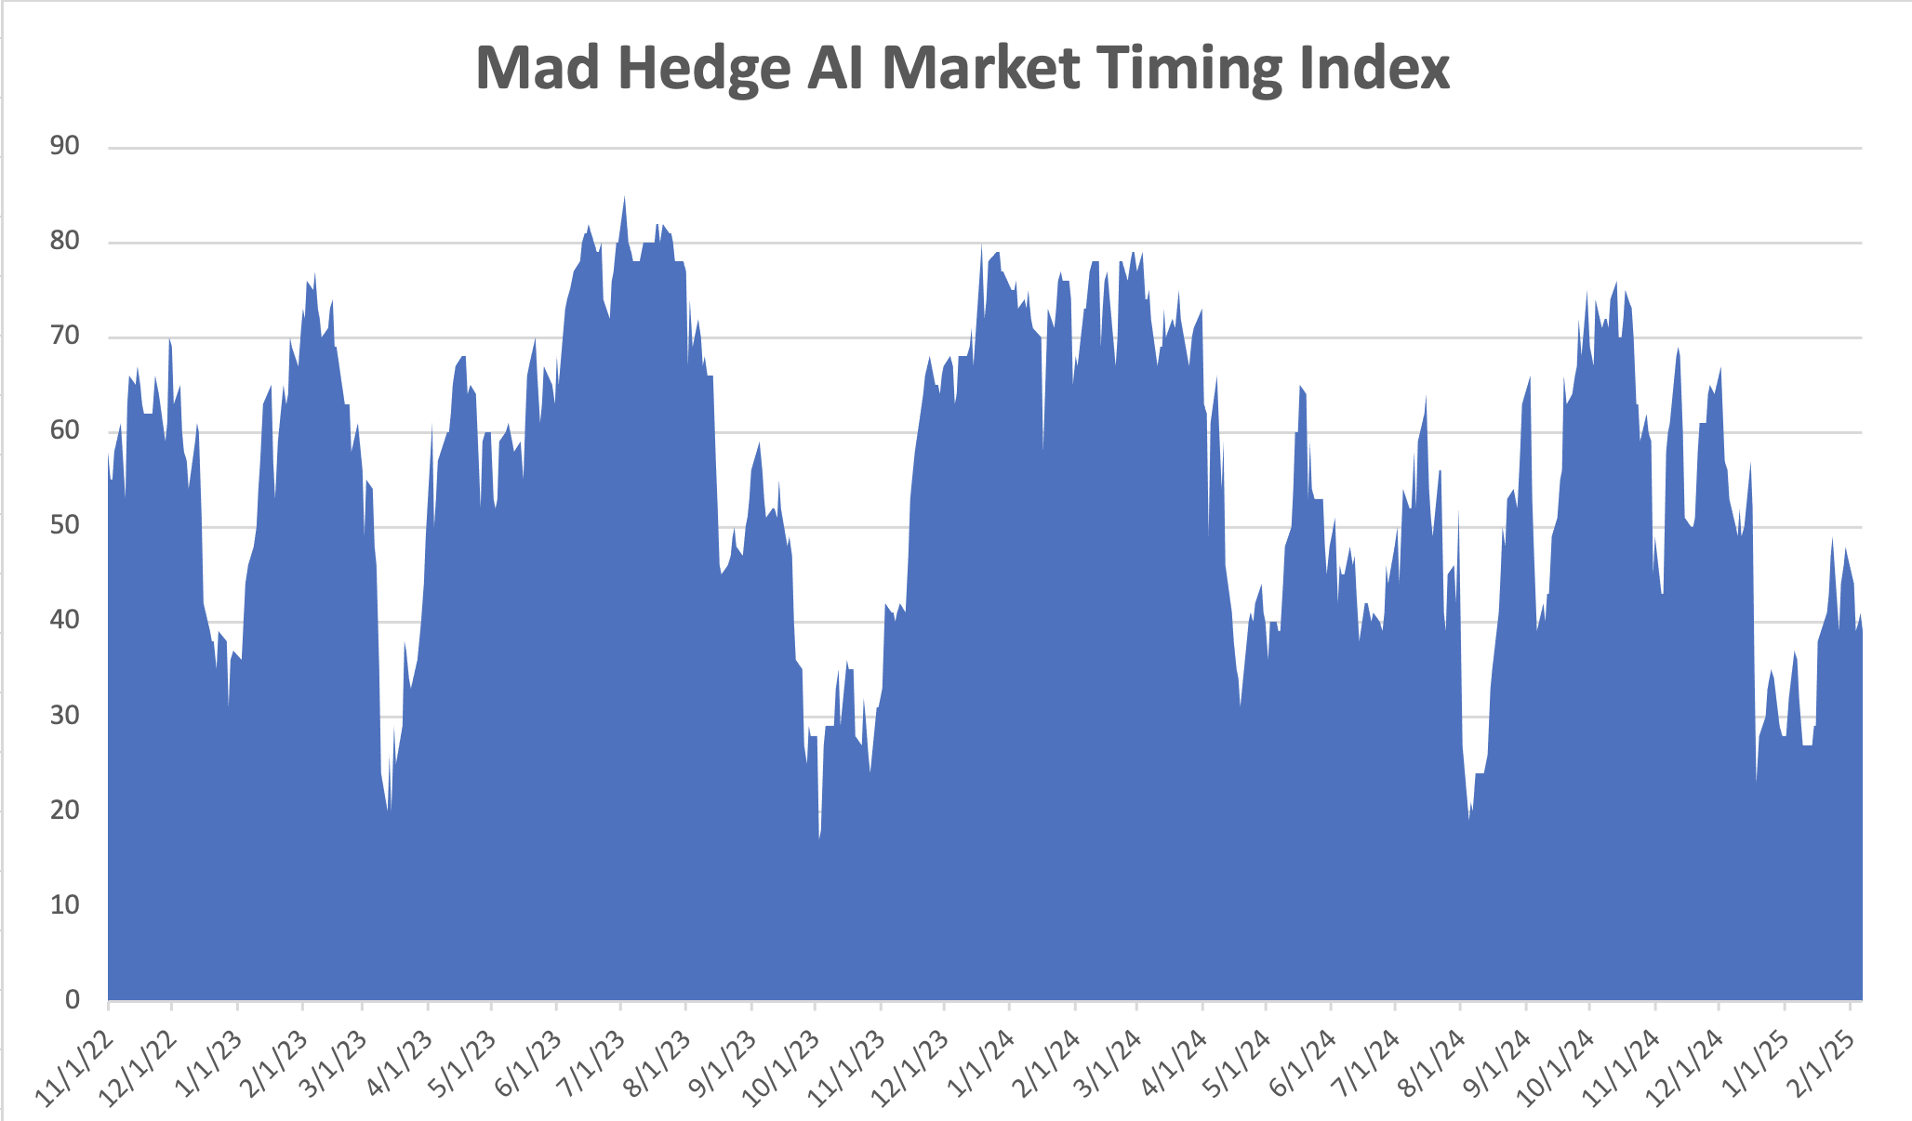
The Mad Hedge Profit Predictor Market Timing Index – New Range? An artificial intelligence driven algorithm that analyzes 30 different economic, technical, and momentum driven indicators
SELL
BUY

Slide 11
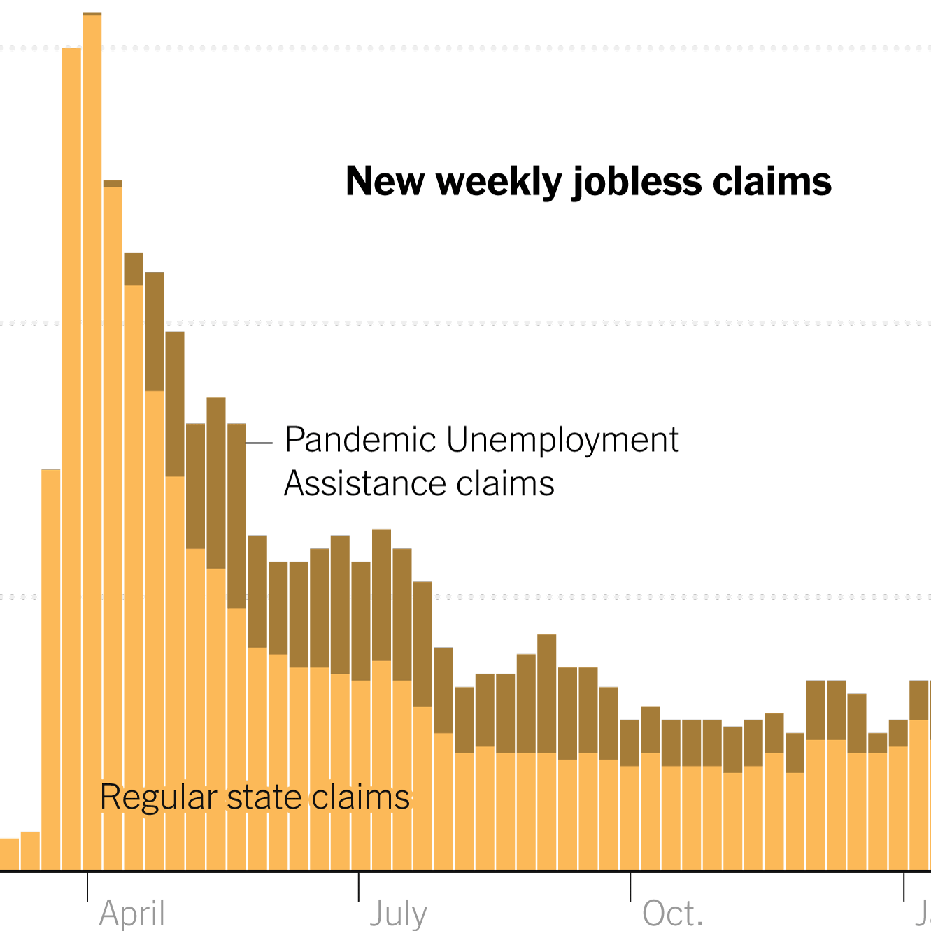
Weekly Jobless Claims – 4 Month Low +11,000 to 219,000

Slide 12
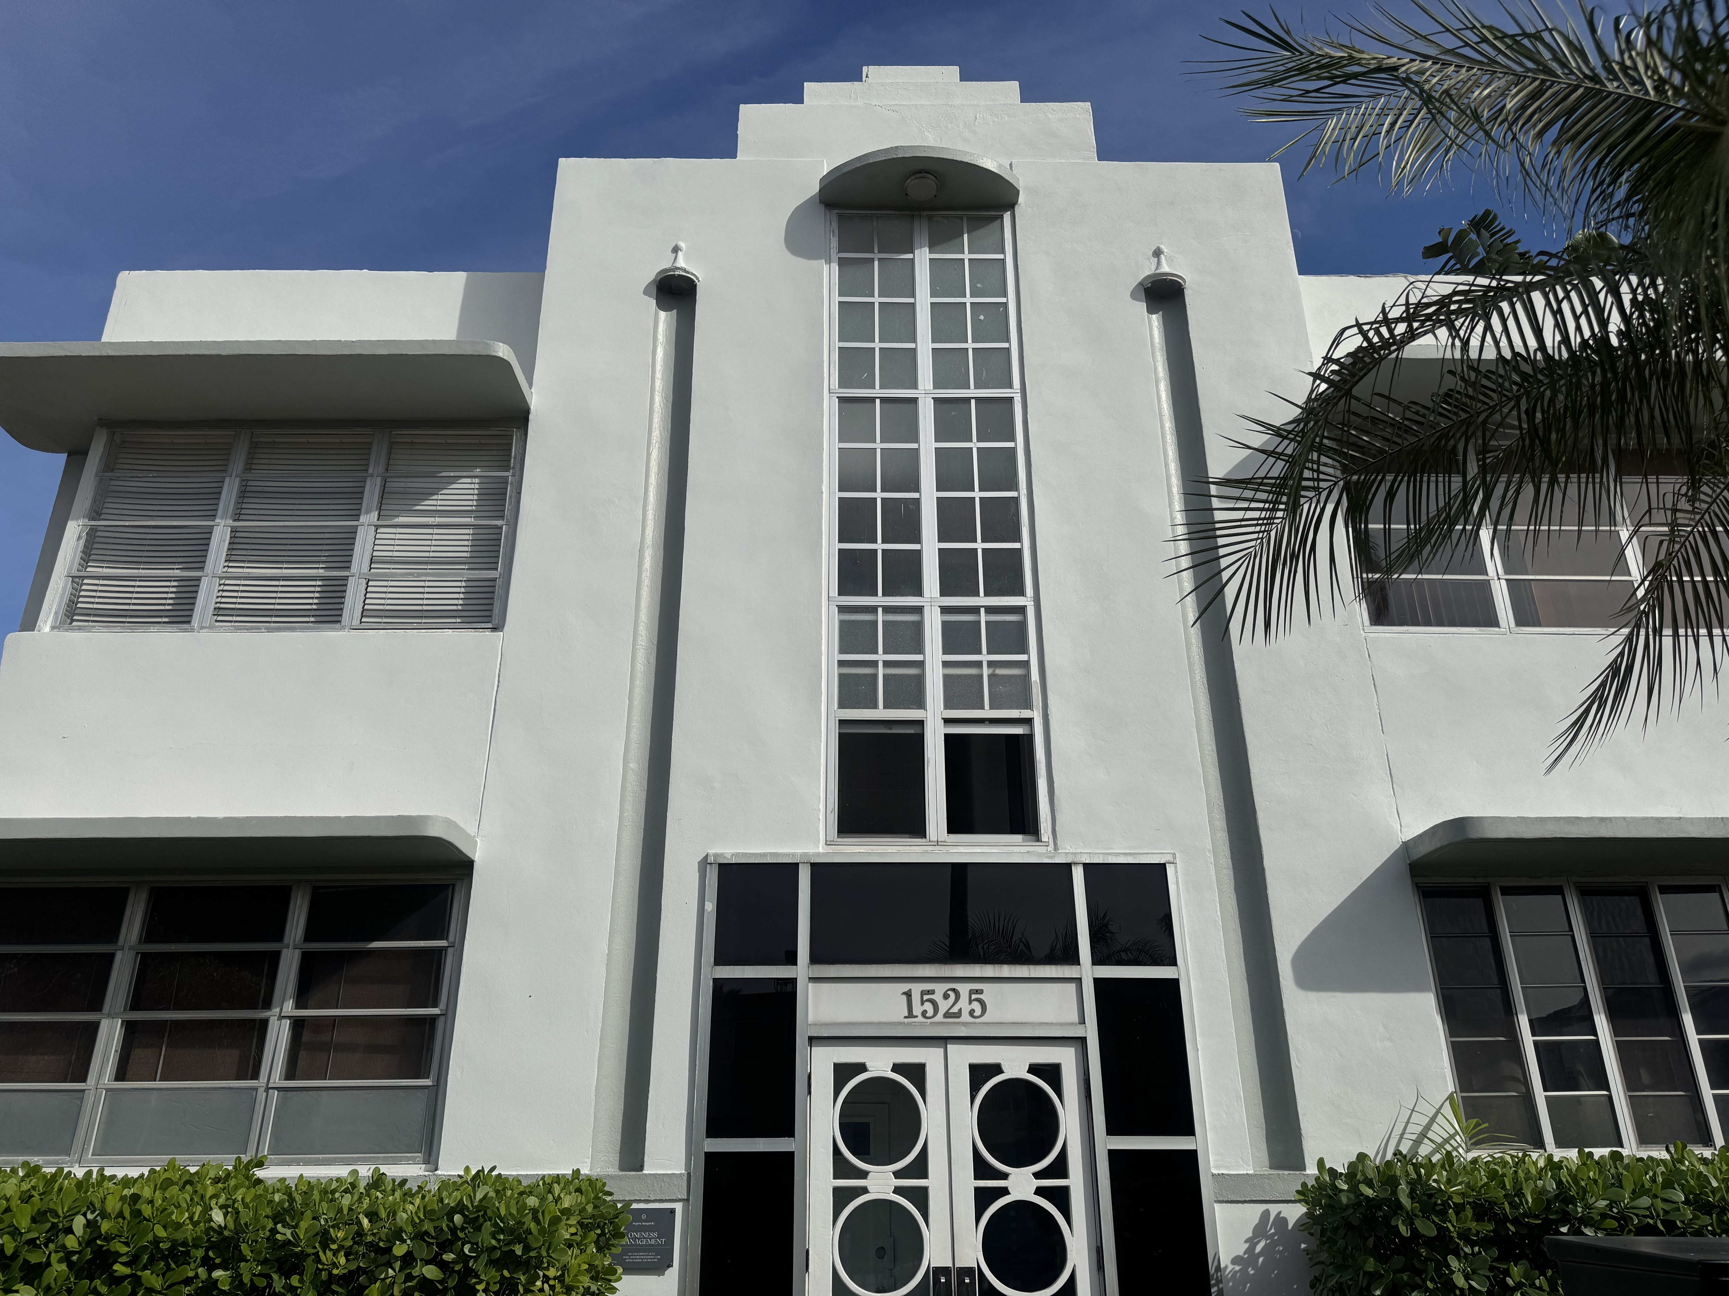

Slide 13
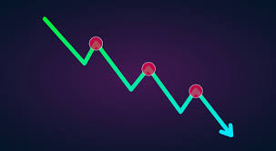
Stocks – Downtrend
*Wall Street Souring on Magnificent Seven, except for Meta *Goldman Sachs Sees a Correction Coming, in the face of a deteriorating global macro conditions, trade wars, and sky-high valuations *Technology Stocks destroyed on News of China’s DeepSeek *Tariffs to Cut US Earnings by 5% *The Exemption Race is On, with many industries pleading for special treatment in the new trade wars. *Palantir Soars 25%, on the prospect of a surge in government contracts *Chevron Posts First Loss in Four Years *U.S. Business Activity Slowed to a Ninth-Month Low

Slide 14
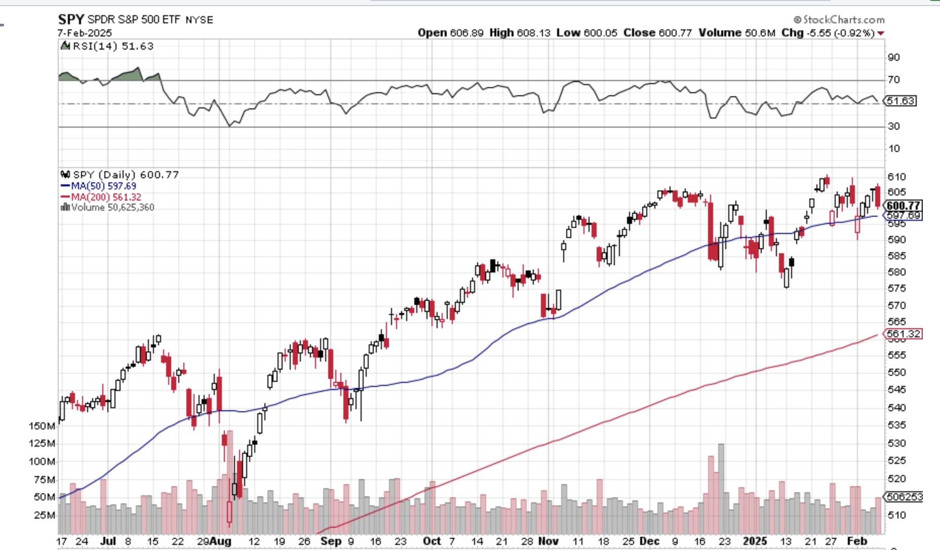
S&P 500 – Correction Time
$575 -6.04% 1st support
$535 -13.02% 1st support

Slide 15
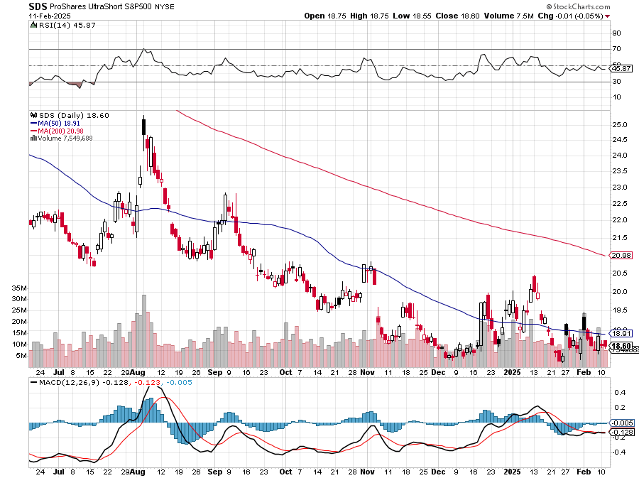
ProShares Ultra Short S&P 500 (SDS)- a great hedge for long stocks and bonds long 2X position has a hedge against longs and bond shorts

Slide 16
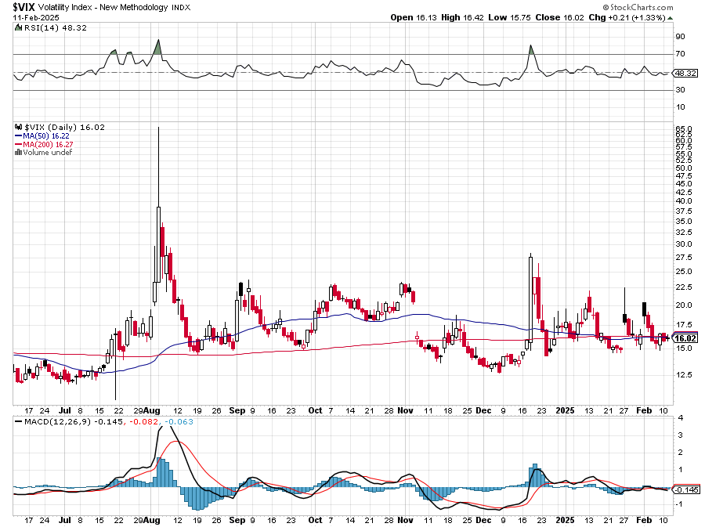
(VIX) – Volatility Index Hits Four Year High at $65, the most since the 2020 pandemic. That implies a 2% move in the S&P 500 (SPX) every day for the next 30 days

Slide 17
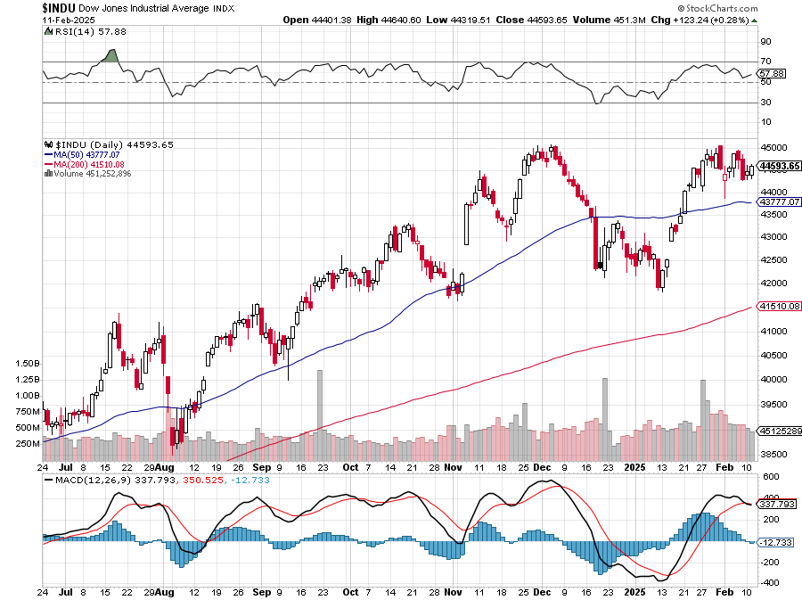
Dow Average ($INDU)-

Slide 18
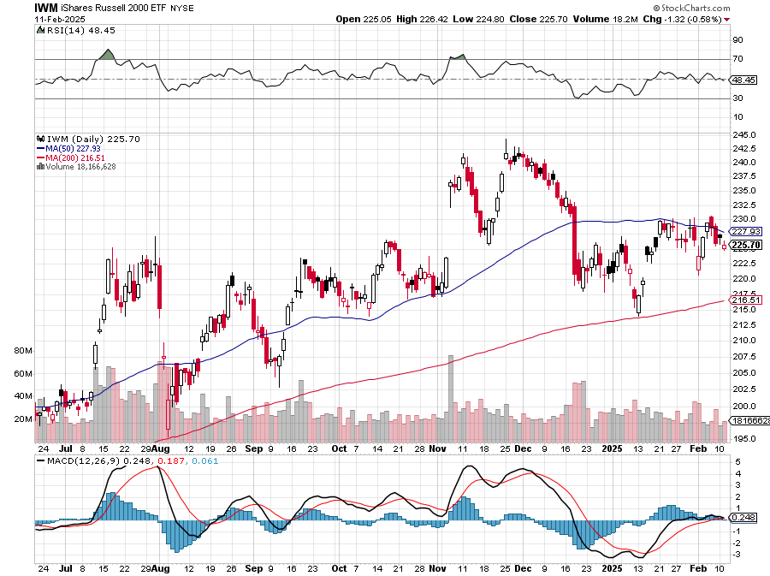
Russell 2000 (IWM)- took profits on Long 10/$137-$142 vertical bull call spread took profits on Long 10/$153-$156 vertical bear put spread

Slide 19
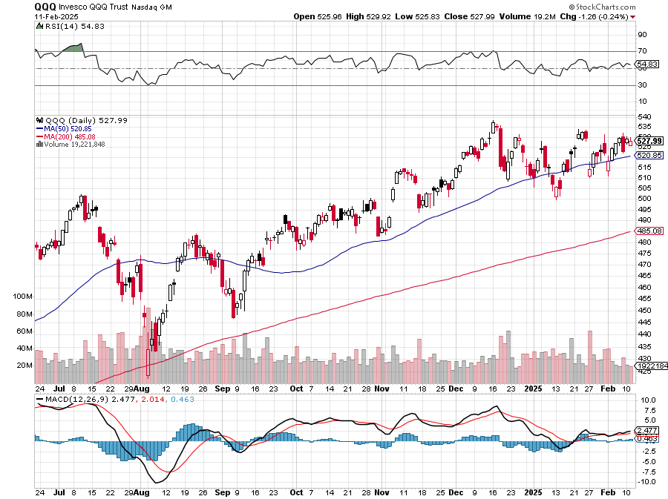
NASDAQ (QQQ) – took profits on Long 5/$335-$345 put spread took profits on long (QQQ) 1/$290-$300 put spread, took profits on long (QQQ) 4/$330-$335 put spread took profits on long (QQQ) 3/$340-$345 put spread, covered long (QQQ) $325-$330 put spread

Slide 20
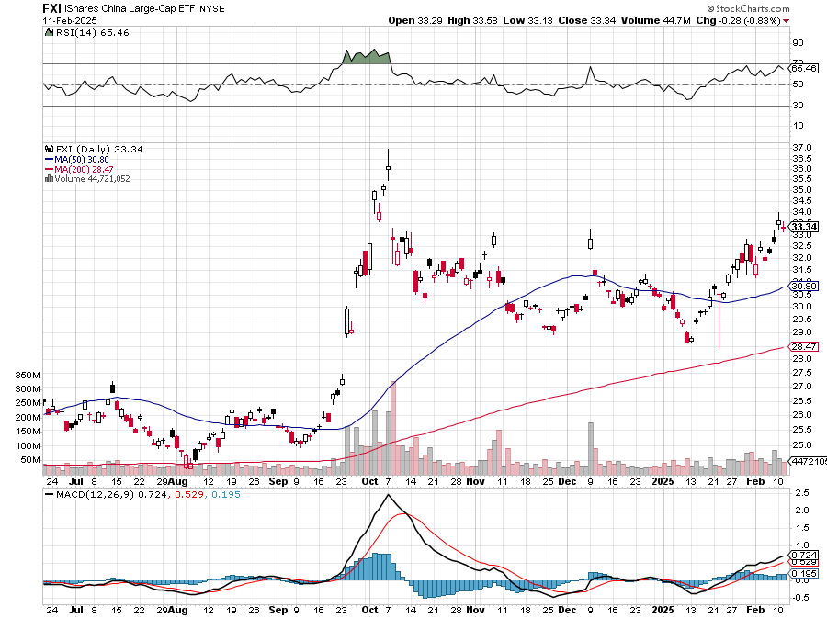
China (FXI)

Slide 21
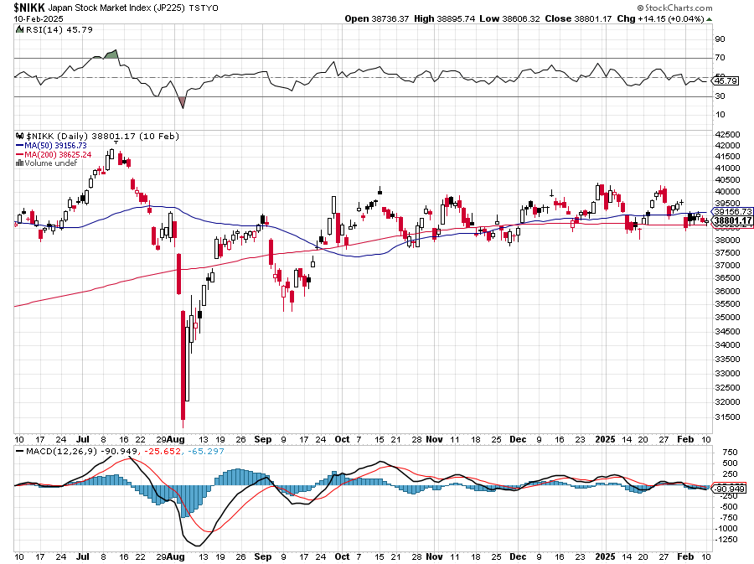
Japan ($NIKK)

Slide 22
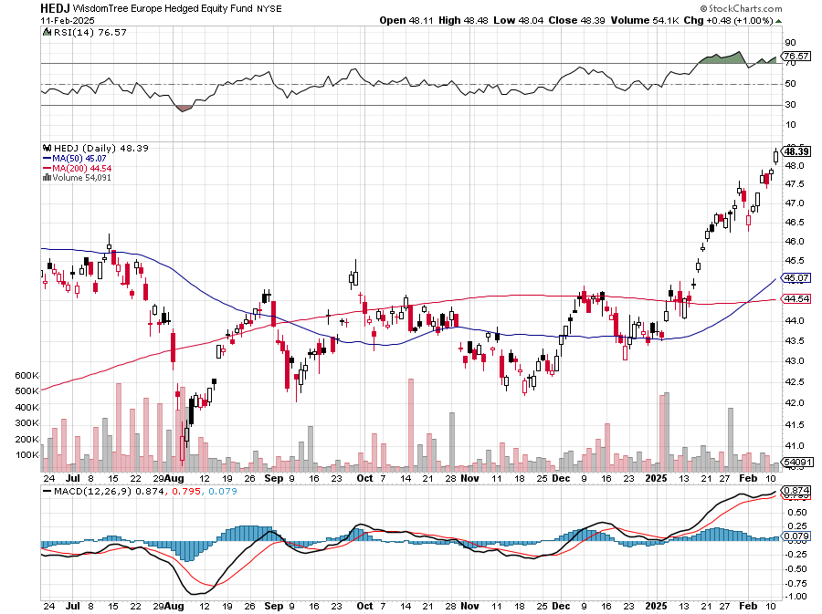
Europe Hedged Equity (HEDJ)-

Slide 23
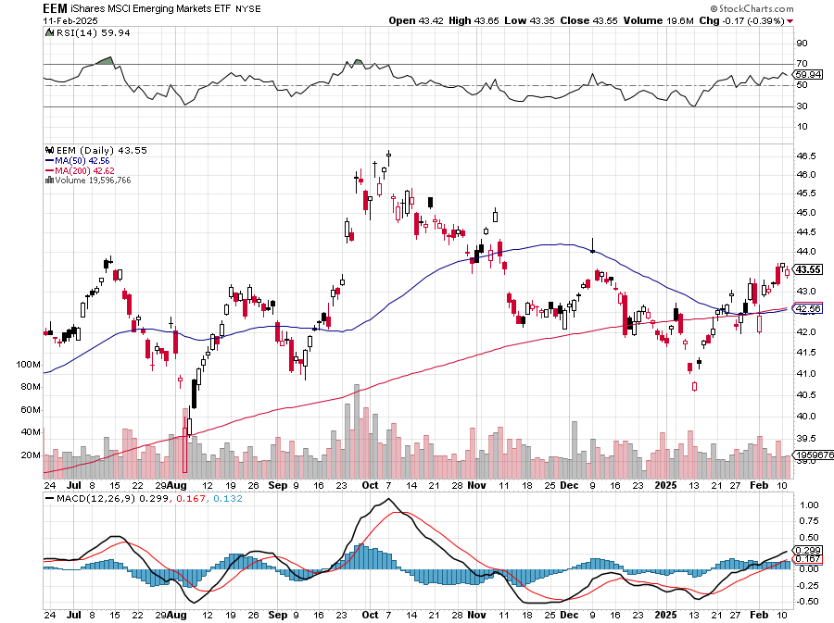
Emerging Markets (EEM) - Pro trade, Weak Dollar, Long Recovery Play Traders are Lining up for a Big Emerging Market Bet. Falling US interest rates will bring a weak US dollar and runaway bull markets in most emerging markets, which have remained unchanged for more than a decade

Slide 24
THE MAD HEDGE FUND TRADER
The Barbell Portfolio
*75% Big Tech – 2% of US workforce, 25% of market cap and 25% of US earnings 25% Domestic Recovery, including: Railroads, airlines, cruise lines, Couriers, steel companies Banks, commodities Construction Credit Card Companies Hotels, casinos Online Ticket Sales

Slide 25
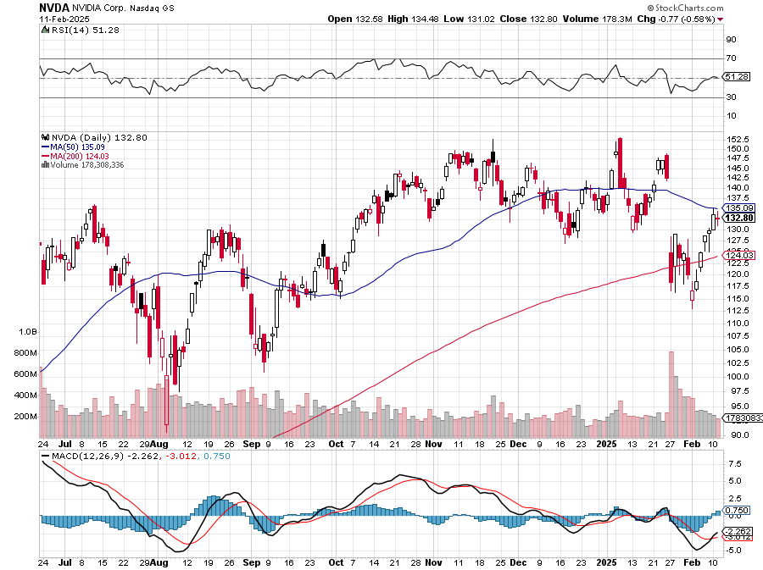
NVIDIA (NVDA) – Joins the Dow Average Club Nvidia Tanks Again, as the incoming government plans new China export restrictions on the company Long 2/$90-$95 call spread - expires in 7 trading days, took profits on Long 12/$117-$120 call spread took profits on long 8/70-$73 call spread took profits on long 8/137-$140 put spread,

Slide 26
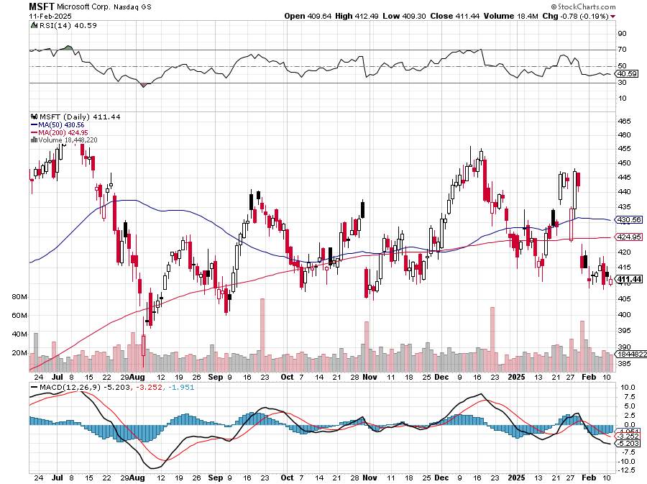
Microsoft (MSFT)-Microsoft Bombs, Microsoft Blows Up on Cloud Guidance took profits on long 5/$430-$440 put spread Took profits on long 2/$330-$340 call spread, took profits on long 12/$320-$330 call spread took profits on long 9/$235-$245 call spread, took profits on long 7/$220-$210 call spread, took profits on long 6/$220-$230 call spread, took profits on long 2/$200-$210 bear put spread

Slide 27
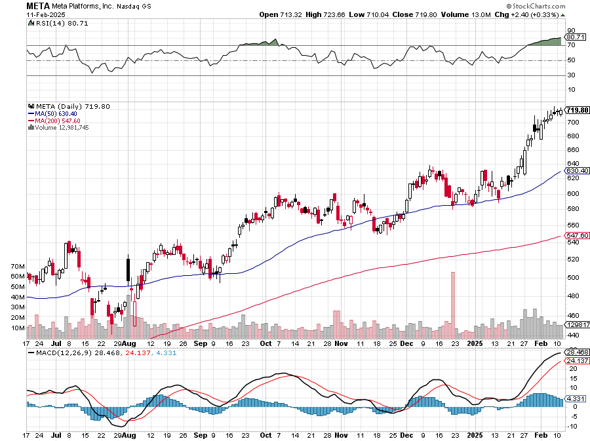
Meta (META) Meta Beats, on improving ad sales, a preeminent AI user took profits on Long 8/$420-$430 call spread took profits on Long 5/$360-$370 vertical bull call spread, took profits on Long 9/$290-$300 vertical bear put spread, stopped out of Long 9/$190-$200 vertical bear put spread

Slide 28
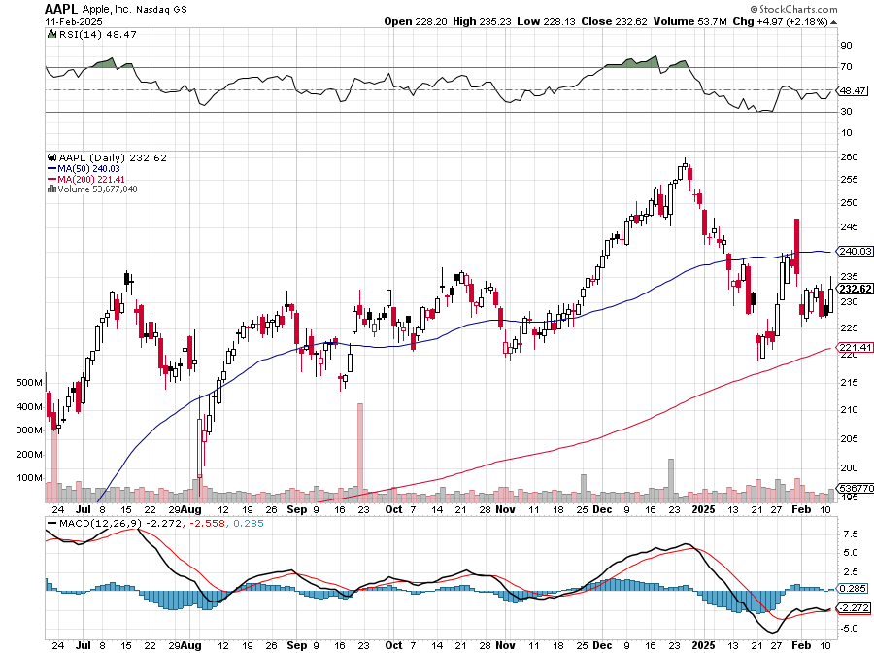
Apple (AAPL) China to Investigate Apple, over sales practices in stores took profits on Long 5/$225-$235 vertical bear put spread, took profits on Long 8/$160-$170 call spread took profits on Long 6/$200-$210 bear put spread, stopped out of Long 5/$185-$195 vertical bear put spread took profits on long 1/$145-$155 put spread, Took profits on long 10/$165-$175 put spread

Slide 29
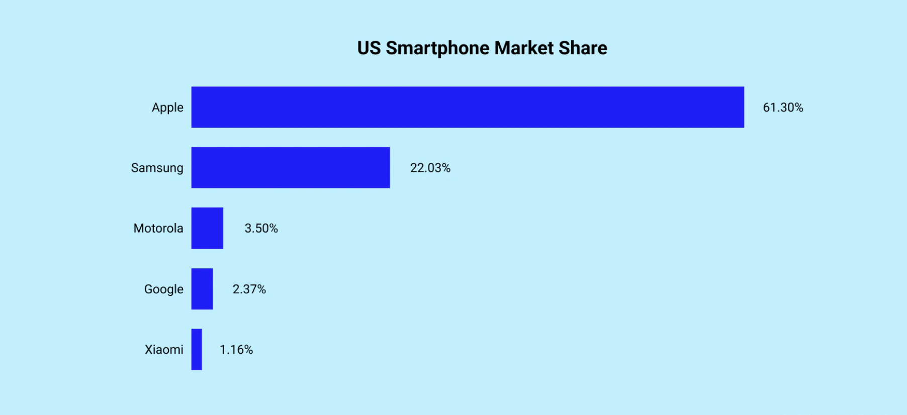

Slide 30
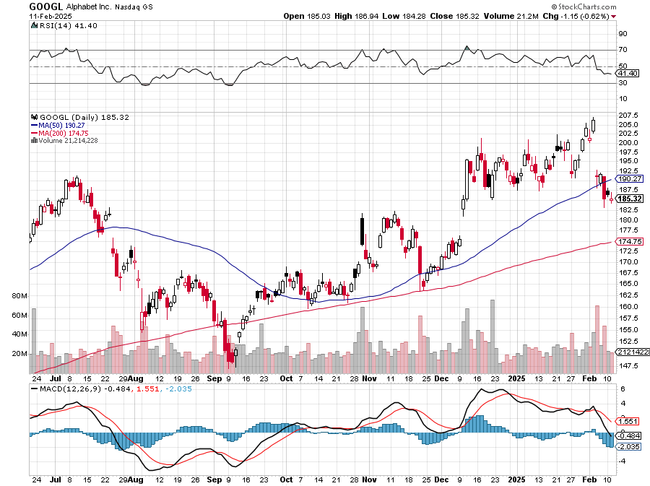
Alphabet (GOOGL) – Back in Play Alphabet Dives 9%, on guidance disappointment, Waymo Self Driving Taxis Expanding to Ten New Cities took profits on long 12/$110-$120 call spread took profits on long 12/$1,200-$1,230 bull call spread, took profits on long 9/$1,030-$1,080 vertical bull call spread

Slide 31
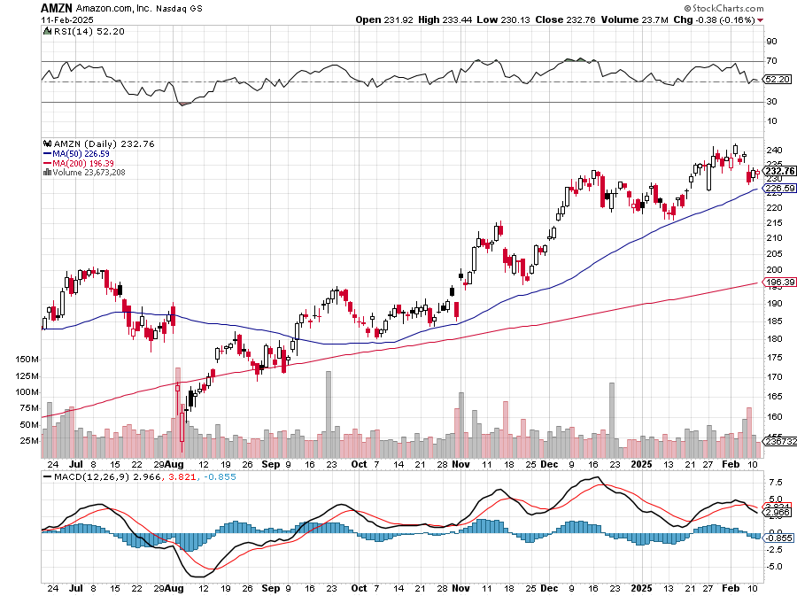
Amazon (AMZN) – Best Value AI Play Amazon is Getting Ready for Another Run took profits on long 3/$155-$160 bull call spread , took profits on long 2/$130-$135 bull call spread

Slide 32
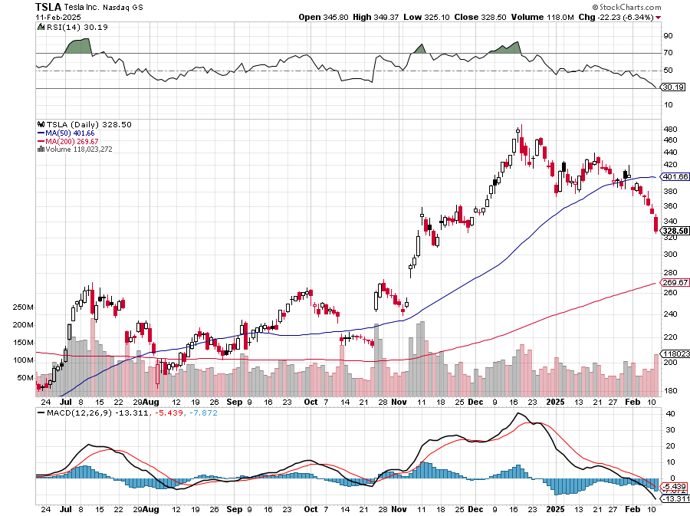
Tesla (TSLA) –Court Bars Elon Musk’s Monster Pay Package, Politics are Tanking Tesla Sales in Europe, Tesla China Sales Dive 11% YOY Tesla Bombs in 2024, with earnings at $25.5 billion last year versus $27.2 billion, or down 5.5%. long 2/$300-$310 call spread, long 2/$300-$310 call spread, 2/$540-$550 put spread 7 days to expiration took profits on long 1/$330-$340 call spread, took profited on long 12/$270-$275 call spread took profits on long 12/$250-$260 call spread, too profits long 12/$250-$260 call spread, took profits on long 11/$320-$330 put spread

Slide 33
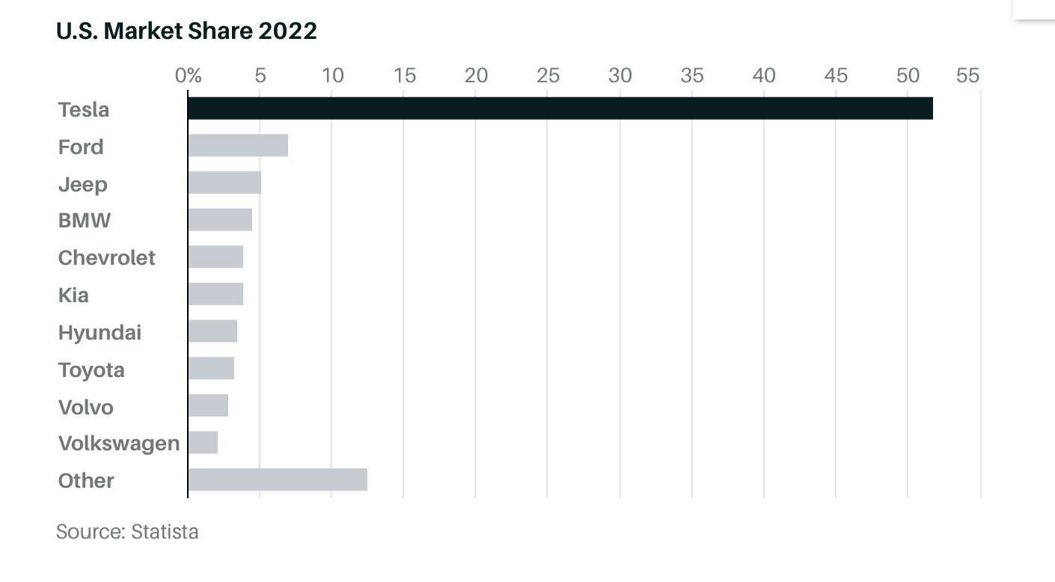

Slide 34
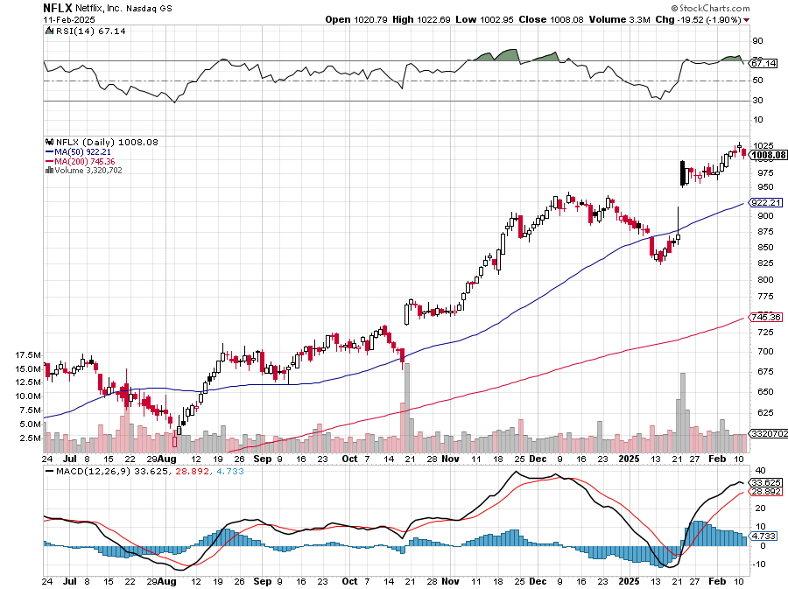
Netflix (NFLX) – Netflix Earnings Rocket, on the back of 19 million new subscriber

Slide 35
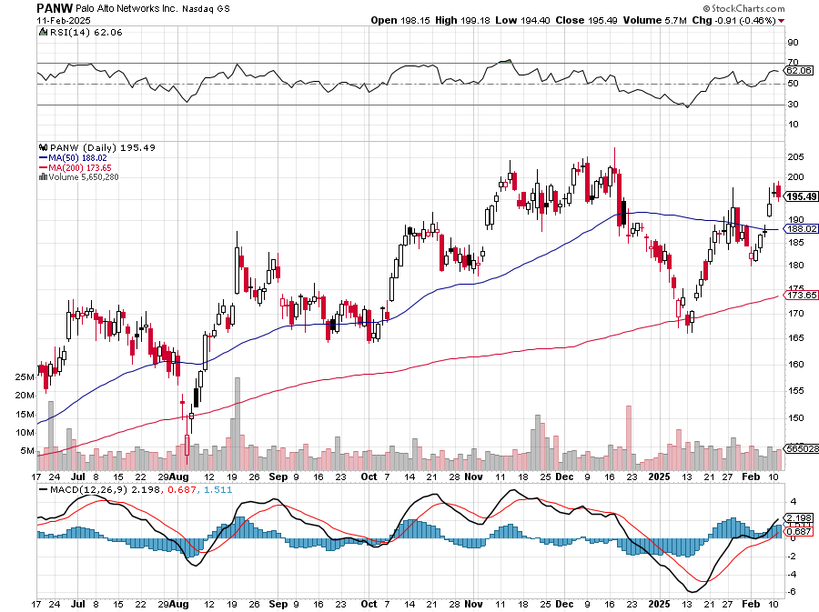
Palo Alto Networks (PANW)- Hacking never goes out of fashion Palo Alto Announced\s 2:1 Split took profits on long 2/$260-$270 call spread, took profits on long 10/$130-$140 call spread

Slide 36
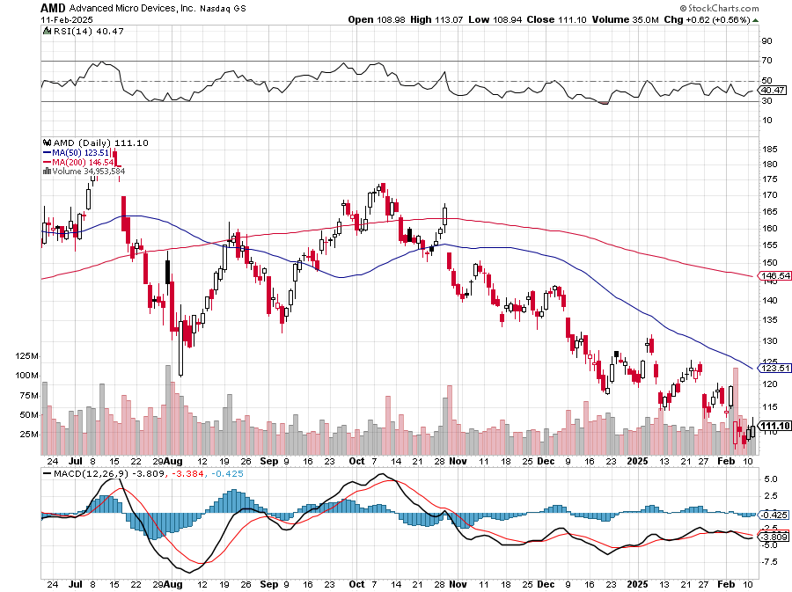
Advanced Micro Devices (AMD)- Recession fears programable logic devices took profits on long 2/$75-$80 call spread

Slide 37
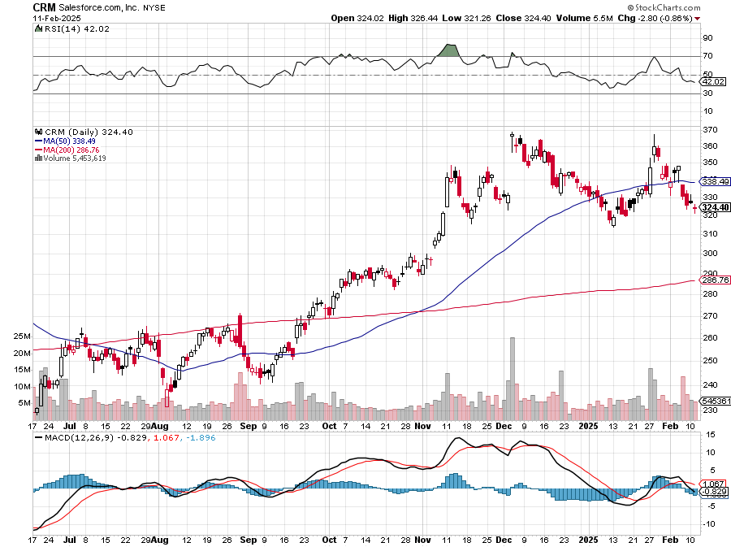
Salesforce (CRM)- Massive Online Migration Salesforce Soars 16%, on better-than-expected guidance took profits on long 12/$185-$195 call spread took profits on long 9/$125-$130 vertical bull call spread took profits on long 8/$125-$130 vertical bull call spread

Slide 38
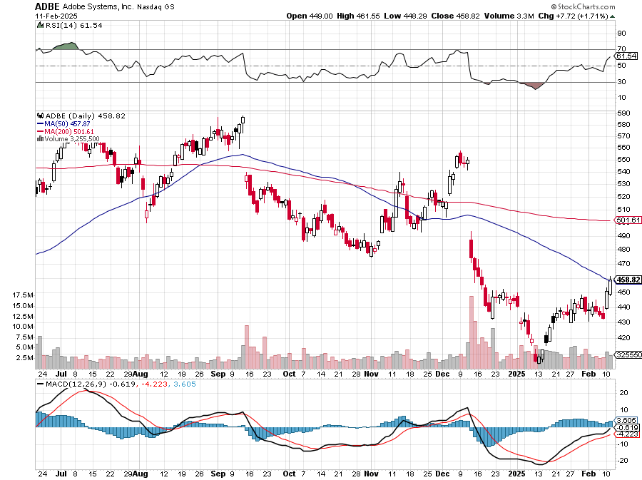
Adobe (ADBE)- Cloud play The Quality Non-China tech play

Slide 39
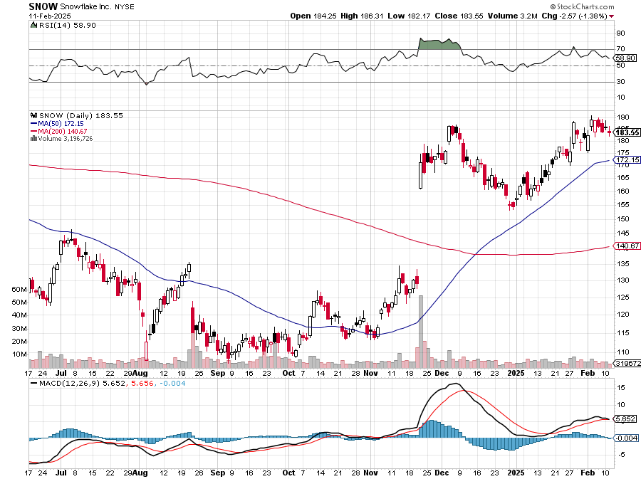
Snowflake (SNOW)- Blockbuster AI Earnings stopped out of long 4/$150-$255 call spread, took profits on long 12/$135-$140 call spread

Slide 40
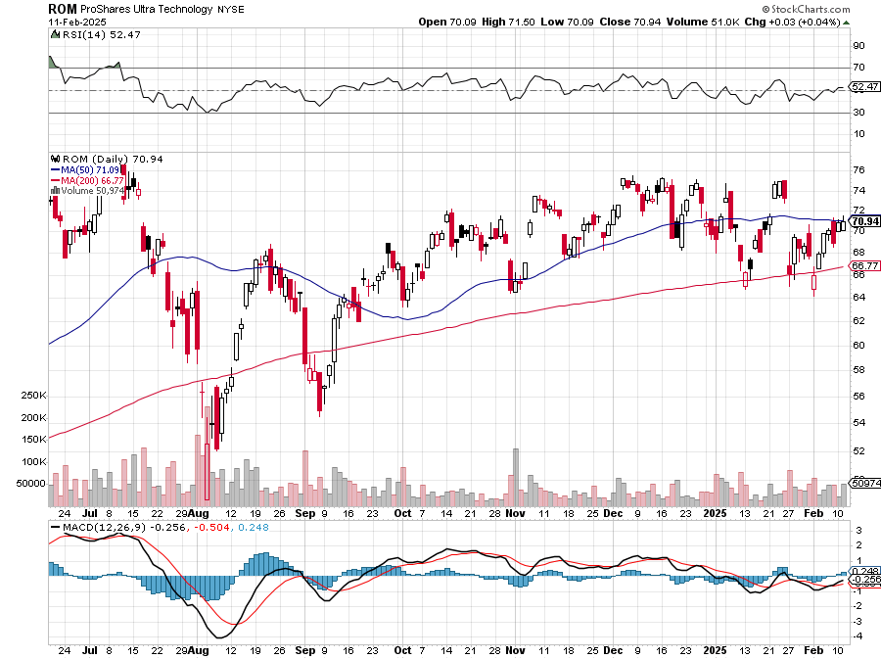
ProShares Ultra Technology ETF (ROM) – 2X Long Technology ETF took profits on long 10/$62-65 call spread

Slide 41
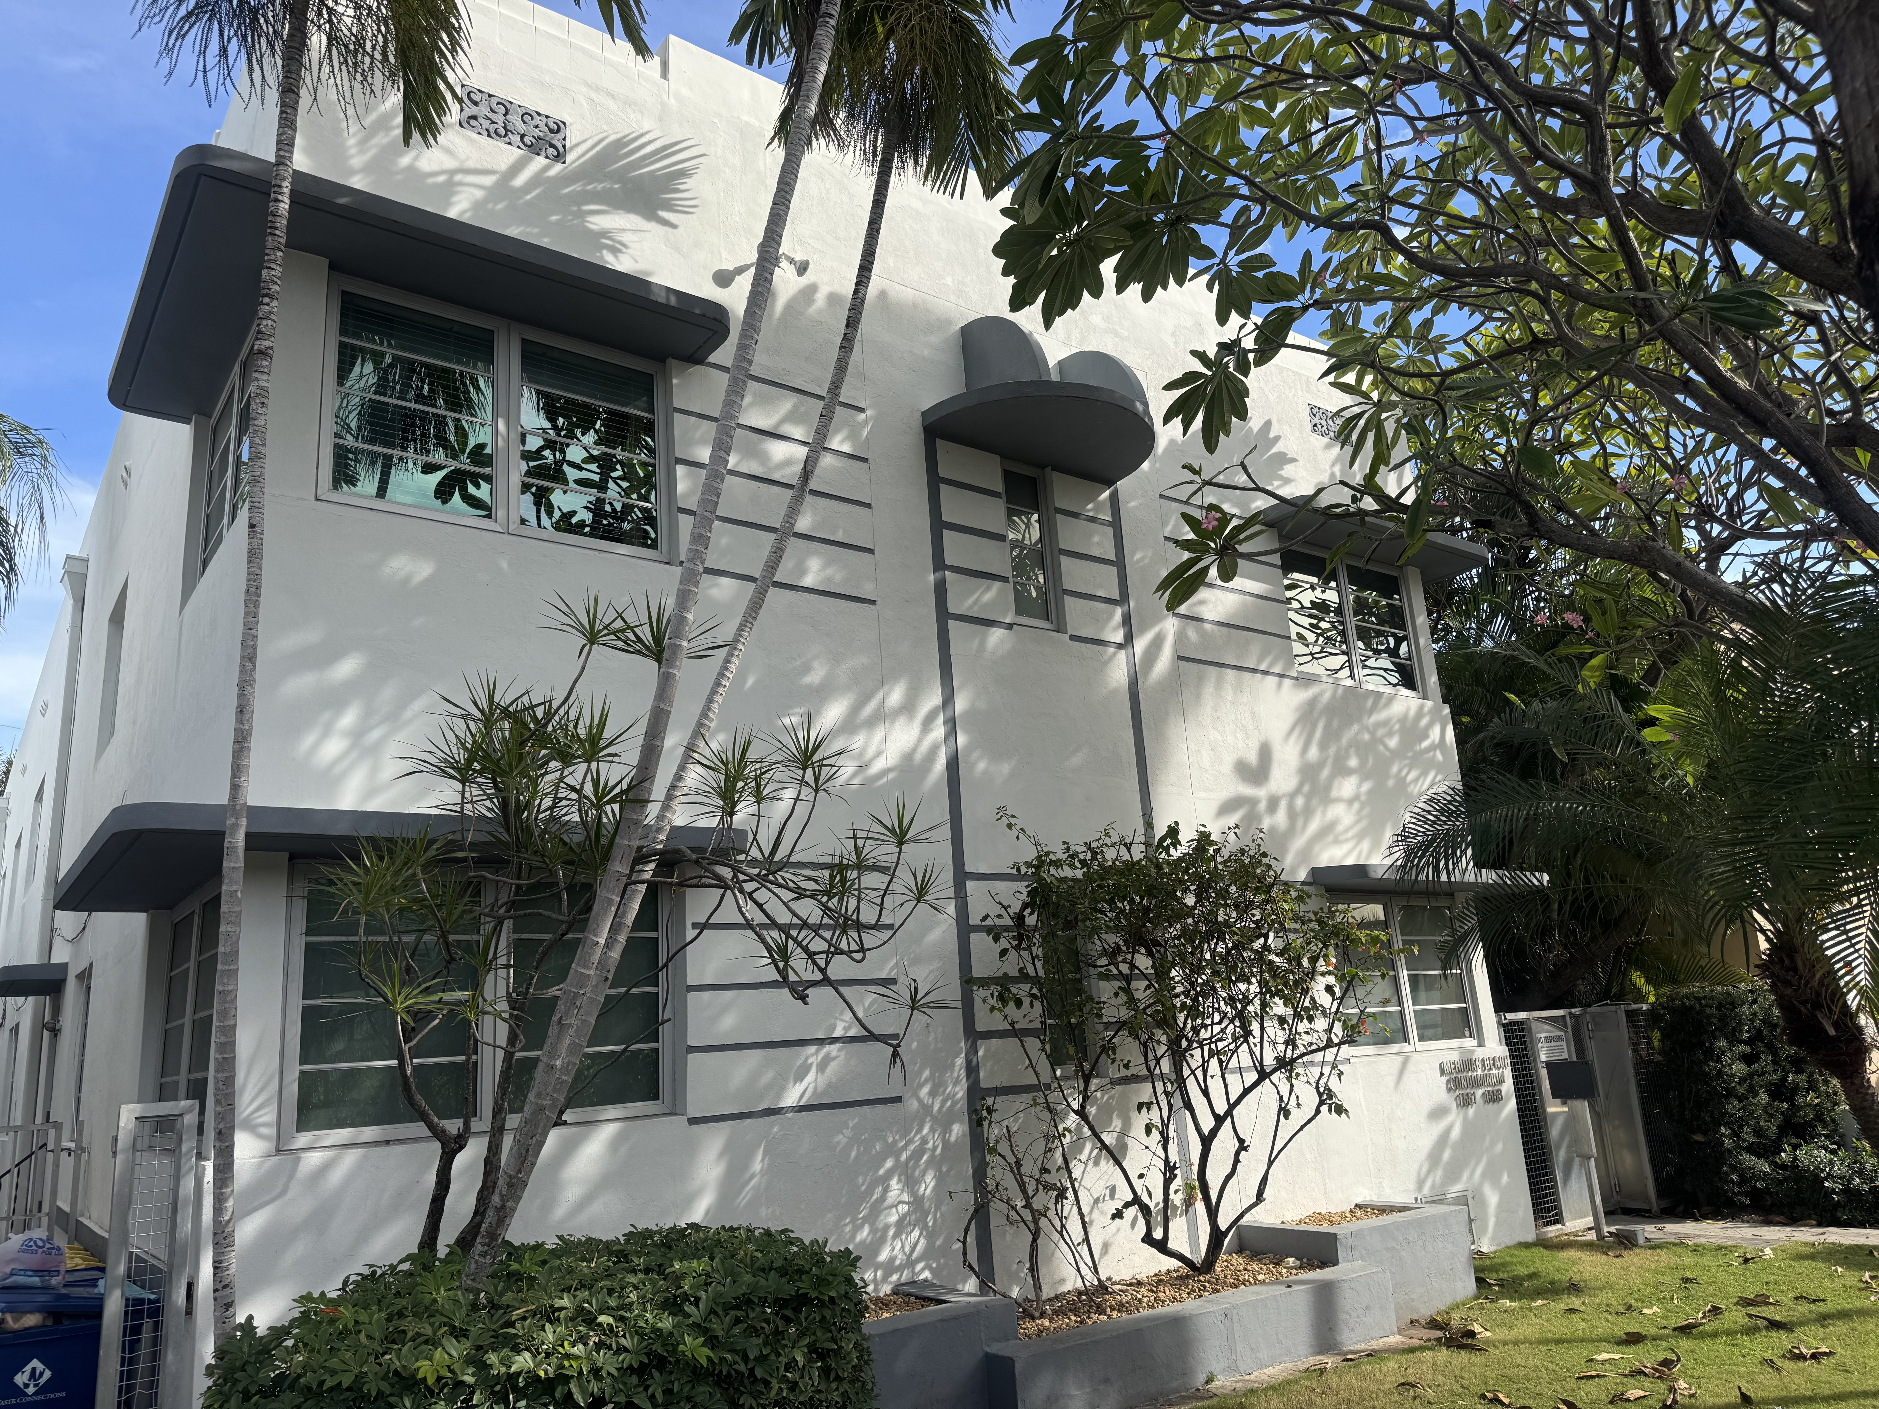

Slide 42
The Second Half of the Barbell
*Bets on a domestic recovery in 2022 Q4 *Upside potential in 2024 far greater than tech *Some of these have not moved for 5 or 10 years *Focuses on economically sensitive cyclical industries *Makes a great counterweight to high-growth technology *We could spend all of next ten years rotating between the two groups

Slide 43
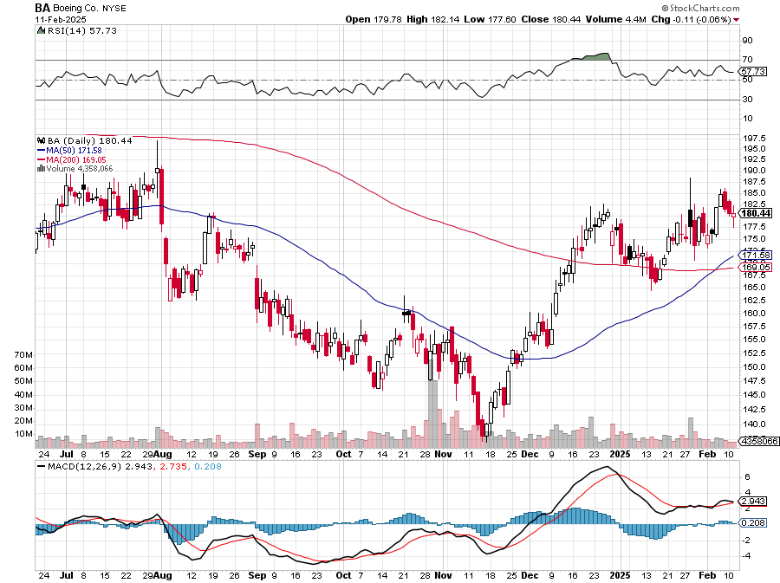
Boeing (BA) – Q3 $6 Billion Loss –b Strike Continues “il pesce marcisce dalla testa” stopped out of long 2/$190-$200 call spread, took profits on long 5/$17-$175 call spread

Slide 44
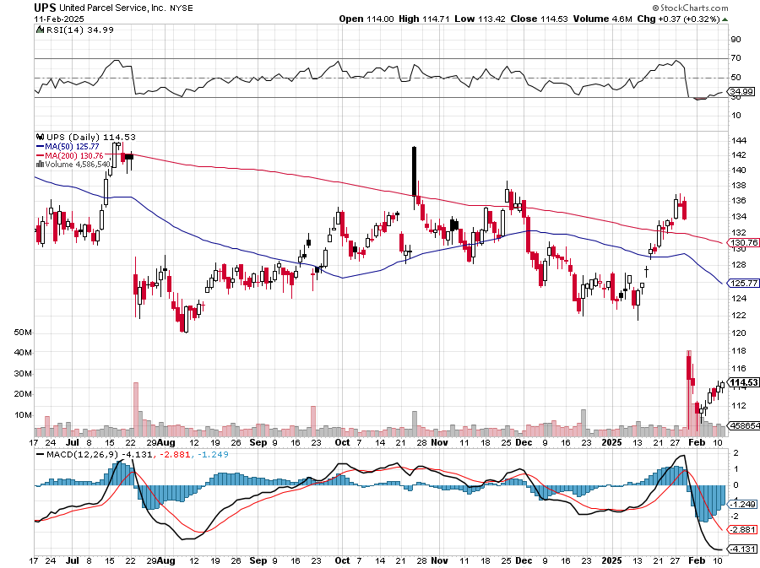
Package Delivery- United Parcel Service (UPS) – strike averted took profits on long 11/$130-$140 call spread

Slide 45
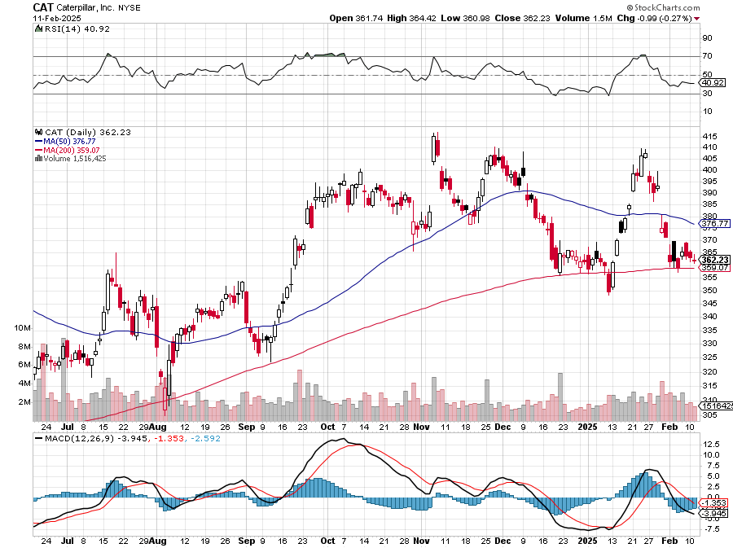
Caterpillar (CAT)- Ag + Infrastructure + Housing stopped out of long 8/$310-$320 call spread, took profits on long 12/$220-$230 calls spread took profits on long 12/$145-$150 call spread, took profits on long 11/$125-$135 call spread

Slide 46
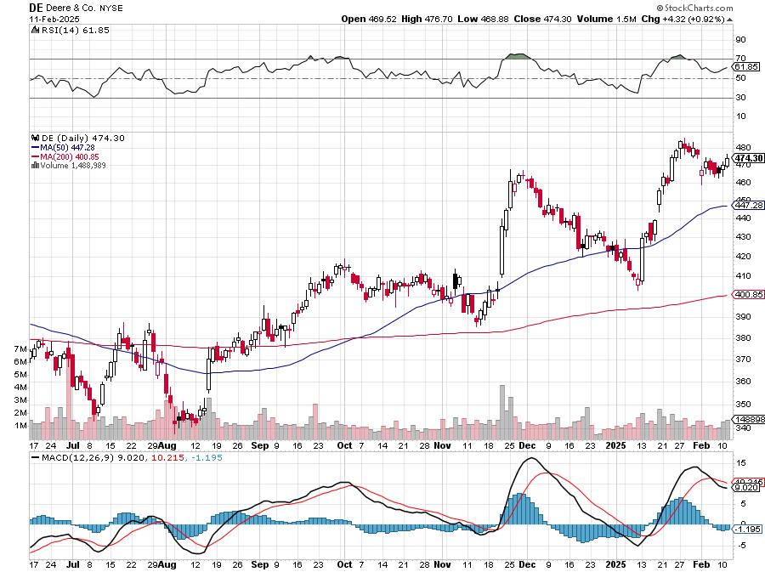
Deere & Co. (DE)- Ag + Infrastructure + Housing took profits on long 8/$330-$340 put spread stopped out of long 8/$330-$340 calls spread

Slide 47
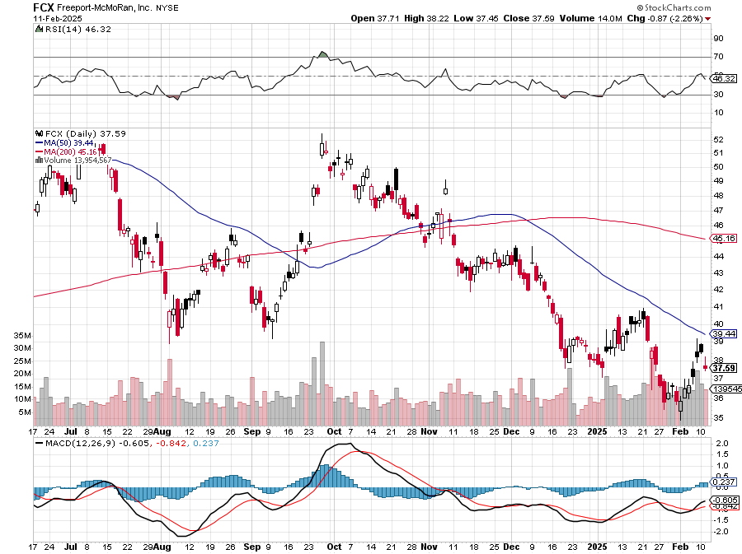
Freeport McMoRan - (FCX)- Coming Copper Crisis Freeport McMoRan Beats, helped by higher production and easing costs took profits on long 4/$37-$40 call spread, took profits on long 5/$42-$45 call spread, stopped out of long $48-$51 put spread, profits on long 6/$32-$35 call spread took profits on long 4/$30-$33 call spread, took profits on long 10/$20-$23 call spread

Slide 48
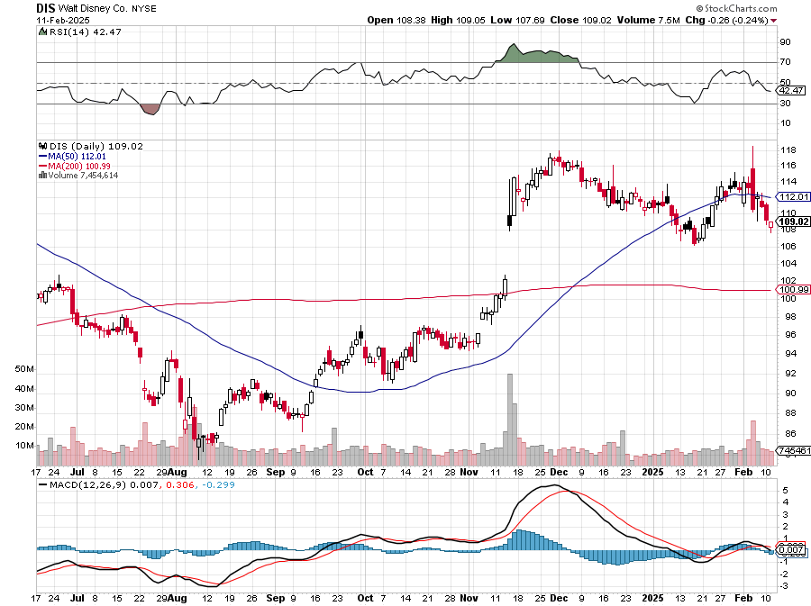
Walt Disney (DIS) -Disney Beats Disney Dives on Earnings Bust, although streaming broke even versus an expected loss

Slide 49
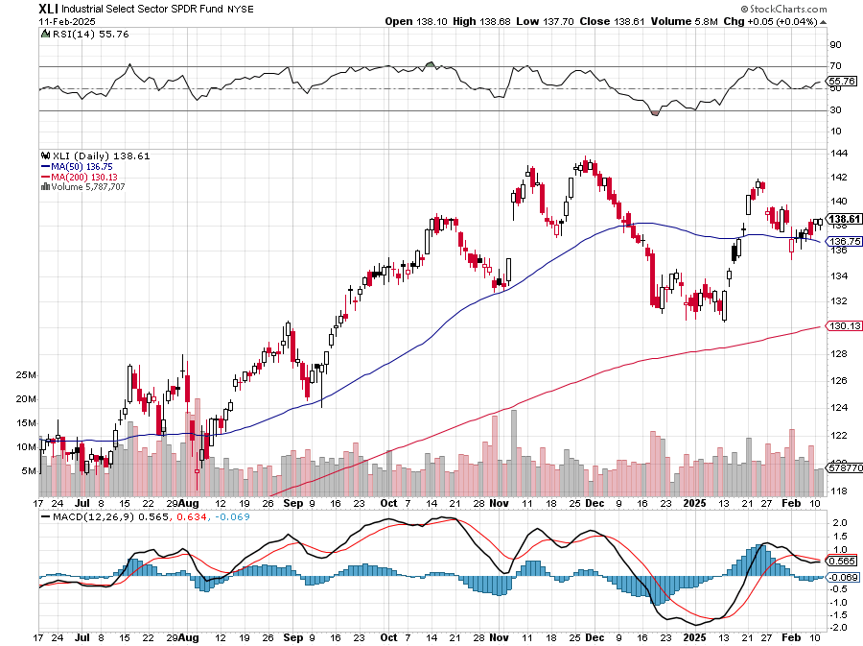
Industrials Sector SPDR (XLI)- (GE), (MMM), (UNP), (UTX), (BA), (HON)

Slide 50
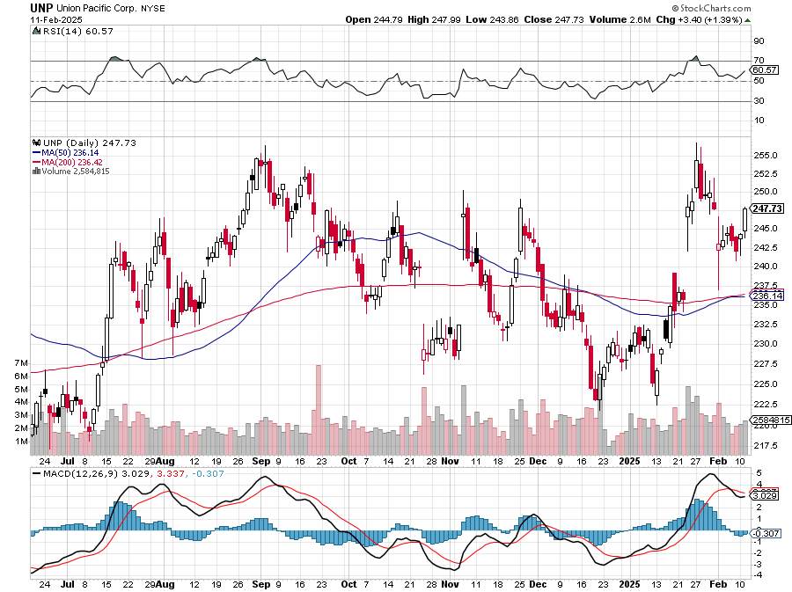
Union Pacific RR (UNP)- Big Stuff to Ship took profits on long 5/$200-$210 call spread took profits on 11/$150-$160 call spread

Slide 51
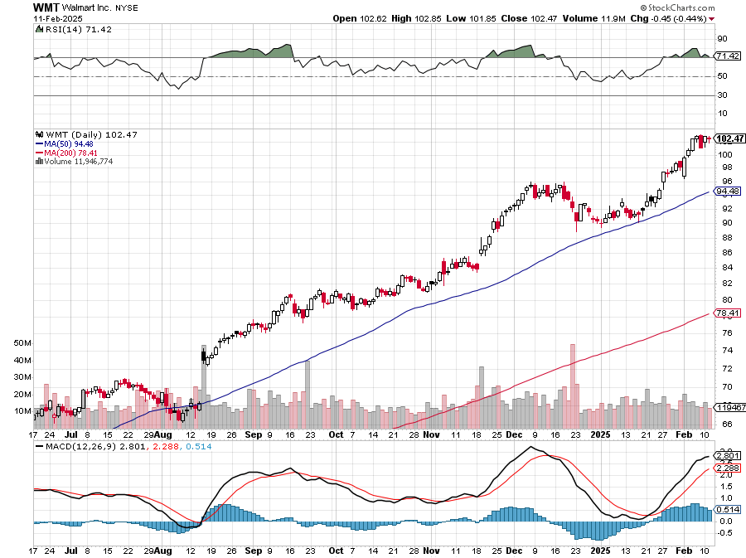
Wal-Mart (WMT)- took profit on Long 11/$125-$130 bear put spread took profit on Long 10/$119-$121 bear put spread took profits on Long 8/$114-$117 bear put spread

Slide 52
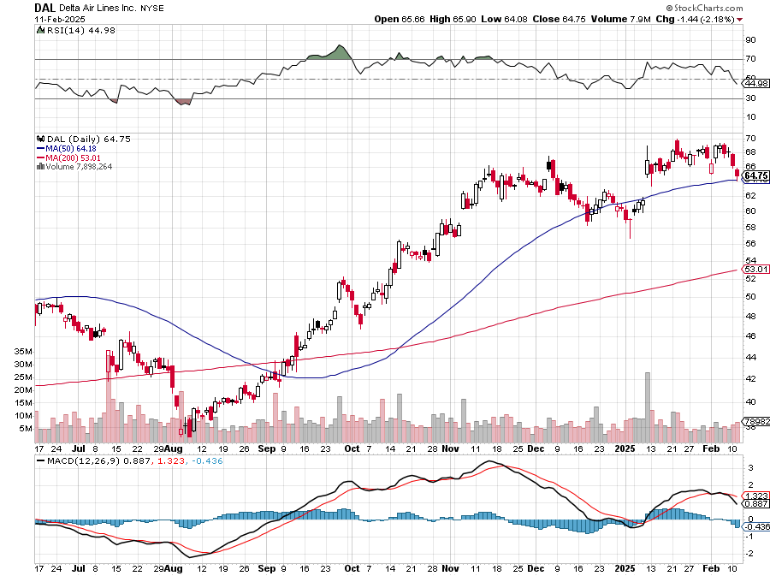
Delta Airlines (DAL) – Travel is Back! The Non-Boeing Airline – uses Airbuses stopped out of long 2/$35-$38 call spread

Slide 53
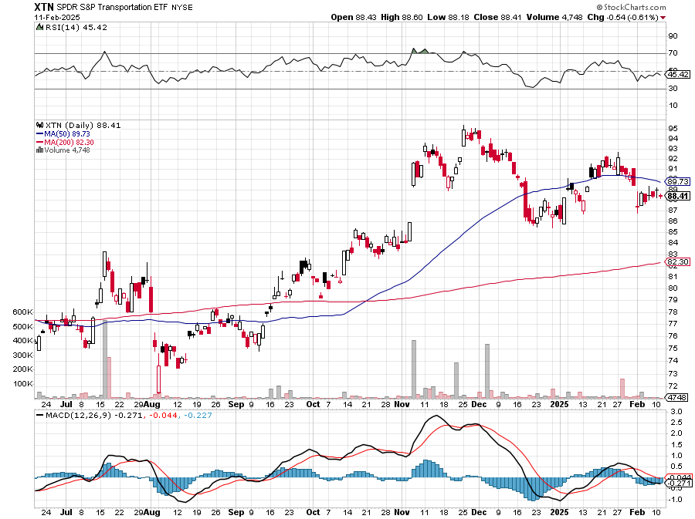
Transports Sector SPDR (XTN)- Worst Hit Sector (ALGT), (ALK), (JBLU), (LUV), (CHRW), (DAL)

Slide 54
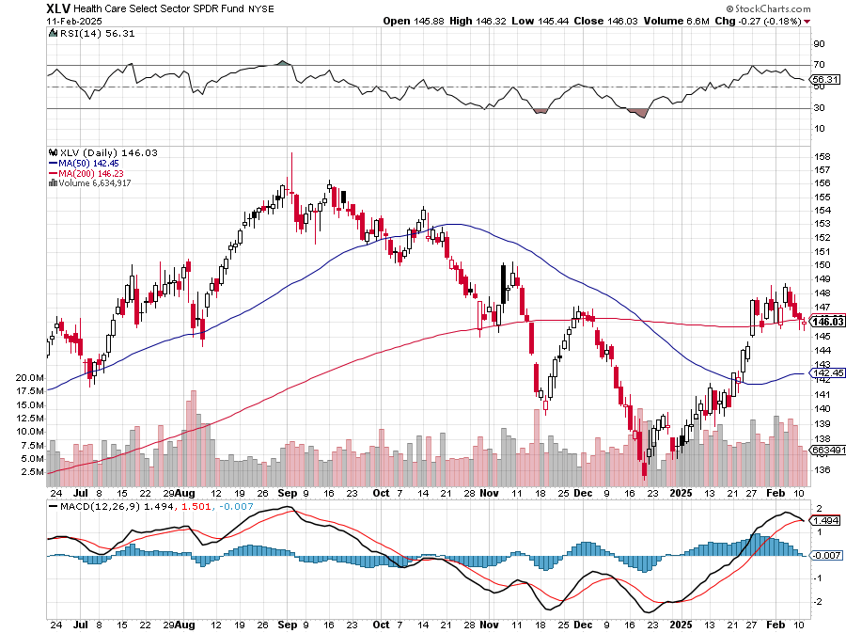
Health Care Sector (XLV) (JNJ), (PFE), (MRK), (GILD), (ACT), (AMGN)

Slide 55
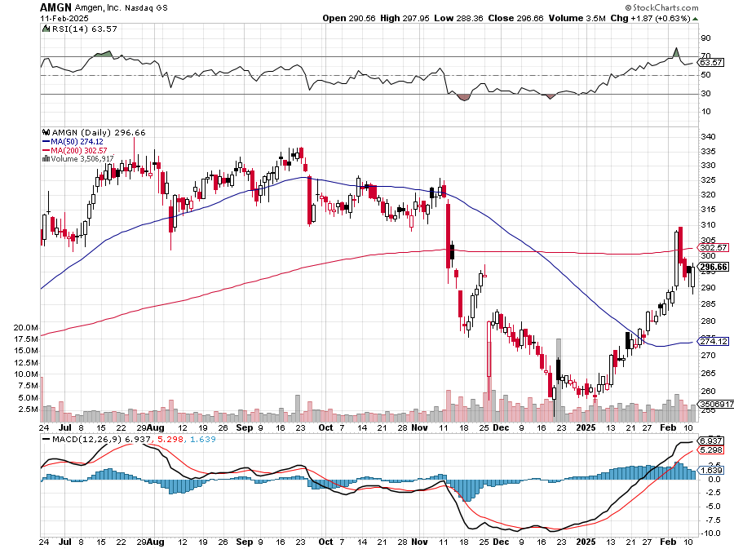
Amgen (AMGN) took profits on long 11/$185-$200 bull call spread

Slide 56
Goldman Sachs (GS) – Goldman Sachs Beats, with Revenues of $12.73 billion vs. $12.46 billion estimate took profits on long 12/$330-$350 call spread, took profits on long 11/$330-$350 call spread stop loss on long 11/$385-$395 call spreads

Slide 57
Morgan Stanley (MS) Morgan Stanley Doubles Profits took profits on long $12/210-$220 call spread, Took profits on long $195-$205 call spread, took profits on long 4/$65-$70 call spread

Slide 58
JP Morgan Chase (JPM) – JP Morgan Delivers Blowout Earnings, JP Morgan to Step Up Share Buybacks took profits on long 12/$210-$220 call spread, took profits on long 11/$195-$205 call spread took profits on 4/$215-225 put spread, took profits on 4/$190-$195 call spread , took profits on long 4/$105-$115 call spread

Slide 59
Bank of America (BAC) – Deregulation play took profits on long long 12/$41-$44 call spread, took profits on long 4/$20-$23 call spread

Slide 60
Citigroup (C) – took profits on long long 12/$60-$65 call spread , took profits on long 4/$30-$35 call spread

Slide 61
Charles Schwab (SCHW) – LEAPS expire at Max profit took profits on long 4/$30-$35 call spread

Slide 62
Interactive Brokers (IBKR) – LEAPS expired at Max Profit stopped out of long 8/$110-$115 call spread , took profits on long 4/$60-$65 call spread

Slide 63
SPDR Metals & Mining ETF (XME) – long 2/$28-$30 call spread

Slide 64
Blackrock (BLK)-Asset Collection Boom took profits on long 12/$850-$860 call spread took profits on long 3/$770-$790 call spread, took profits on long 3/$310-$340 call spread

Slide 65
Visa (V) – Inflation boost Justice Hits Visa (V) with Antitrust Suit, with a 47% market share took profits on long 2/$240-$250 bull call spread took profits on long 10/$160-$170 bull call spread, took profits on long 6/$150-$160 bull call spread

Slide 66
Consumer Discretionary SPDR (XLY) (DIS), (AMZN), (HD), (CMCSA), (MCD), (SBUX)

Slide 67
Berkshire Hathaway (BRKB)- Natural Barbell Buffet Sells More Apple, taking Berkshire Hathaway cash up to a record $325 billion stopped out of long 12/$405-$415 call spread, took profits on long 12/$320-$330 call spread took profits on long 4/$260-$270 call spread, took profits on long 1/$290-$300 call spread

Slide 69
Bonds – Rallying
*Foreign Investors Continue to Soak Up US Debt, seeking higher interest rates in an appreciating currency *Americans own 55% of the outstanding $36 trillion in US debt, while foreign investors own 24%, and the Federal Reserve 13%. *Market is Giving Up on any Interest Rate Cuts this Year, as the prospects of rising inflation from trade wars weigh on the market *All fixed income plays have gone dead *“Higher Rates for longer” don’t fit in here anywhere. But there may be a BUY setting up for
(TLT) at 5.0%, or $82

Slide 71
Treasury ETF (TLT) – stopped out of long 1/$82-$85 call spread, took profits on long 10/$103-$106 put spread took profits on long 6/$$94-$97 put spread, took profits on long 5/$82-$85 calls spread took profits on long 4/$87-$90 call spread took profits on long 2/$90-$93 call spread,

Slide 72
Ten Year Treasury Yield ($TNX) – 4.50%

Slide 73
Junk Bonds (JNK) 6.43% Yield

Slide 74
Municipal Bonds (MUB) 2.87% Yield-

Slide 75
Emerging Market Debt (ELD) 5.14% Yield-

Slide 76
2X Short Treasuries (TBT)-Out of Favor

Slide 77
Anally Capital Management (NLY) – Leveraged REIT Play Yield 13.25% took profits on long 12/$15-$16 call spread

Slide 78
Acelryn (SLRN) – Double B Bond Fund took profits on long 12/$15-$16 call spread

Slide 80
Foreign Currencies – Trade War Boost
*Trade Wars are Pushing Up the US Dollar, making American exports more expensive *High import duties will shrink US imports dramatically and impoverish our foreign customers, creating dollar strength. *Ten-year US Treasuries have risen from 4.40%% to 4.50% *The mere fact that rates have stalled ha allowed currencies to rally *Higher for longer interest rates mean higher for longer US dollar *Avoid (FXA), (FXE), (FXB), (FXC), and (FXY)

Slide 81
THE MAD HEDGE FUND TRADER
Australian Dollar (FXA) - Major Long-Term Bottom is In Targeting Parity – A call option on a global synchronized recovery

Slide 82
Japanese Yen (FXY)

Slide 83
Euro (FXE)-

Slide 84
British Pound (FXB)-

Slide 85
Emerging Market Currencies (CEW)

Slide 87
Energy & Commodities –
*US global economic disruption tank oil prices *Oil & Gas Dealmaking Hit $105 billion in 2024 *It’s the third highest annual total ever, but activity slowed in the second half as buyers found fewer targets to acquire *Government to Stop Minting new Pennies. With copper at current prices, its costs two cents to mint one penny *Nuclear plays like (VST) and (CCJ) rebound sharply *The EIA said it expects Brent crude oil prices to fall 8% to average $74 a barrel in 2025, then fall further to $66 a barrel in 2026.

Slide 88
Oil-($WTIC)

Slide 89
United States Oil Fund (USO)

Slide 90
Energy Select Sector SPDR (XLE)-No Performance! (XOM), (CVX), (SLB), (KMI), (EOG), (COP)

Slide 91
ExxonMobile (XOM)- Exxon Moves Big into Lithium, with the construction of a major mining operation in Arkansas took profits on Long 4/$100-$105 call spread, took profits on long 12/$120-$125 put spread

Slide 92
Occidental Petroleum (OXY)- Buffet’s a Buyer took profits on long 4/$59-$62 call spread took profits on long 2/$55-$60 call spread, took profits on long 12/$77.50-$82.50 put spread

Slide 93
Natural Gas (UNG) – Free Fall on Warm Winter took profits on Long January 2025 $7-8 Call Spread LEAPS

Slide 94
Cameco (CCJ) – Global Uranium Renaissance Microsoft to Reopen Three Mile Island to power AI data centers took profits on long 12/$41-$44 call spread, took profits on long 12/$35-$38 call spread, took profits on long 5/$20-$23 bull call spread

Slide 95
Vistra Corp. (VST) – Global Uranium Renaissance long 2/$100-$110 call spread - 7 days to expiration

Slide 97
Precious Metals – Bid Again
*Government May Revalue Gold Holdings, from the current 1932 price of $42 an ounce to $2,936 *It is just a bookkeeping move, but it has put the yellow metal back in the spotlight *As of January 2025, the United States government owned 8,133.46 tons of gold worth $39.9 billion at current market prices. This makes the US the country with the largest gold reserves in the world. *40 basis point drop in 10-year rates has given a boost *Gold has become the only way the average Chinese can save as they can no longer speculate in real estate or copper and don’t trust the Chinese Yuan, so there is support lower down *Central banks in emerging market countries are continuing to buy gold, with 693 metric tonnes of buying, or $5.3 billion this year Buy (GLD), (SLV), (AGQ), and (WPM) on dips

Slide 98
Gold (GLD) – China and Falling Rate took profits on Long 10/$230-$235 call spread took profits on Long 10/$220-$225 call spread, took profits on Long 8/$210-215 call spread, took profits on Long 7/$200-205 call spread, Long 6/$207.5-$212.5 call spread took profits on Long 4/$194-$197 call spread, took profits on long 5/$165-$170 bull call spread

Slide 99
Market Vectors Gold Miners ETF- (GDX) – took profit on long 6/$207.50-$212.50 call spread, took profit on long 7/$200-$205 call spread

Slide 100
Barrick Gold (GOLD) took profit on long 1/$15.50-$16.50 call spread

Slide 101
Newmont Mining- (NEM)- Sometimes you Just Get Lucky took profits on long 10/$47-$50 call spread, took profits on long $55-60 call spread

Slide 102
Silver- (SLV)- stopped out of long 6/$23-$25 call spread, took profits on long 11/$19-$20 call spread

Slide 103
Silver Miners - (SIL)-

Slide 104
Wheaton Precious Metals - (WPM)- LEAPS Approaching Max Profit took profits on long 4/$39-$42 call spread , took profits on long 1/$36-$39 call spread

Slide 105
Platinum- (PPLT)- 556,000-ounce shortage this year took profits on long 1/$36-$39 call spread

Slide 107
Real Estate – Stay Away
*Homebuyer Mortgage Demand is Collapsing, with the 30-year fixed at a buzzkill 7.0% *Demand is 39% lower YOY, with housing demand at a 30-year low *Homes are sitting on the market much longer. Avoid all real estate plays *US Home Sales Hit 30-Year Low, in 2024, the second year in a row of weak sales *High costs related to homeownership sapped sales again *The average rate for a 30-year fixed mortgage has hovered between 6% and 8% since late 2022 *Avoid real estate plays.

Slide 108
S&P Case Shiller Slows S&P Case Shiller Rises to +4.2% YOY in September, with its National Home Price Index New York gained +7.5%, Chicago +6.2%, and Las Vegas+5.9%.

Slide 109
Crown Castle International (CCI) – 6.62% yielding 5G cell phone tower REIT Eliot Management Pushes up stock with activist bid Long 8/$90-$95 call spread,

Slide 110
US Home Construction Index (ITB) (DHI), (LEN), (PHM), (TOL), (NVR)

Slide 111
DH Horton (DHI) Horton Bombs, with the stock dropping some 11% in Tuesday morning trading after the U.S.'s largest homebuilder issued its fiscal 2025 guidance took profits on long 11/$165-$175

Slide 112
Trade Sheet- So What Do We Do About All This?
*Stocks – buy the next big dip, sell rallies *Bonds – sell rallies *Commodities- stand aside *Currencies-stand aside *Precious Metals – buy dips *Energy – buy nuclear dips *Volatility – sell over $30 *Real estate – stand aside

Slide 113
Next Strategy Webinar 12:00 EST Wednesday, February 26 2025 from Incline Village, NV email me questions at support@madhedgefundtrader.com
Good Luck and Good Trading!
Notes:
*

